Slide 1
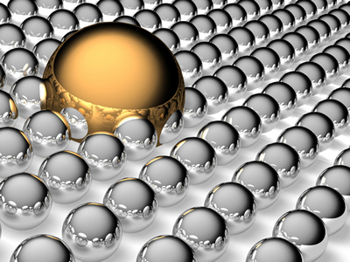
Introduction to surface chemistry: From: Asha KV Nangalbhur
It is that branch of chemistry which deals with the study of phenomena occurring at the surface.

Slide 2
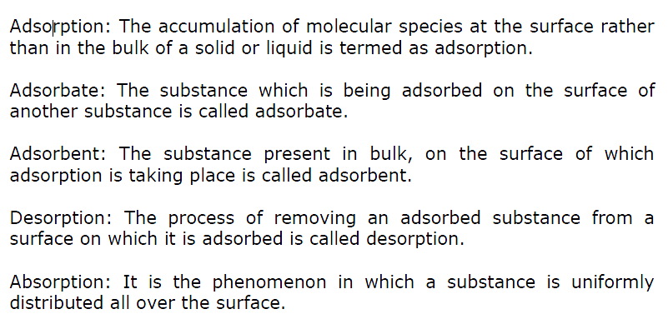
Introduction to surface chemistry

Slide 3
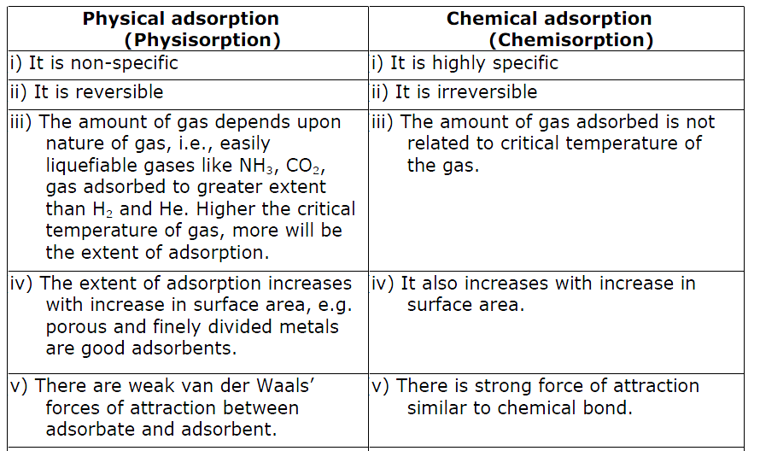

Slide 4
Factors affecting adsorption of gases on solids
Nature of adsorbate
Nature of adsorbent
Specific area of adsorbent
Pressure of the gas

Slide 5
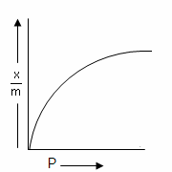
Freundlich Adsorption isotherm
The relationship between x/m and pressure of the gas at constant temperature is called adsorption isotherm and is given by

Slide 6
Some important terms
Catalyst
Promoters
Catalytic poisons (Inhibitors)
Types of catalysis
Homogenous catalysis
Hetrogenous catalysis

Slide 7
Activity of catalyst
Selectivity of catalyst
Shape–selective catalysis : eg. Zeolites

Slide 8
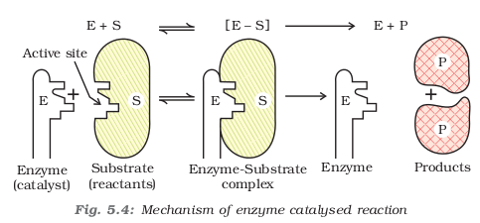
Enzymes

Slide 9
Distinction between true solution, colloids and Suspension

Slide 10
Classifications of colloids
On the basis of interaction between dispersed phase and dispersed medium
Lyophobic sols
Lyophilic sols
Classification of colloids on the basis of types of particles of the dispersed phase
Multimolecular colloids
Macromolecular colloids
Associated colloids (Micelles)

Slide 11
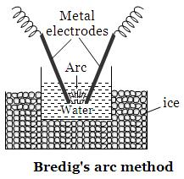
Methods of preparation of colloids
Chemical methods
Electrical disintegration or Bredig’s Arc method
Peptization

Slide 12
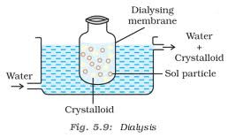
Purification of colloids
Dialysis
Electro dialysis
Ultrafiltration

Slide 13
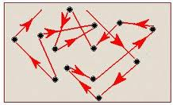
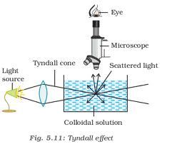
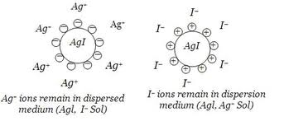
Properties of colloids
Colour
Brownian movement
c. Tyndall effect
Charge on colloidal
particles

Slide 14
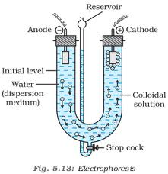
Properties of colloids
Electrophoresis
f. Coagulation or precipitation

Slide 15
Hardy–Schulze rules
Oppositely charged ions are effective for
coagulation.
ii) The coagulating power of electrolyte
increases with increase in charge on the ions
used for coagulation, e.g. Al₃⁺ > Ba₂⁺ > Na⁺
for negatively charged colloids.
[Fe (CN)₆]⁴⁻ > PO₄³⁻ > SO₄ ²⁻ > Cl⁻ for positively
charged colloids.

Slide 16
Emulsions
An emulsion is a mixture of two or more liquids that are normally immiscible.
Types of emulsions
Water dispersed in oil
Oil dispersed in water

Slide 17
The end

