Slide 1
CHEMISTRY IN EVERY DAY LIFE
ENZYME ANT ITS MECHANISM
ATTACHMENT OF DRUG WITH AN ENZYME
SOAP, SAPONIFICATION & its CLEANING ACTION
DETERGENTS

Slide 2
MECHANISM OF ENZYME CATALYSIS
1. FORMATION OF ACTIVATED COMPLEX
2. DECOMPOSITION OF ACTIVATED COMPLEX

Slide 3
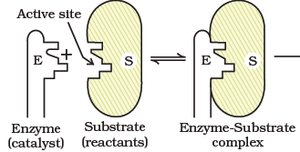
AMIL FISCHER’S KEY LOCK MECHANISM

Slide 4
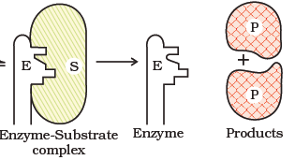
FORMATION OF PRODUCT

Slide 5
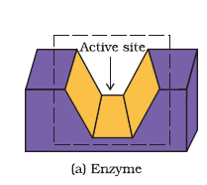

Slide 6
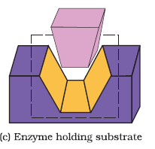
HOLDING OF A SUBRATE ON ACTIVE SITE OF THE ENZYME

Slide 7
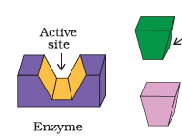
DRUG & SUBSTRATE COMPETING FOR THE ACTIVE SITE

Slide 8
ATTACHMENT OF DRUG WITH AN ENZYME
1. AS COMPETITIVE INHIBITOR
2. AS ALLOSTERIC INHIBITOR

Slide 9
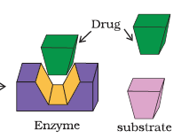
DRUG BLOCKS THE ACTIVE SITE OF ENZYME

Slide 10
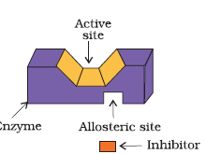
ATTACHMETN OF DRUG ON ALLOSTRIC SITE

Slide 11
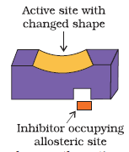
THE SHAPE OF ACTIVE IS CHANGED

Slide 12
SAPONIFICATION- FOMATION OF SOAP

Slide 13
STRUCTURE OF SOAP
Sodium salt of fatty acid R-COONa
R= C17H35
SODIUM STEREATE

Slide 14
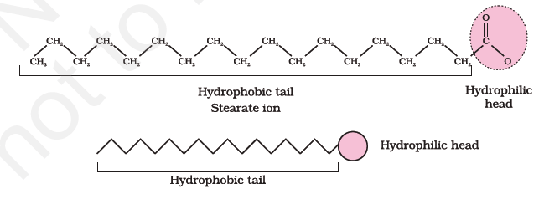
TWO PARTS OF THE SOAP

Slide 15
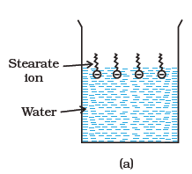
BEHAVE OF SOAP WITH WATER

Slide 16
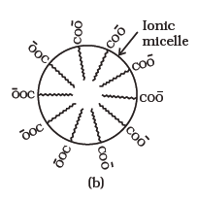
BEHAVE OF SOAP WITH OIL

Slide 17
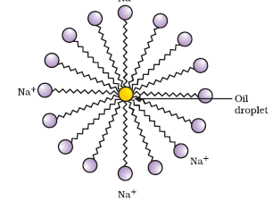
FORMATION OF MICELLE

Slide 18
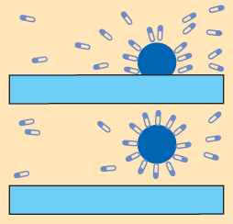
CLEANING ACTION OF SOAP

Slide 20
SYNTHETIC DETERGENTS

Slide 21
TYPES OF DETERGENTA
1. ANIONIC DETERGENT- The log chain of hydrocarbon which form lather, is connected with negative part

Slide 22
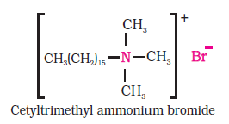
2.CATIONIC DETERGENT
The log chain of hydrocarbon which form lather, is connected with POSITIVE part

Slide 23
3. NON IONIC DETERGENT
Do not contain any ion in their constituents.
poly ethylene glycol stearate detergent .Liquid dish washing detergent

Slide 24
DISTINGUISH BT. SOAP & DETERGENTS CHHAT छत
 | DETERGENT | SOAP
IN COLD WATER | √ | X
IN HOT WATER | √ | X
HARMFULL | √ | X
ACTIVE | √ | X
TYPES | +/-/NI | X
CHHAT

Slide 25
TYPES OF DRUGS
07 Anti (माफ़ है)
SAT Anti(MAF H)
1,2,3 4,5,6,7

Slide 26
DRUGS
1. STERILISATION a. Antiseptic b. Disinfectant
2. ANALGESIC (PAIN KILLER)
a. norcotic b. non norcotic
3. TRANQUILIZER (TENSION)
a. hypnotic b. non hypnotic
4. Anti microbial (anti biotics)
5. Ant acids

Slide 27
6. anti fertility
7. anti histamine

