Slide 1
Condensation POLYMERS
Mrs.Neelima Pathak
PGT-chemistry
Kendriya Vidyalaya
Vayusenanagar ,Nagpur.

Slide 2
Polymer:-
The word polymer has a Greek origin. which means many units (parts).
Polymerisation:-
The process by which the monomers get combined and transformed into polymers is known as polymerisation.
n [Monomer] → Polymer

Slide 3
Condensation polymers :-
The polymers which are formed by the combination of monomers with the elimination of small molecules such as water, alcohol, hydrogen chloride etc.., are known as condensation polymers,
e.g., nylon 6,6 is formed by the condensation of hexamethylene diamine with adipic acid.

Slide 4
Distinction Between Chain Growth Polymerisation and Step Growth Polymerisation
S.No. | Chain growth polymerisation | Step growth polymerisation
1. | It proceeds by a chain mechanism characterized by initiation, chain propagation and chain termination. | It proceeds by an equilibrium step mechanism. The step growth process is usually much slower than chain growth polymerisation.
2. | Only one repeating unit is added at a time. | Any two species present can react with elimination of some small molecule.

Slide 5
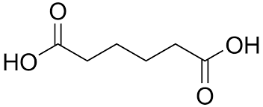
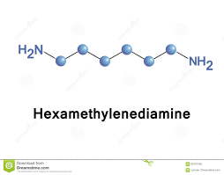
1. Nylon 6,6
Monomers:-
adipic acid
a
2.hexamethylenediamine

Slide 6
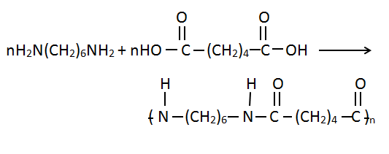
Nylon 6,6
It is obtained by the condensation of adipic acid and hexamethylenediamine with the elimination of water molecule.

Slide 7
Properties
***Nylon-6,6 is a linear polymer
***It has very high tensile strength.
***It shows good resistance to abrasion.

Slide 8
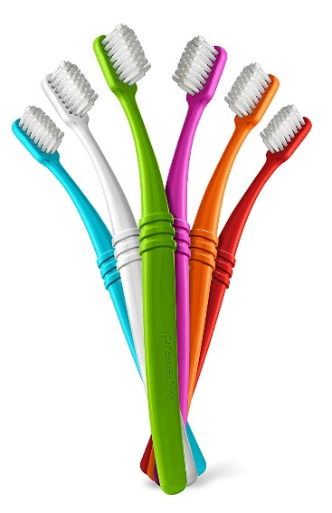
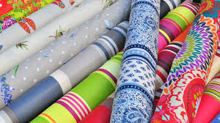
Uses:-
Nylon-6,6 is usually fabricated into sheets.
It is used in bristles for brushes and in textile.

Slide 9
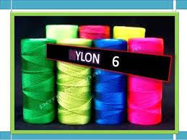
2. Nylon-6
Monomer:-caprolactam

Slide 10
Caprolactam

Slide 11
2. Nylon-6
Nylon-6 is obtained by heating caprolactam with water at a high temperature.

Slide 12
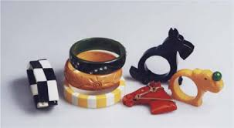
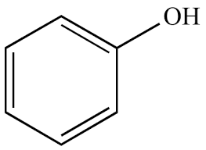
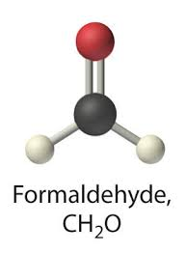
RESINS
1. Phenol-Formaldehyde Polymer(Bakelite)
Monomers:
Phenol
2. Formaldehyde
C

Slide 13
These polymers are obtained by the condensation reaction of phenol with formaldehyde in the presence of either acid or a base catalyst. The reaction involves the formation of methylene bridge at ortho, para or both ortho and para positions. A linear or cross linked material is obtained depending upon the condition of reaction.

Slide 14
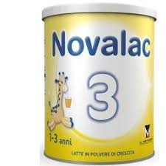
NOVOLAC----
LINEAR ARRANGEMENT

Slide 15
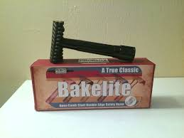
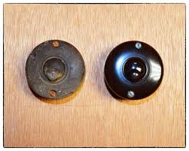
BAKELITE----
CROSS LINKED ARRANGEMENT

Slide 16
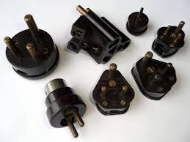
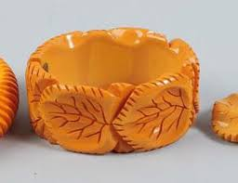
Uses:-
Bakelite is used for making combs, photograph records, electrical switches etc.

Slide 17
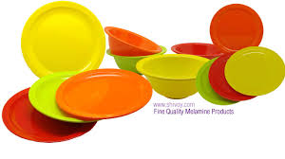
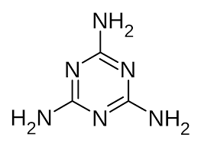
Melamine-formaldehyde Resin
Monomers:-
1.Melamine
2.Formaldehyde

Slide 18
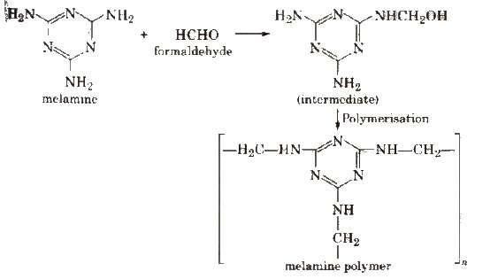
2. Melamine-formaldehyde Resin
It is a copolymer formed by the polymerisation of melamine (which is a heterocyclic triamine) and formaldehyde as follows :

Slide 19
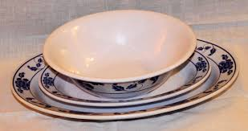
Properties and Uses:-
**It is very hard and tough.
**It has assumed great importance these days particularly in making crockery.
**They do not break even when dropped from a height.

Slide 20
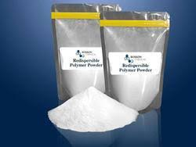
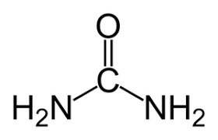
3. Urea-formaldehyde Resin
Monomers:-
1.Urea
2.Formaldehyde

Slide 21
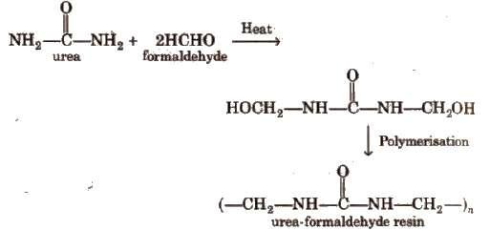
3. Urea-formaldehyde Resin

Slide 22
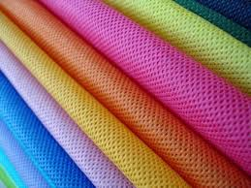
Polyesters
The polymers which contain an ester linkage are known as polyester,
e.g. Terylene
Glyptal

Slide 23
Properties and uses
It is a hard and transparent polymer and is quite resistant to the effect of light, heat and ageing. It is used, in the manufacture of unbreakable lights, protective coatings, dentures, and in making windows for aircrafts.

Slide 24
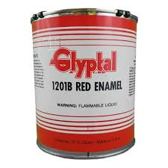
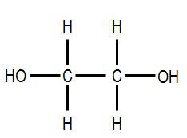
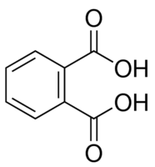
Glyptal
Monomers:-
1.Ethylene glycol
2.Phthalic acid

Slide 25
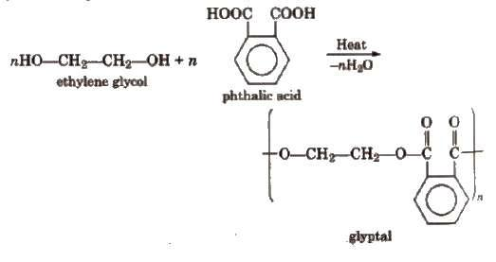
Glyptal
It is a polyester having crosslinks.

Slide 26
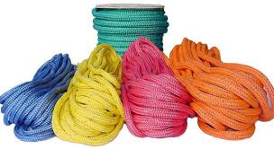
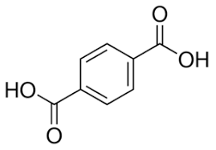
Terylene (Dacron)
Monomers:-
1.Ethylene glycol
2.Phthalic acid

Slide 27
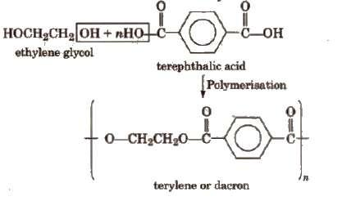
Terylene (Dacron)
It is a condensation product of ethylene glycol and terephthalic acid.
Polymerisation is carried out at 420 to 460 K in the presence of catalyst mixture of zinc acetate and antimony trioxide.

Slide 28
Properties and uses:-
Terylene is highly resistant to the action of chemical and biological agents. Its fibers are quite strong and durable. It can also be blended with wool or cotton to obtain fabrics of desired composition.
Terylene is used in the manufacture of a variety of clothes such as terycot, terywool and terysilk as a result of blending with other yarns. It is also used for preparing magnetic recording tapes, conveyer belts, aprons for industrial workers etc..

Slide 29
Biopolymers
Nature has provided us a variety of polymers which can be produced by the biological systems in plants and animals.
****These are called biopolymers,
e.g., polysaccharides, proteins, nucleic acids, etc..
****In the biological system, these polymers decompose or hydrolyse in the Presence of different enzymes.
This means that they are biodegradable.

Slide 30
Biodegradable Polymers
The synthetic polymers which can be decomposed by microorganisms or living system are called Biodegradable Polymers.

Slide 31
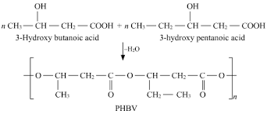
PHBV
It is a copolymer of 3-hydroxybutanoic acid and 3-hydroxypentanoic acid.

Slide 32
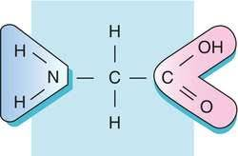
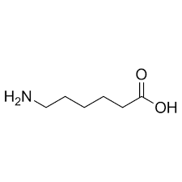
Nylon-2-Nylon-6 (Polyamide copolymer)
Monomer:-glycine (H₂N-CH₂-COOH)
Amino caproic acid [H₂N(CH₂) ₅COOH]

Slide 33
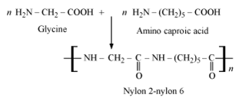
Nylon-2-Nylon-6

Slide 34
THANK
YOU

