Slide 1
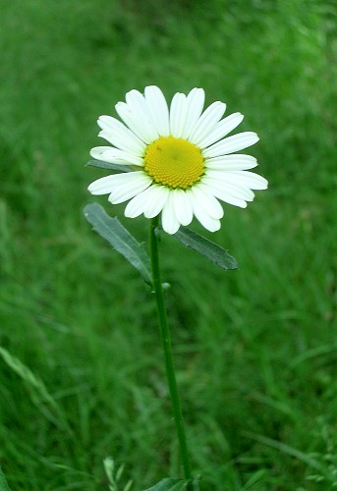
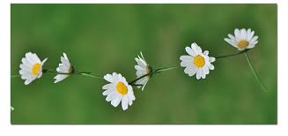
Addition polymerisation
Addition polymerisation is a reaction where lots of/many alkene molecules (monomers) join together to form a long chain polymer.
polymer
Lots of
monomer molecules
Often a high pressure, temperature, and an initiator is needed to start the reaction.

Slide 2
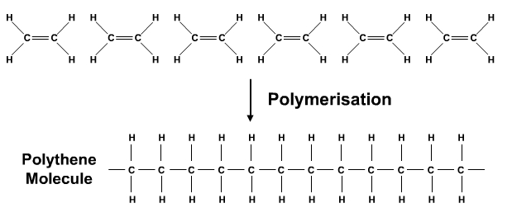
Lots of ethene (monomer) molecules
Double bonds ‘open up’ to join the monomers together to form a long chain called a polymer.
poly(ethene)
In reality, this equation is too complicated to use, so we simplify it to…

Slide 3
This displayed formula is often called the repeating unit. It is the same as the monomer, but with the double bond changed to a single bond and new bonds drawn in to show where the repeating unit joins to other repeating units.
n
Represents an unspecified large number of monomers reacting together.
n
ethene
poly(ethene)
This is the type of equation you should use in an exam question.

Slide 4
The name of the polymer can easily be worked out from the name of the monomer used to make it:
Name of monomer | Name of polymer
ethene | poly(ethene)
propene | poly(propene)
styrene | poly(styrene)
ethene terephthalate | poly(ethene terephthalate)
commonly known as PET

Slide 5
You need to know about the production and uses of three polymers: poly(ethene), poly(chloroethene), and poly(propene).
Follow the link to find some of the uses of these polymers.
http://www.bbc.co.uk/schools/gcsebitesize/science/edexcel/fuels/hydrocarbonsrev5.shtml

Slide 6
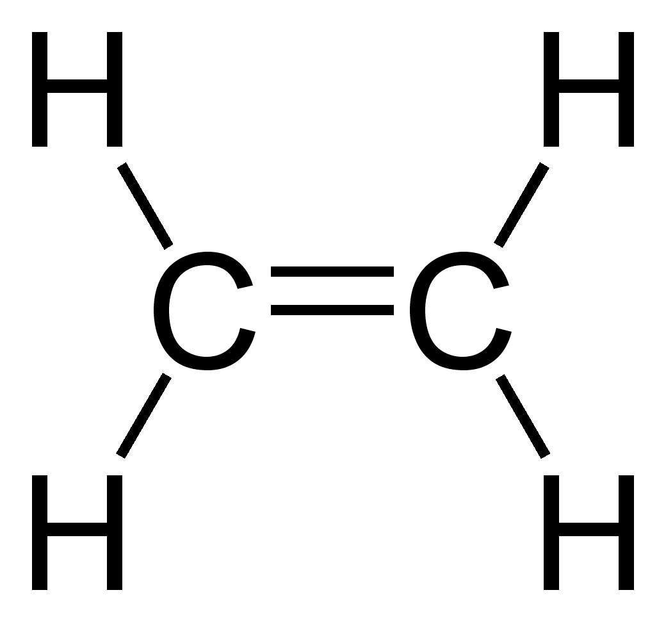
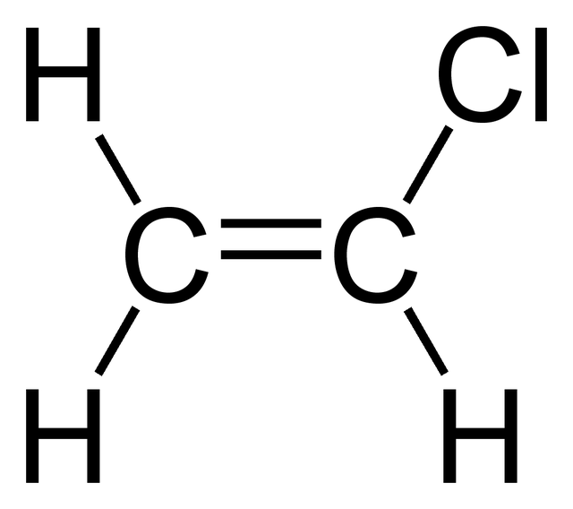
A chloroethene molecule is the same as an ethene molecule with a hydrogen atom substituted for a chlorine atom.
ethene
chloroethene

Slide 7
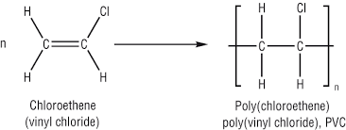
In the addition polymerisation of chloroethene, the double bond opens up joining lots of the monomers together to form poly(chloroethene).
Poly(chloroethene) is still widely known as PVC because of the old name of the monomer it is made from.
Chloroethene is sometimes known by its old name, vinyl chloride.

Slide 8
A propene molecule is an alkene molecule, like ethene, but with 3 carbon atoms rather than 2.
Normally, we would draw propene like this, but in the polymerisation topic it is easier to draw it with the double bond at the centre of the molecule. This is because the bonds that join the monomer molecules together come from the double bond opening up.
propene
This is the same molecule, but drawn slightly differently, with the double bond at the centre.
Learn this way of drawing it.
propene

Slide 9
In the addition polymerisation of propene, the double bond opens up joining lots of the monomers together to form poly(propene).
repeating unit
propene
poly(propene)

Slide 10
The problem with addition polymers is that they are very difficult to dispose of. The bonds between the atoms are very strong, so they are not easily broken down and can stay in landfill for a very long time because they are non-biodegradable.

