Slide 1
AMINO ACIDS & PROTEINS
Amino acids contains main elements as C, H, O, N, S

Slide 2
Amino acids
Amino group, carboxyl group, hydrogen and a variable side group (residue) each joined to a central carbon atom
R
H₂N-C-COOH
H

Slide 3
Types of amino acids
Amino end and carboxyl end can be ionised NH₃⁺ and COO⁻ to give acidic and basic characteristics
At pH 7 both groups are ionised
The residues are side chains which give the individual properties to the amino acid (acidic, basic, neutral and nonpolar).

Slide 4
The peptide bond
Carboxyl group + amino group form a strong covalent bond releasing water in the process = a condensation reaction (the reverse is hydrolysis)
Amino acids join together in a long chain: N terminal end to C terminal end = a polypeptide.

Slide 5
R
O
R
O
H
H
N C C-OH
N C C-OH
H
H
H
H
Condensation reaction
A dipeptide is formed
R
O
H
R
O
H
N C C
N C C-OH
+ H₂O
H
H
H
The peptide bond

Slide 6
PROTEIN FUNCTIONS
Protein structure determines protein function
Denaturation or inhibition which may change protein structure will change its function
Coenzymes and cofactors in general may enhance the protein's structure.

Slide 7
Fibrous proteins
Involved in structure: tendons ligaments blood clots (e.g. collagen and spiders silk)
Contractile proteins in movement: muscle, microtubules (cytoskelton, mitotic spindle, cilia, flagella).

Slide 8
Globular proteins
most proteins which move around (e.g. albumen, casein in milk)
Proteins with binding sites: enzymes, hemoglobin, immunoglobulins, membrane receptor sites.

Slide 9
Proteins Come In Many Varieties!
Proteins include a diversity of structures, resulting in a wide range of functions
Proteins account for more than 50% of the dry mass of most cells
Protein functions include structural support, storage, transport, cellular communications, movement, and defense against foreign substances

Slide 10
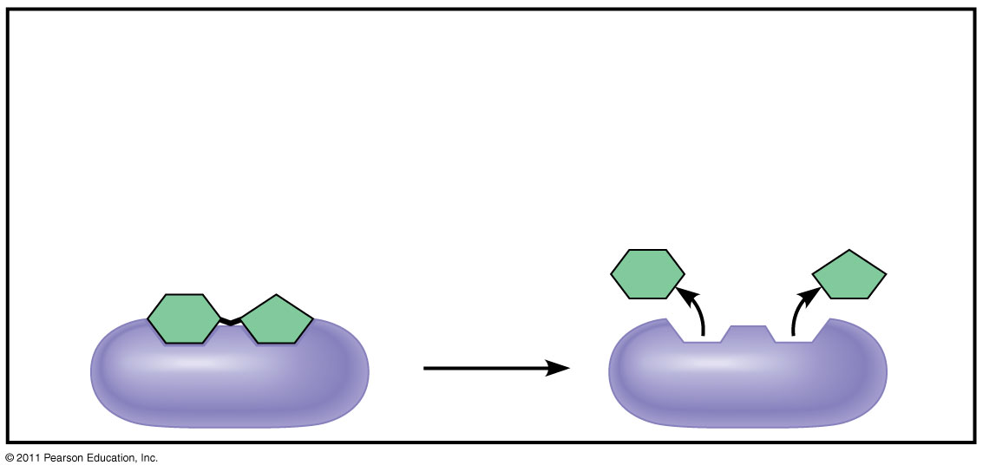
Enzymatic
Enzymatic proteins
Function: Selective acceleration of chemical reactions
Example: Digestive enzymes catalyze the hydrolysis of bonds in food molecules.
Enzyme
Notes:
Emphasize the specificity of enzymes. Also emphasize the catalytic nature of enzymes and that they function best in a unique set of pH and temperature conditions. Why is that? It is due to the shape of the enzyme molecule. That shape is held in place by IMFs and/or covalent or ionic bonding. Changes in pH or temperature often disrupt the electrostatic forces that are responsible for an enzyme’s specific shape.

Slide 11
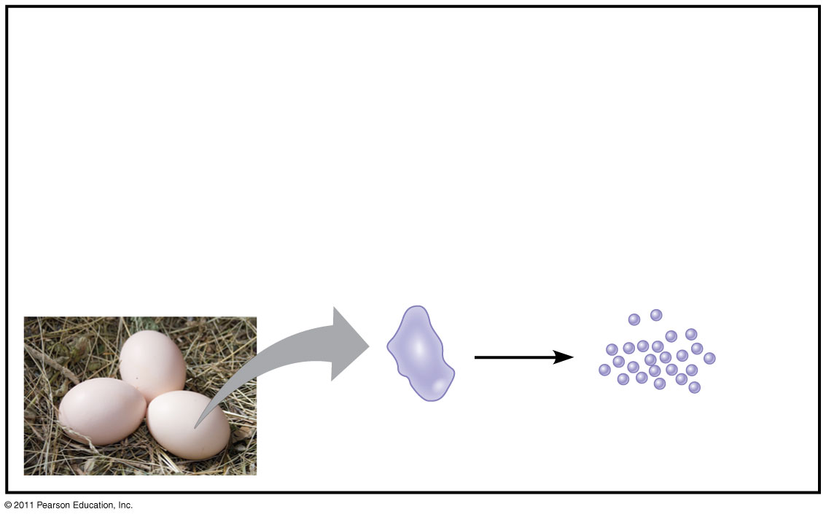
Storage
Storage proteins
Function: Storage of amino acids
Examples: Casein, the protein of milk, is the major source of amino acids for baby mammals. Plants have storage proteins in their seeds. Ovalbumin is the protein of egg white, used as an amino acid source for the developing embryo.
Amino acids for embryo
Ovalbumin
Notes:
Ask students to identify other food sources that are proteins. One of my favorite quotes ever is from Bob Harper, a personal trainer from The Biggest Loser. Simply put, “If the food in question had a mother, then it’s a protein!”

Slide 12
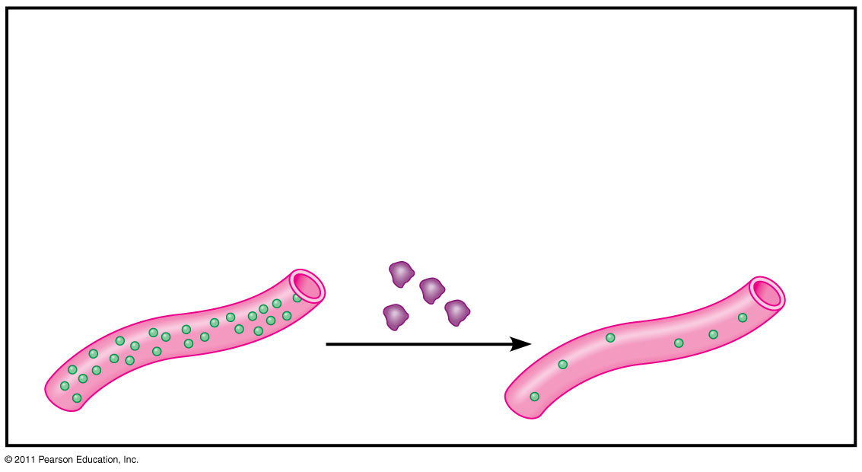
Hormonal
Hormonal proteins
Function: Coordination of an organism’s activities
Example: Insulin, a hormone secreted by the pancreas, causes other tissues to take up glucose, thus regulating blood sugar concentration
Insulin secreted
High blood sugar
Normal blood sugar
Notes:
Ask students to give examples of hormonal proteins. They should easily come up with testosterone and estrogen among others.

Slide 13
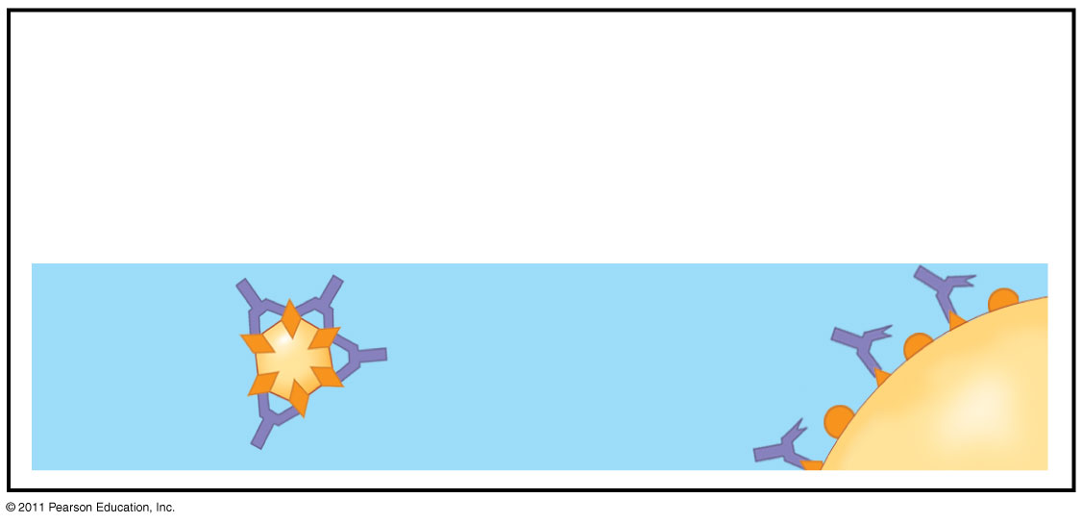
Defensive
Defensive proteins
Function: Protection against disease
Example: Antibodies inactivate and help destroy viruses and bacteria.
Antibodies
Virus
Bacterium
Notes:
Ask students which body system utilizes these types of proteins.

Slide 14
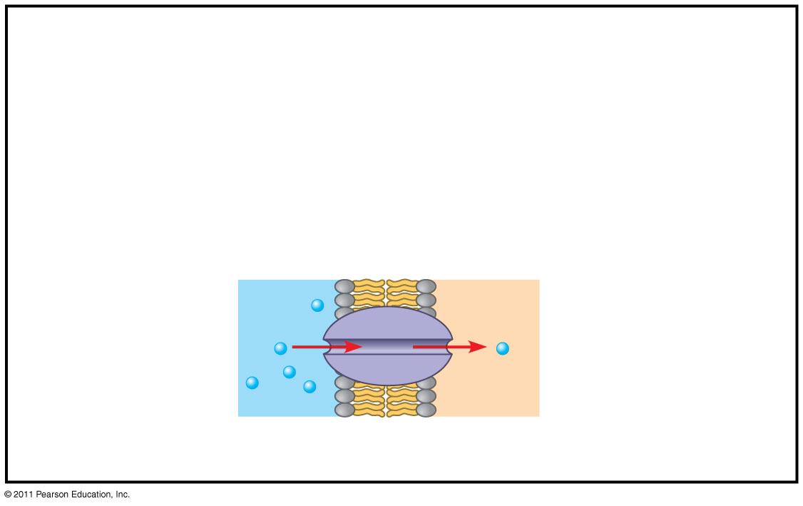
Transport
Transport proteins
Function: Transport of substances
Examples: Hemoglobin, the iron-containing protein of vertebrate blood, transports oxygen from the lungs to other parts of the body. Other proteins transport molecules across cell membranes.
Transport protein
Cell membrane
Notes:
Ask which body system utilizes hemoglobin.

Slide 15
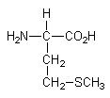
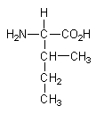
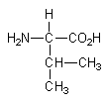
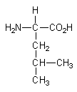
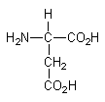
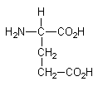
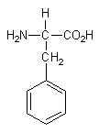
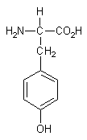
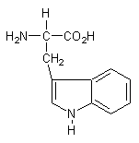
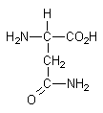
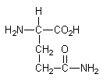
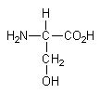
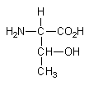
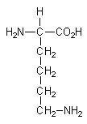
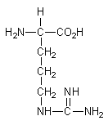
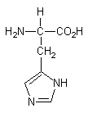
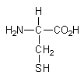
Amino acid structures
2-2
methionine (M)
isoleucine (I)
valine (V)
leucine (L)
aspartic
acid (D)
glutamic
acid (E)
phenylalanine (F)
tyrosine (Y)
tryptophan (W)
aspargine (N)
glutamine (Q)
serine (S)
threonine (T)
lysine (K)
arginine (R)
histidine (H)
glycine (G)
alanine (A)
cysteine
proline
+
+
2
3

Slide 16
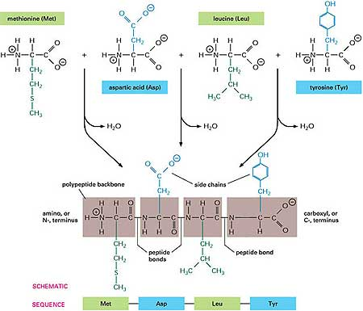
Peptide bond formation
2-4
You should know the structure of a polypeptide chain (protein)!

Slide 17
Protein structure: overview
Structural element Description
primary structure amino acid sequence of protein
secondary structure helices, sheets, turns/loops
super-secondary structure association of secondary structures
domain self-contained structural unit
tertiary structure folded structure of whole protein • includes disulfide bonds
quaternary structure assembled complex (oligomer) • homo-oligomeric (1 protein type) • hetero-oligomeric (>1 type)

Slide 18
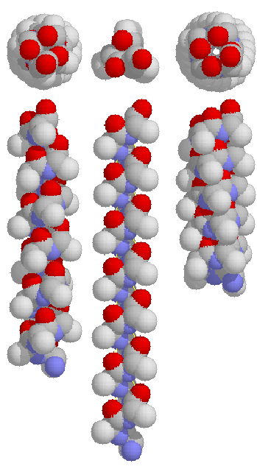
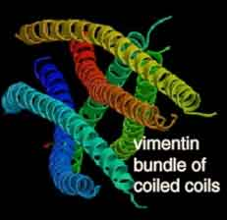
Protein structure: helices
alpha
3.10
pi
- alpha helices are about 10 residues on average
- side chains are well staggered, preventing steric hindrance
- helices can form bundles, coiled coils, etc.
H-bonding
amino acids
per turn:
3.6
3.0
4.4
frequency
~97%
~3%
rare

Slide 19
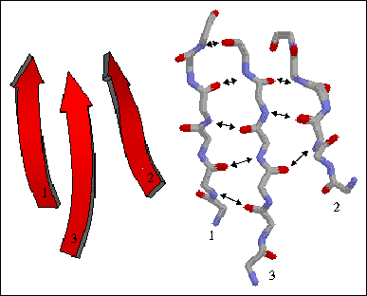
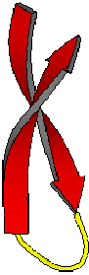
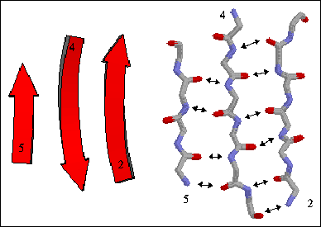
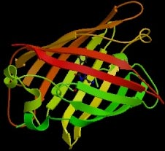
Protein structure: sheets
- the basic unit of a
beta-sheet is called a
beta-strand
- unlike alpha-helix, sheets can be formed from discontinuous regions of a polypeptide chain
parallel
- beta-sheets can form
various higher-level
structures, such as a
beta-barrel
‘twisted’
anti-parallel
Green
Fluorescent
Protein
(GFP)

Slide 20
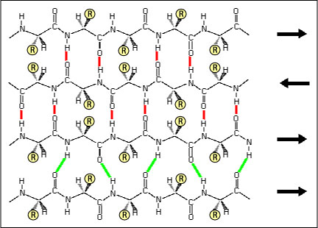
Protein structure: sheets (detail)
- notice the difference in H-bonding pattern between parallel and anti-parallel beta-sheets
- also notice orientation of side chains relative to the sheets
‘twisted’

Slide 21
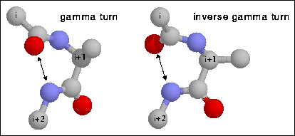
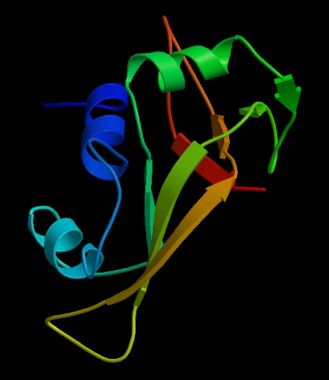
Protein structure: turns/loops
alpha-helix
beta-sheet
- there are various types of
turns, differing in the number of residues and
H-bonding pattern
- loops are typically longer;
they are often called coils and do not have a ‘regular’,
or repeating, structure
ribonuclease A
loop
(usually exposed on surface)

Slide 22
Protein denaturants
• high temperatures
- cause protein unfolding, aggregation
• low temperatures
- some proteins are sensitive to cold denaturation
• heavy metals (e.g., lead, cadmium, etc.)
- highly toxic; efficiently induce the ‘stress response’
• proteotoxic agents (e.g., alcohols, cross-linking agents, etc.)
• oxygen radicals, ionizing radiation
- cause permanent protein damage
• chaotropes (urea, guanidine hydrochloride, etc.)
- highly potent at denaturing proteins;
often used in protein folding studies

Slide 23
Following the loss of structure
• loss of secondary structure
- the far-UV circular dichroism spectrum of a protein changes at the so-called ‘melting temperature’ or T_{m}
- fluorescence characteristics will likely also change
• loss of tertiary structure
- the far- and near-UV circular dichroism spectra of a protein change, but the Tm of both spectra may be different
- fluorescence characteristics will likely also change
• loss of activity
- the activity of a protein can be monitored over time
• aggregation
- can measure light scattering (e.g., at 320 nm) spectrophoto-metrically, or by detecting the protein in a precipitate

Slide 24
Vitamins

Slide 25
Polish biochemist Casimir Funk discovered vitamin B1 in 1912 in rice bran.
He proposed the complex be named "Vitamin" (vital amines).
By the time it was shown that not all vitamins were amines, the word was already ubiquitous.

Slide 26
Vitamin - definition
An organic compound required as a nutrient in tiny amounts by an organisms.
It cannot be synthesized in sufficient quantities by an organism, and must be obtained from the diet.
Vitamins have diverse biological function:
hormone-like functions as regulators of mineral metabolism (vit. D),
regulators of cell and tissue growth and differentiation (some forms of vit. A)
antioxidants (vit. E, C)
enzyme cofactors (tightly bound to enzyme as a part of prosthetic group, coenzymes)

Slide 27
Vitamin classification
Lipid-soluble vitamins (A, D, E and K)
hydrophobic compounds, absorbed efficiently with lipids,
transport in the blood in lipoproteins or attached to specific binding proteins,
more likely to accumulate in the body,
more likely to lead to hypervitaminosis

Slide 28
Vitamin classification
Water-soluble vitamins - 8 B vitamins and vitamin C
Function: mainly as enzyme cofactors,
hydrophilic compounds dissolve easily in water,
not readily stored, excreted from the body,
their consistent daily intake is important.
Many types of water-soluble vitamins are synthesized by bacteria.

Slide 29
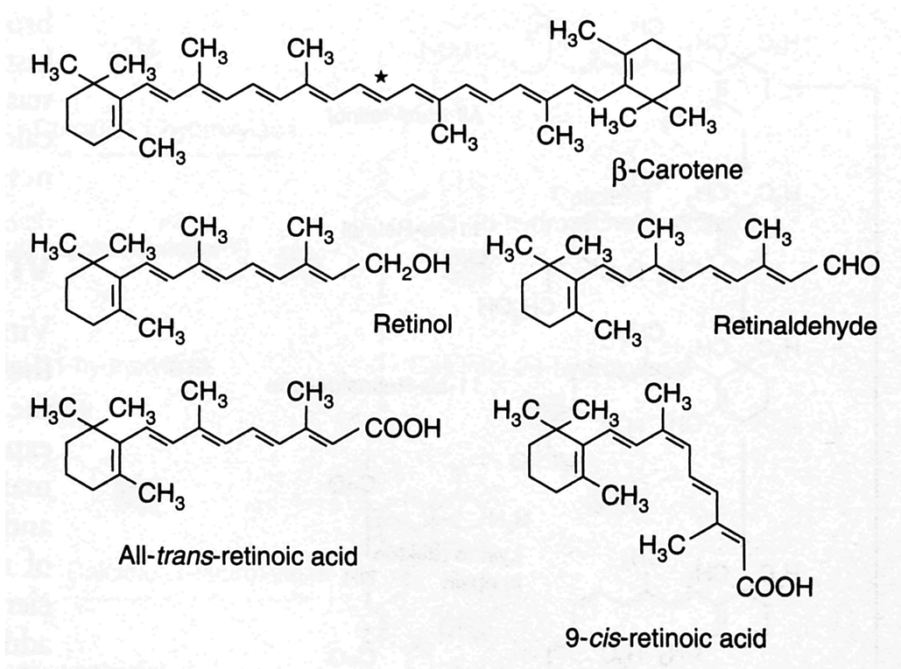
Lipid-soluble vitamins Vitamin A
Retinol
Biologically active forms - retinoids: retinol, retinal, retinoid acid.
Major vit. A precursors (provitamins) → plants carotenoids.
Foodstaf of animals origin contain most of vit. A in the form of esters (retinylpalmi-tates) – retinol and long fatty acid
Cyklohexan ring and isoprenoid chain

Slide 30
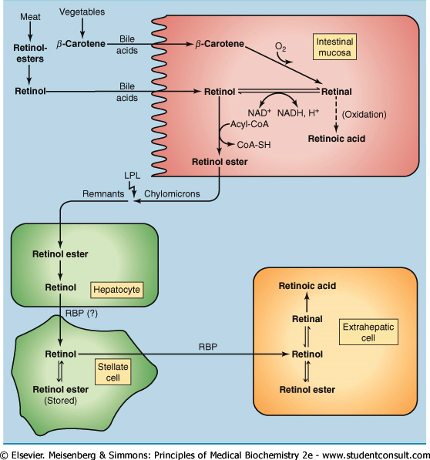
Vit. A transport and metabolism
Retonol esters → hydrolysis by pancreatic enzymes to retinol.
β-caroten is cleaved to retinal by β-carotene 15,15´ dioxygenase (cofactors iron and bile salts).
Intestinal cells → esterification of retinol → transported in chylomicrons.
Remnants of chylomicrons → liver→ esterification (if the concentration exceeds 100 mg, esters are stored ).
Transport of retinol to target organs tightly bound to retinol-binding protein, RBP.

Slide 31
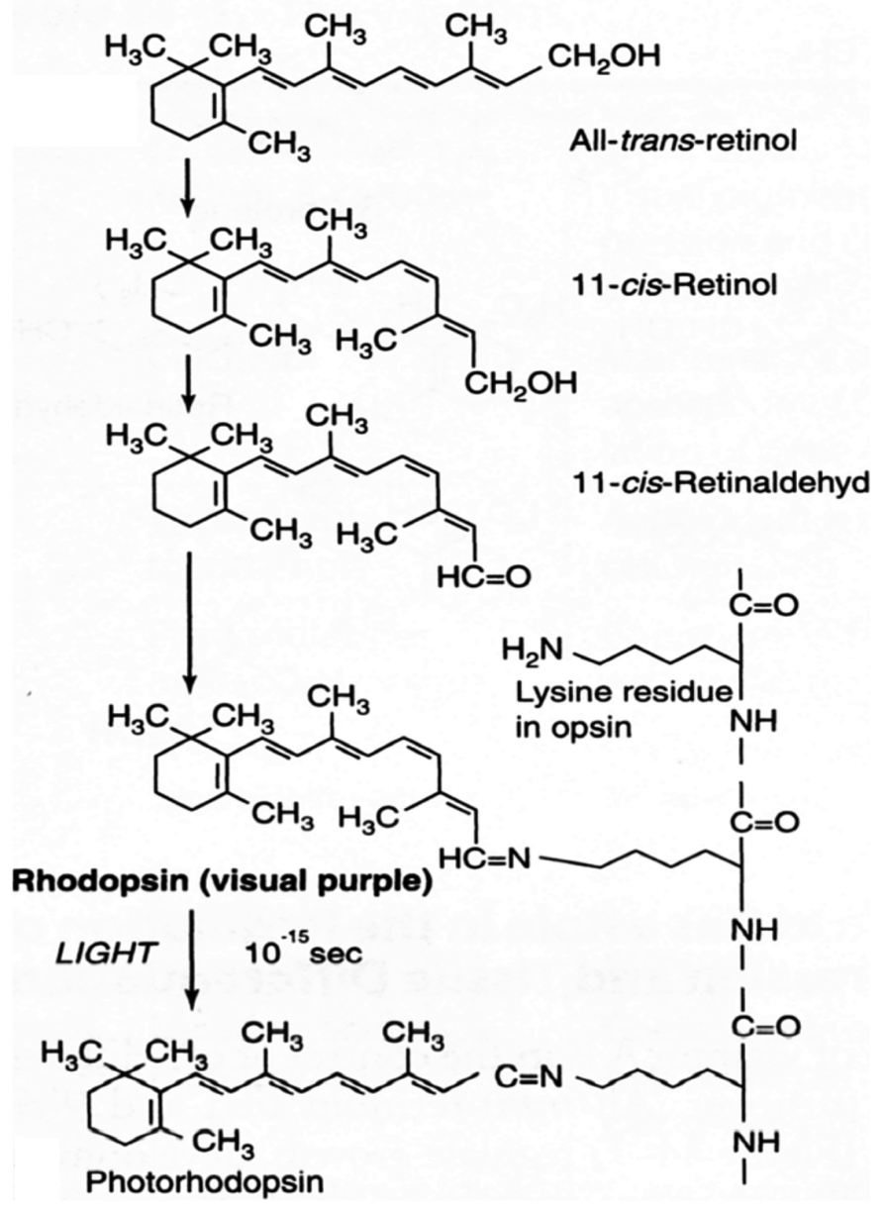
Vitamin A and vision
Vit. A is necessary to form rhodopsin (in rodes, night vision) and iodopsins (photopsins, in cones – color vision) - visual pigment.
Retinaldehyd is a prosthetic group of light-sensitive opsin protein.
In the retina, all-trans-retinol is isomerized to 11-cis-retinol → oxidized to 11-cis-retinaldehyd, this reacts with opsin (Lys) → to form the holoprotein rhodopsin.
Absorption of light → conformation changes of opsin → photorhodopsin.

Slide 32
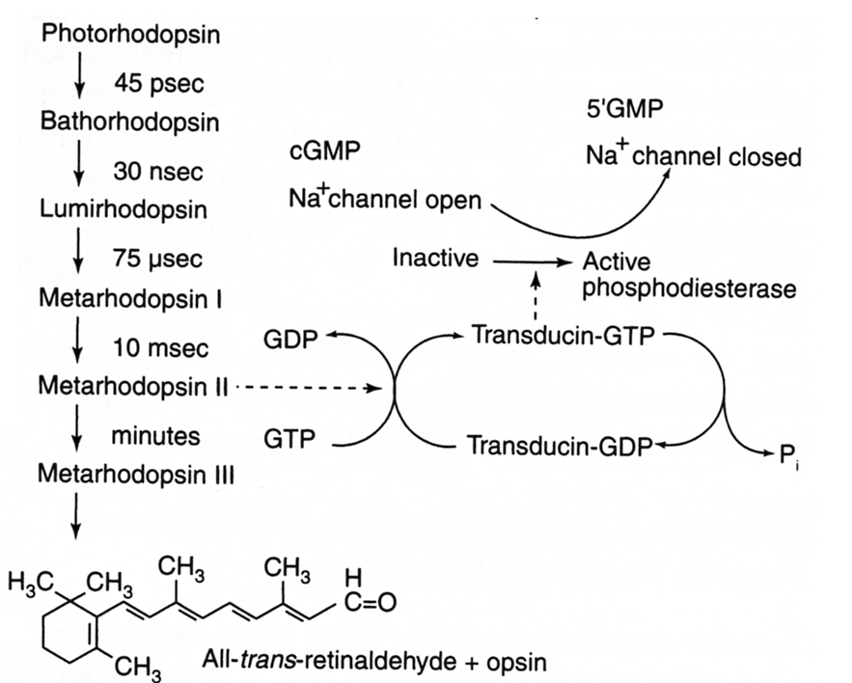
Vitamin A and vision
The following is a series of izomerisation→ initiation of nerve impulse.
The final step is hydrolysis to release all-trans-retinaldehyde and opsin.
Deficiency of vit. A leads to night blindness.
Vitamin A is an important antioxidant.

Slide 33
Vitamin A and other functions
Transcription and cell differentiation
Retinoic acid regulates the transcription of genes - acts through nuclear receptors (steroid-like receptors).
By binding to various nuclear receptors, vit. A stimulates (RAR – retinoid acid receptor) or inhibits (RXR- retinoid „X“ receptor) transcription of genes transcription. All-trans-retinoic acid binds to RAR and 9-cis-retinoic acid binds to RXR.
Retinoic acid is necessary for the function and maintenance of epithelial tissues.
Retinol retinal retinoic acid
Retinol dehydrogease
Retinaldehyde dehydrogenasa

Slide 34
Vitamin A - deficiency
The early sign → a loss of sensitivity to green light,
prolonged deficiency → impairment to adapt to dim light
more prolonged deficiency leads to night blindness
Ever escalated deficiency leads to squamous metaplasia - columnar epithelia are transformed into heavily keratinized squamous epithelia.
The conjunctiva loses mucus-secreting cells → glykoprotein content of the tears is reduced → xeroftalmia ( „dry eyes“)
Often complication - bacterial or chlamidial infection which results in perforation of the cornea and blindness

Slide 35
Vitamin A - deficiency
Transformation of respiratory epithelium – loss of protective airway function (antibacterial properties) → bronchitis.
Conversion of the urinary tract epithelium → higher frequency of urinary stone formation
Immunosuppression
Impairment of reproductive function (both in men and women).
Worldwide deficiency of vit. A
3 – 10 mil. children become xerophtalmic every year
250 000 to 500 000 go to blindness
1 million die from infections

Slide 36
Vitamin A - toxicity
Toxic dose:
single dose of more than 200 mg
more than 40 mg per day
Acute symptoms - headache, vomiting, impaired consciousness.
Chronic intoxication – weight loss, vomiting, pain in joints, muscles, blurred vision, hair loss, excessive bone growth.
Both vit. A excess and deficiency in pregnancy are teratogenic – retinoic acid is gene regulator during early fetal development
Carotenoids are non toxic - accumulation in tissues rich in lipids (the skin of babies overdosed with carrot juice may be orange).

Slide 37
Metabolic functions of vitamin A
Vision
Gene transcription
Immune function
Embryonic development and reproduction
Bone metabolism
Haematopoieis
Skin health
Antioxidant activity

Slide 38
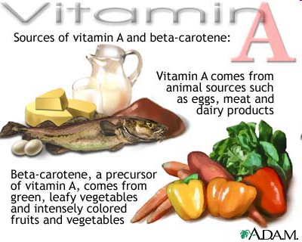
Sources of vitamin A
cod liver oil
meat
egg
milk
dairy products
carrot
broccoli
spinach
papaya
apricots

Slide 39
Vitamin D
Calciol, vitamin D₂ (cholecalciferol) → precursor of calcitriol, D₃ (1,25-dihydroxycalciferol).
Regulates with PTH calcium and phosphate level (absorption, reabsorption, excretion).
Synthesis in the skin (7-dehydrocholesterol) UV → further transformation in the liver and kidneys .

Slide 40
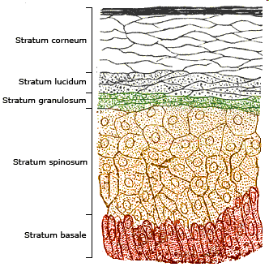
Synthesis
UV irradiation 270 – 300 nm
Photolysis
Non-enzymatic reaction in the skin
Transport to the liver

Slide 41
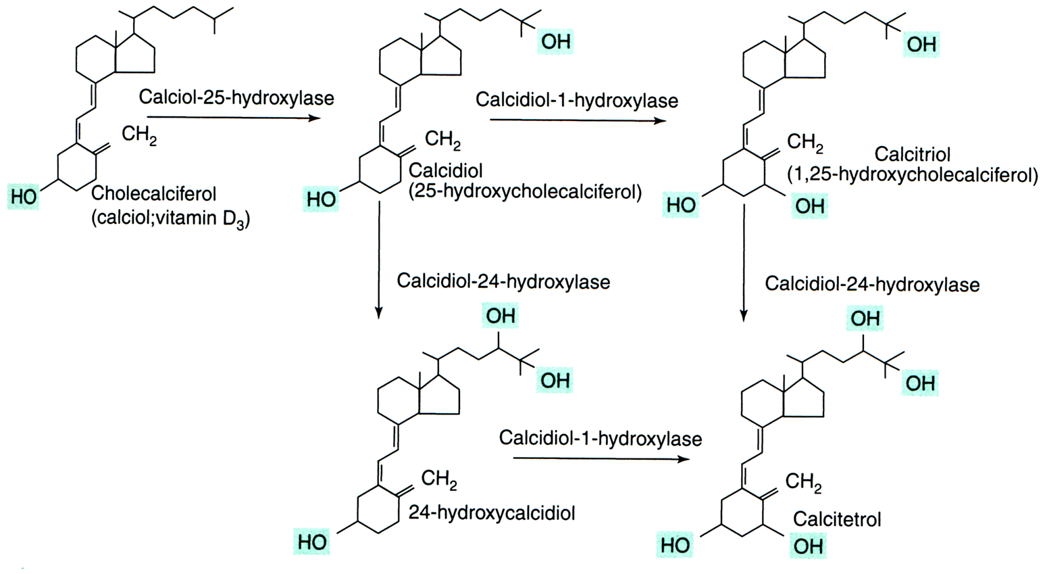
Liver
Kidneys
Inactive form

Slide 42
Effects of vitamin D
Transported in the blood on a carrier (vitamin-D binding protein, VDBP).
1,25(OH)₂D binds to intracellular receptors (intestine, bone, kidney).
The main function is to maintain plasma levels of calcium (essential for neuromuscular activity) and phosphate levels:
increase Ca absorption in the intestine,
reduce the excretion of calcium (stimulates parathyroid hormone-dependent Ca reabsorption in the distal tubule),
mobilizing bone mineral, together with parathyroid hormone

Slide 43
Vitamin D - deficincy
Failure of absorption in the intestine.
The lack of the liver and the renal hydroxylation of vit. D (congenital deficiency of 1-hydroxylase).
The lack of UV irradiation.
The main manifestation - impaired ossification of the newly created osteiod, abundance of non mineralized matrix.
Vit. D is necessary for the prevention of skeletal changes (rickets in growing individuals, osteomalacia in adults).

Slide 44
Vitamin D and imunity
It increases the activity of natural killer cells (cytotoxic lymphocytes).
Increases the phagocytic ability of macrophages .
Reduces the risk of virus diseases (colds, flu).
Reduces the risk of many cancers (colon, breast and ovarian cancer).
Reduces the risk of cardiovascular disease → have a positive impact on the composition of plasma lipids.

Slide 45
Sources of vitamin D
In addition to sunbathing:
various fish species (salmon, sardines and mackerel, tuna, catfish, eel), fish oil, cod liver
eggs, beef liver, mushrooms

Slide 46
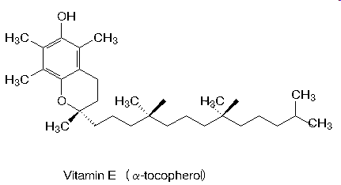
Vitamin E
Vitamin E is a famil of α−, β−, γ−, δ− tocopherols and corresponding tocotrienols izomers.
They are formed from chroman ring and hydrofobic fytyl side chain.
The highest biological activity has α-tokoferol.

Slide 47
Vitamin E
Adsorbtion from the small intestine.
Its absorption is dependent on the presence of lipids in the diet.
Associated with plasma lipoproteins → liver uptake through receptors for apolipoprotein E.
α−tocopherol is bind to α-tocopherol transport protein (α-TTP) → transported to the target organs (the excess is stored in adipocytes, in muscle, liver).
β−, γ− a δ−tocopherols are transferred into the bile and degraded.

Slide 48
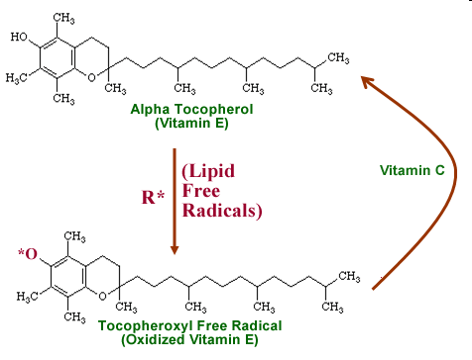
Vitamin E as antioxidant
Stops free radical reactions (peroxyl radicals ROO• , oxygen radicals HO•, lipoperoxid radicals LOO•). Chroman ring with OH group → uptake radicals.

Slide 49
Interaction and synergism between antioxidant systems operating in the lipid phase (membranes) and the aqueous phase (cytosol)
PUFA-H = polyunsaturated fatty acid
PUFA-OO• = peroxyl radical of polyunsaturated fatty acid
PUFA-OOH = hydroxyperoxy polyunsaturated fatty acid
PUFA-OH = hydroxy polyunsaturated fatty acid
Free radical
chain reaction

Slide 50
Vitamin E as enzyme cofactor
α-tocopherol quinon generated by oxidation of α-tocopherol can acts as a cofactor of mitochondrial unsaturated fatty acids .
α-tocopherol quinon + cytochrom B₅ + NADH+H⁺ initiate formation of double bonds in FA – temporarily changes to α-tocopherol-hydroquinon (in the presence of O₂ changes back to α-tocopherol quinon).

Slide 51
Vitamin E – deficiency and toxicity
The lack of α-tocopherol in plasma is often associated with impaired fat absorption or distribution (in patients with cystic fibrosis, in patients with intestine resection)
deficit of vit. D exhibit - neurological problems, impaired vision, eye muscle paralysis, platelet aggregation, impairment of fertility in men, impaired immunity.
Toxicity is relatively small.

Slide 52
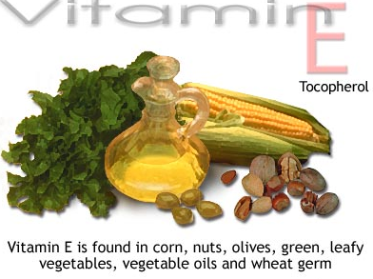
Sources of vitamin E
fortified cereals
seeds and seed oils, like sunflower
nuts and nut oils, like almonds and hazelnuts
green leafy vegetables,
broccoli
cabbage
celery

Slide 53
Vitamin K
Vitamin K is a group of lipophilic, hydrophobic vitamins.
They are needed for the postranslation modification of proteins required for blood coagulation,
They are involved in metabolism pathways, in bone mineralisation, cell growth, metabolism of blood vessel wall.

Slide 54
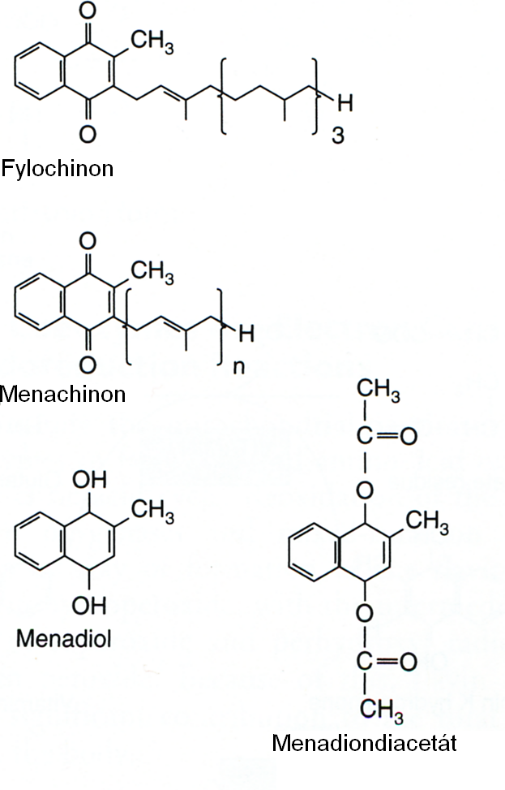
Vitamin K
Vitamin K₁
Vitamin K₁ (phylloquinon) – plant origin
Vitamin K₂ (menaquinon) – normally produced by bacteria in the large intestine
K₁ a K₂ are used differently in the body
K₁ – used mainly for blood clothing
K₂ – important in non-coagulation actions - as in metabolism and bone mineralization, in cell growth, metabolism of blood vessel walls cells.
Vitamin K₂
Synthetic derivatives of Vit.K

Slide 55
Vitamin K - function
Cofactor of liver microsomal carboxylase which carboxylates glutamate residues to γ-carboxyglutamate during synthesis of prothrombin and coagulation factors VII, IX a X (posttranslation reaction).
Carboxylated glutamate chelates Ca²⁺ ions, permitting the binding of blood clotting proteins to membranes.
Forms the binding site for Ca²⁺ also in other proteins – osteocalcin.

Slide 56
Vitamin K - deficiency
Deficiency is caused by fat malabsorption or by the liver failure.
Blood clotting disorders – dangerous in newborns, life-threatening bleeding (hemorrhagic disease of the newborn).
Osteoporosis due to failed carboxylation of osteokalcin and decreased activity of osteoblasts.
Under normal circumstances there is not a shortage, vit. K is abundant in the diet.

Slide 57
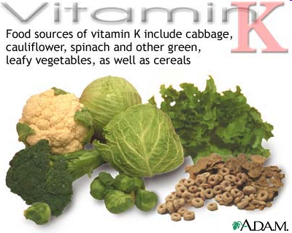
Sources of vitamin K
Green leafy vegetables
vegetable oil
broccoli
cereals
http://health.allrefer.com/health/nutrition.html

Slide 58
Water soluble vitamins
Vitamin B₁ (thiamine)
Vitamin B₂ (riboflavin)
Vitamin B₃ or Vitamin P or Vitamin PP (niacin)
Vitamin B₅ (panthotenic acid)
Vitamin B₆ (pyridoxine and pyridoxamine)
Vitamin B₇ or Vitamin H (biotin)
Vitamin B₉ or Vitamin M and Vitamin B-c (folic acid)
Vitamin B₁₂ (cobalamin)

Slide 59
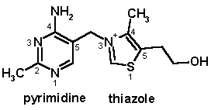
Vitamin B₁ (thiamine)
Thiamin has a central role in energy-yielding metabolism.
Composed of a substituted pyridine and thiazole ring.
Active form is thiamine diphosphate (thiamin pyrophosphate, TPP), a coenzyme for three multi-enzyme complex →
This complex catalyses oxidative decarboxylation of α-ketoacids →
pyruvate dehydrogenase in carbohydrate metabolism,
α-ketoglutarate dehydrogenase → cytric acid cycle,
Branched-chain keto-acid dehydrogenase .
TPP is coenzyme for transketolase – pentose phosphate pathway.

Slide 60
Vitamin B₁ - deficiency
Mild deficiency – leads to gastrointestinal complients, weakness
Moderate deficiency - peripheral neuropathy, mental abnormalities, ataxia
Full-blown deficiency - beri-beri – characterized with severe muscle weakness, muscle wasting and delirium, paresis of the eye muscles, memory loss.
Degeneration of the cardiovascular system. .
Beri-beri causes long-term consumption of foods rich in carbohydrates but poor in thiamine - husked rice, white flour and refined sugar.

Slide 61
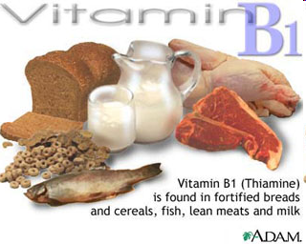
Source of vitamin B₁
paddy grains, cereals meat yeast honey nuts

Slide 62
Vitamin B₂ (riboflavin)
Yellow to orange-yellow natural dye slightly soluble in water.
Has a central role in energy-yielding metabolism.
Provides the reactive moieties of the coenzymes flavin mononucleotide (FMN) and flavin adenine dinucleotid (FAD).
Flavin coenzymes are electron carries in oxidoreduction reaction.

Slide 63
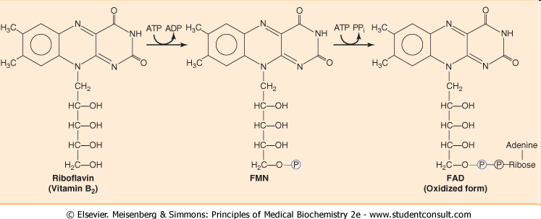
Vitamin B₂
FMN → ATP-dependent phosphorylation of riboflavin
FAD → further reaction with ATP in which its AMP moiety is transferred to FMN.

Slide 64
Vitamin B₂ absorption
Riboflavin is absorbed in the proximal intestine.
Riboflavin is stored mainly in the liver, kidney and heart in the form of FAD (70- 90%) or FMN.

Slide 65
Causes of vitamin B₂ deficiency
Lack of dietary vitamin B.
A result of conditions that affect absorption in the intestine.
The body not being able to use the vitamin.
An increase in the excretion of the vitamin from the body.

Slide 66
Vitamin B₂ – symptoms of deficiency
Cracked and red lips.
Inflammation of the lining of mouth and tongue.
Dry and scaling skin- keratitis, dermatitis and iron-deficiency anemia

Slide 67
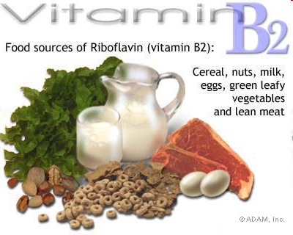
Sources of vitamin B₂
foods of animal origin (liver, pork and beef, milk, dairy products, fish eggs)
cocoa,
nuts,
yeast,
of smaller quantities in cereals.

Slide 68
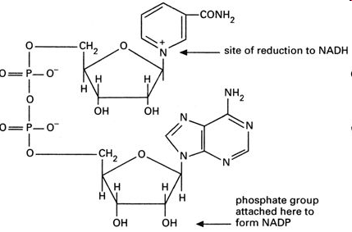
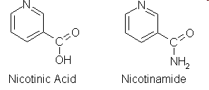
Vitamin B₃ - niacin
Active form – nikotinic acid and nikotinamid.
NAD a NADP → key components of the metabolic pathways of carbohydrates, lipids, amino acids.
Nicotinic acid prevents the release of fatty acids from adipose tissue, decreases lipoproteins VLDL, IDL a LDL.
High dose of niacin dilates blood vessels .

Slide 69
Vitamin B₃ - niacin
Absorption:
At low concentration by active transport.
At high concentration by passive diffusion.
Transportation:
Both nicotinic acid (NA) and nicotinamide (NAm) bind to plasma proteins for transportation.
Biosynthesis:
The liver can synthesize Niacin from the essential amino acid tryptophan, but the synthesis is extremely slow and requires vitamin B₆ (60 mg of Tryptophan= 1mg of niacin). Bacteria in the gut may also perform the conversion but are inefficient.

Slide 70
Vitamin B₃ - deficiency
Pellagra: A serious deficiency of niacin.
The main results of pellagra can easily be remembered as "the four D's": diarrhea, dermatitis, dementia, and death.
Pelagra is very rare now, except in alcoholics, strict vegetarians, and people in areas of the world with very poor nutrition.
Milder deficiencies of niacin can cause dermatitis around the mouth and rashes, fatigue, irritability, poor appetite, indigestion, diarrhea, headache.

Slide 71
Sources of vitamin B₃
foods of animal origin
yeast
sunflower seeds, beans, peas
green leafy vegetable
broccoli, carrots

Slide 72
Vitamin B₅ – panthotenic acid
Part of acetyl-CoA – consists of pantoic acid and β-alaninem.

Slide 73
Vitamin B₅ – panthotenic acid
Co-enzyme A assists the following reactions:
formation of sterols (cholesterol and 7-dehydrocholesterol).
formation of fatty acids.
formation of keto acids such as pyruvic acid.
Other reactions are acylation, acetylation, signal transduction deamination

Slide 74
Vitamin B₅ - deficiency
Rare to occur.
When occur it leads to paresthesias.
Disorders of the synthesis of acetylcholine – neurological symptoms (parestesie).

Slide 75
Sources of vitamin B₅
meat, foods of animal origin,
yeast,
wholemeal bread,
broccoli, avocado
royal gelly

Slide 76
Vitamin B₆
Vitamin B₆ is needed for more than 100 enzymes involved in protein metabolism.
It is also essential for red blood cell metabolism and hemoglobin formation.
The nervous and immune systems need vitamin B₆ to function efficiently.
It is also needed for the conversion of tryptophan to niacin (vitamin B₃).
Vitamin B₆ also helps maintain blood glucose within a normal range. When caloric intake is low, vitamin B₆ helps to convert stored carbohydrate or other nutrients to glucose to maintain normal blood sugar levels.

Slide 77
Vitamin B₆ deficiency
Signs of vitamin B₆ deficiency include:
Skin: dermatitis (skin inflammation), stomatitis (inflammation of the mucous lining of any of the structures in the mouth), glossitis (inflammation or infection of the tongue ).
Neurological abnormalities: Depression, confusion, and convulsions.
Vitamin B₆ deficiency also can cause anemia.

Slide 78
Vitamin B₆ – narural sources
cereals,
beans,
meat,
liver,
fish,
yeast,
nuts and some fruits as banana
potatoes.
It is also produced by bacterial flora in the colon.

Slide 79
Vitamin B₇ - biotin
Prosthetic group of pyruvate carboxylase, acetyl-CoA carboxylase and other ATP-dependent carboxylases.

Slide 80
Biotin – natural source
liver
meat
kidney
yeast
egg yolk
mushrooms
milk and diary products.

Slide 81
Vitamin B₉ – folic acid
Consist of pteroic acid - pteridine + paraaminobenzoic acid (PABA) + glutamic acid

Slide 82
Vitamin B₉ – folic acid
Active metabolit of folic acid is tetrahydrofolate (THF) .
THF is coenzym of transferases carrying one carbon units.
This reaction participate in nucleotide and nucleic acid synthesis
N⁵,N¹⁰-THF carries one carbon units (methylen or methenyl).

Slide 83
Folic acid deficiency
Deficiency results in elevated levels of homocystein.
Deficiency in pregnant women can lead to birth defects.

Slide 84
Sources of vitamin B₉
sources of animal origin
milk and milk products
yeast
greens

Slide 85
Vitamin B₁₂ - cobalamin
Chemically most complex vitamin
Complex of organic compounds atom within the molecule is Co, similar to the heme.
In man there are two metabolically active forms: methylkobalamin a adenosylkobalamin.

Slide 86
Vitamin B₁₂ - cobalamin
Cobalamin catalyses two reactions
Cytoplasmic methylation of homocystein to methionin.
Mitochondrial methylmalonyl-CoA mutase (methylmalonyl-CoA → sukcynyl-CoA) needs deoxy adenosylkobalamin.

Slide 87
Vitamin B₁₂ – cobalamin
Essential for the maturation of erythrocytes.
Protects against pernicious anemia.
Essential for cell growth and reproduction.
Essential for the formation of myelin and nucleoproteins.

Slide 88
Vitamin B₁₂ – cobalamin
Vitamin B₁₂ in food is bound to the protein.
Hydrochloric acid in the stomach releases free vitamin B₁₂.
Once released vitamin B₁₂ combines with a substance called intrinsic factor (IF). This complex can then be absorbed by the intestinal tract.

Slide 89
Sources of vitamin B₁₂
fish and shellfish,
meat (especially liver),
poultry,
eggs,
milk, and
milk products
while lacto-ovo vegetarians usually get enough B₁₂ through consuming diary products, vegan will lack B₁₂

Slide 90
Vitamin C
Vitamin C is a water-soluble vitamin.
Almost all animals and plants synthesize their own vitamin C, not man.
Vitamin C was first isolated in 1928 and in 1932 it was proved to be the agent which prevents scurvy.

Slide 91
Vitamin C
Vitamin C is a weak acid, called ascorbic acid or its salts “ascorbates”.
It is the L-enantiomer of ascorbic acid.
The D-enantiomer shows no biological activity.

Slide 92
The role of vitaminC
Cofactor in the synthesis of norepinephrine from dopamine.
Involved in a variety of metabolic processes (oxidation-reduction reactions and cellular respiration, carbohydrate metabolism, synthesis of lipids and proteins).
antioxidant and free radical scavenger → maintain proper immune system.

Slide 93
The role of vitaminC
T-lymphocyte activity, phagocyte function, leukocyte mobility, and possibly antibody and interferon production seem to be increased by vitamin C.
Involved in the synthesis of collagen, the major component of ligaments, tendons, cartilages and skin.
Involved in tyrosine metabolism.

Slide 94
Deficiency of vitaminC
Fatigue, personality changes, decline in psychomotor performance and motivation.
Vitamin C deficiency over 3-5 months results in symptomatic scurvy.
Scurvy leads to the formation of liver spots on the skin, spongy gums, and bleeding from all mucous membranes.
In advanced scurvy there are open, suppurating wounds and loss of teeth. Severe scurvy may progress to neuritis, jaundice, fever, dyspnea, and death.

Slide 95
By-
ABHISHEK PATEL
(PGT-Chemistry) KV VF ,JABALPUR(M.P)
GROUP-1

