Slide 1
PREPARATION AND PHYSICAL PROPERTIES
AMINES
MAMSHAD AHMAD
PGT (CHEMISTRY)
KV, ITBP, GAUCHAR

Slide 2
What are amines?
Amines can be considered as derivatives of ammonia, obtained by replacement of one, two or all the three hydrogen atoms by alkyl and/or aryl groups.

Slide 3
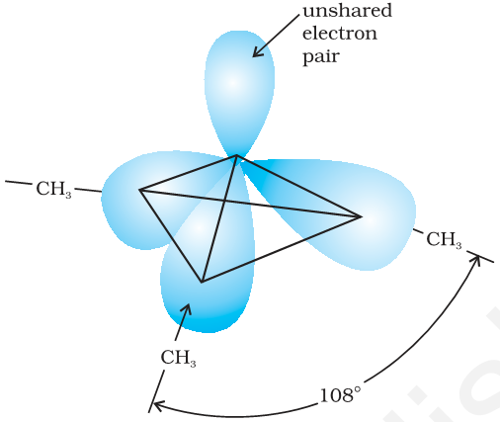
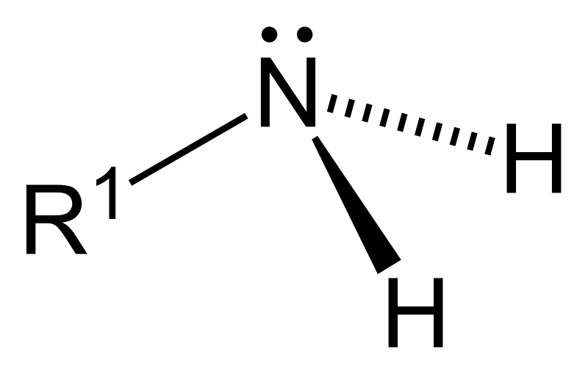
Structure of Amine group
Nitrogen atom of amines is trivalent and carries an lone pair of electrons.
Nitrogen orbitals sp3 hybridised and the geometry is pyramidal.
Due to the presence of lone pair of electrons, the angle is less than 109.5°; for example, it is 108º in case of trimethylamine a
Pyramidal Shape

Slide 4
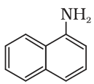
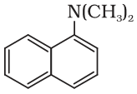
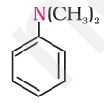
Classification of amines
Primary (1º)
Secondary (2º)
Tertiary (3º)

Slide 5
Nomenclature of amines
In IUPAC system, amines are named as alkanamines
By considering the position and no. of amino groups, position and number are given to amino group in IUPAC name. e.g.

Slide 6
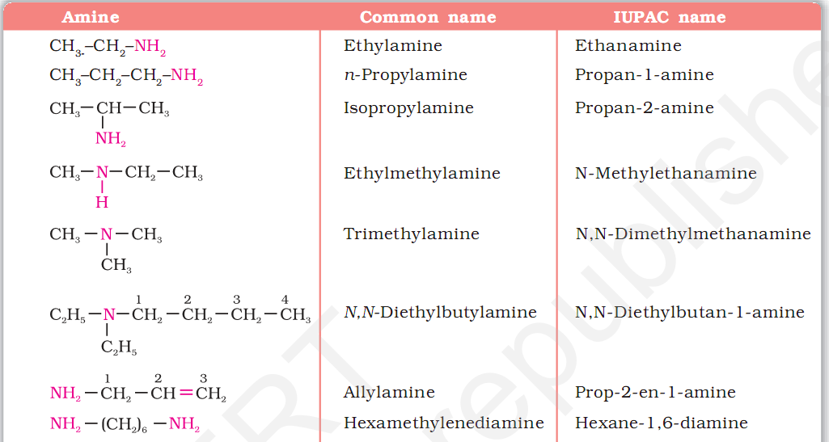
Some amines with their common and IUPAC names

Slide 7
Preparation of Amines
1. Reduction of nitro compounds
>>By passing H2 gas in the presence of finely divided nickel, palladium or platinum
>>By reduction with metals in acidic medium
Reduction of nitriles
Nitriles on reduction with lithium aluminium hydride (LiAlH4) or catalytic hydrogenation produce primary amines.

Slide 8
From amides
>>The amides on reduction with lithium aluminium hydride yield amines.
>>Hoffmann bromamide degradation reaction
Amines can be prepared by treating an amide with bromine in an aqueous or ethanolic solution of sodium hydroxide.
Ammonolysis of alkyl halides

Slide 9
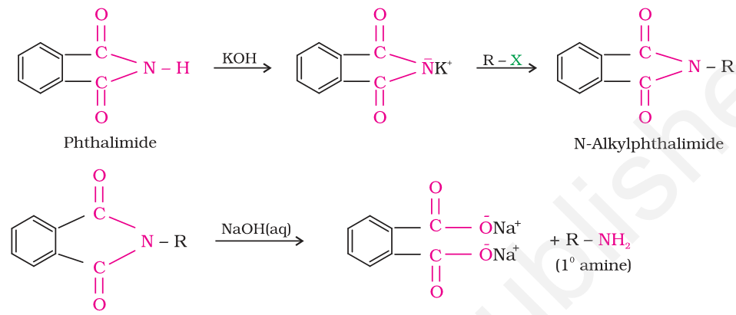
Gabriel phthalimide synthesis
Phthalimide on treatment with ethanolic potassium hydroxide forms potassium salt of phthalimide which on heating with alkyl halide followed by alkaline hydrolysis produces the corresponding primary amine.
>>>Aromatic primary amines cannot be prepared by this method because aryl halides do not undergo nucleophilic substitution with the anion formed by phthalimide.

Slide 10
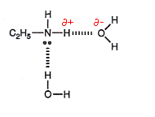
Physical Properties of Amines
Physical State
Lower aliphatic amines are gases (Methylamine and Ethylamine)
Primary amines with three or more carbon atoms are liquid
Higher amines are solid
Solubility in Water
Lower aliphatic amines are soluble in water because they can form hydrogen bonds with water molecules.
solubility decreases with increase in molar mass of amines due to increase in size of the hydrophobic alkyl part.

Slide 11
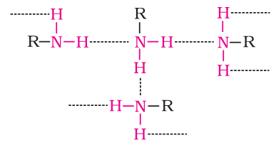
Boiling Point
Primary and secondary amines are engaged in intermolecular association due to hydrogen bonding between nitrogen of one and hydrogen of another molecule.
Therefore, the order of boiling points of isomeric amines is as
Primary > Secondary > Tertiary

Slide 12
THANKYOU

