Slide 1
ALDEHYDE
BY : VIBHA TEWARI
PGT CHEM K.V. HALDWANI

Slide 2
Session Objectives
Introduction
Nomenclature of aldehydes
Physical properties
Preparation of aldehydes
Chemical reactions
Nucleophilic reactions
Reduction
oxidation
Reactions involving α−hydrogen

Slide 3
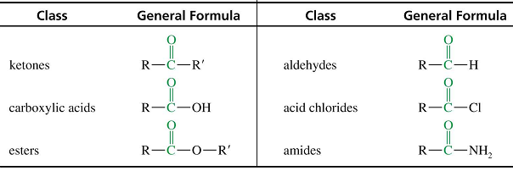
Aldehydes and ketones are characterized by the the carbonyl functional group (C=O).

Slide 4
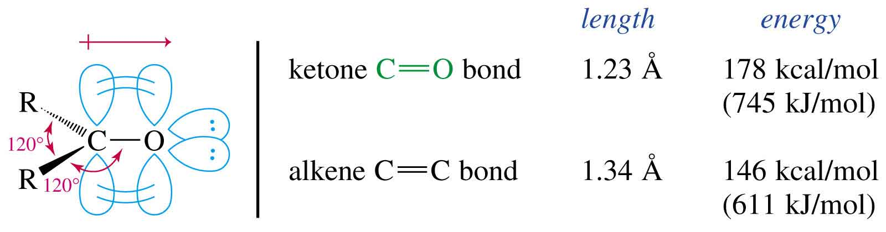
Carbonyl Structure
Carbon is sp² hybridized.
C=O bond is shorter, stronger, and more polar than C=C bond in alkenes.

Slide 5
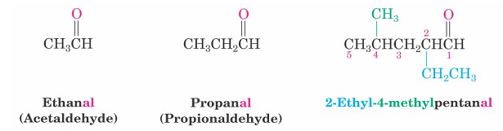
Naming Aldehydes
Aldehydes are named by replacing the terminal -e of the corresponding alkane name with –al
The parent chain must contain the ⎯CHO group
The ⎯CHO carbon is numbered possible minimum number.

Slide 6
General methods of preparation
From alcohols
by oxidation
by dehydrogenation
From acid chlorides
From nitriles
From hydrocarbons
by ozonolysis of alkenes
by hydration of alkenes
by oxidation of methylbenzenes

Slide 7
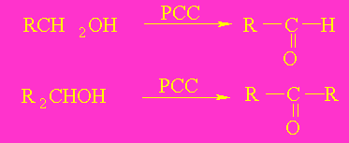
From alcohols
Oxidation
  2° alcohol + Na₂Cr₂O₇ → ketone
  1° alcohol + PCC → aldehyde

Slide 8
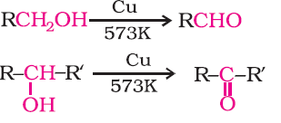
By dehydrogenation of alcohols
This method is suitable for volatile alcohols and is of industrial application
.

Slide 9

From hydrocarbons
By ozonolysis of alkenes: Ozonolysis of alkenes followed by reaction with zinc dust and water gives aldehydes.
(ii)By hydration of alkynes: Addition of water to ethyne in the presence of H2SO4 and HgSO4 gives acetaldehyde.

Slide 10
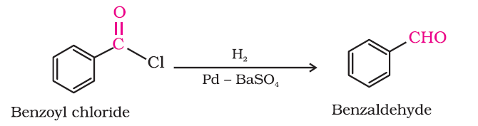
From acyl chloride (acid chloride)
Acyl chloride (acid chloride) is hydrogenated over catalyst, palladium on barium sulphate. This reaction is called Rosenmund reduction.

Slide 11

From nitriles and esters
This reaction is called Stephen reaction.

Slide 12
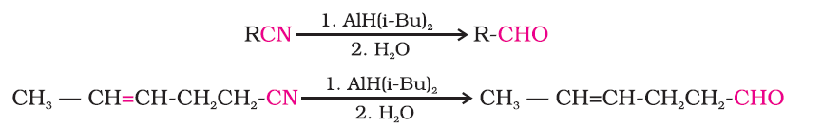
Alternatively, nitriles are selectively reduced by diisobutylaluminium hydride, (DIBAL-H) to imines followed by hydrolysis to aldehyde
.

Slide 13
From hydrocarbons
Aromatic aldehydes (benzaldehyde and its derivatives) are prepared from aromatic hydrocarbons by the following methods:
(i) By oxidation of methylbenzene
Strong oxidising agents oxidise toluene and its derivatives to acids:

Slide 14
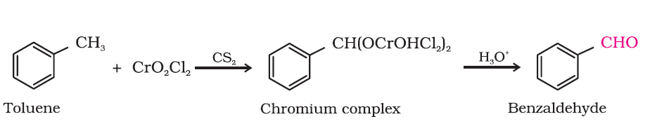
(a) Use of chromyl chloride (CrO2Cl2): Chromyl chloride oxidises methyl group to a chromium complex, which on hydrolysis gives corresponding benzaldehyde. This reaction is called Etard reaction.

Slide 15
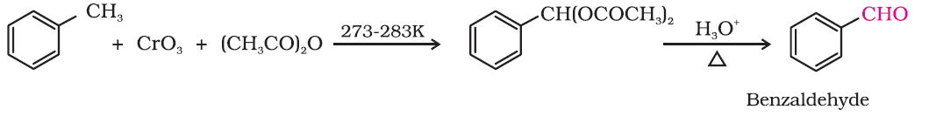
(b) Use of chromic oxide (CrO3): Toluene or substituted toluene is converted to benzylidene diacetate on treating with chromic oxide in acetic anhydride. The benzylidene diacetate can be hydrolysed to corresponding benzaldehyde with aqueous acid.

Slide 16
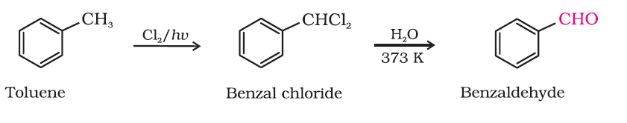
(ii) By side chain chlorination followed by hydrolysis
Side chain chlorination of toluene gives benzal chloride, which on hydrolysis gives benzaldehyde. This is a commercial method of manufacture of benzaldehyde.

Slide 17
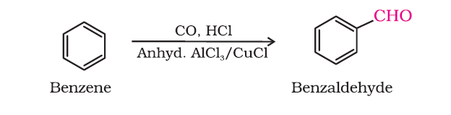
(iii) By Gatterman – Koch reaction
When benzene or its derivative is treated with carbon monoxideand hydrogen chloride in the presence of anhydrous aluminium chloride or cuprous chloride, it gives benzaldehyde or substituted benzaldehyde.

Slide 18
PHYSICAL PROPERTIES
Physical State - Methanal is a gas at room temperature. Ethanal is a volatile liquid. Other aldehydes and ketones are liquid or solid at room temperature.
Boiling Point –The boiling points of aldehydes and ketones are higher than hydrocarbons and ethers of comparable molecular masses. It is due to weak molecular association in aldehydes and ketones arising out of the dipole-dipole interactions. Also, their boiling points are lower than those of alcohols of similar molecular masses due to absence of intermolecular hydrogen bonding

Slide 19
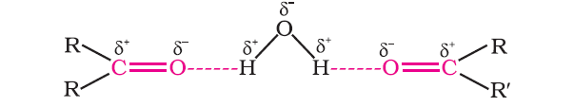
Solubility
The lower members of aldehydes and ketones such as methanal, ethanal and propanone are miscible with water in all proportions, because they form hydrogen bond with water.

Slide 20
CHEMICAL PROPERTIES
Since aldehydes and ketones both possess the carbonyl functional group, they give following reaction:
Nucleophilic Addition Reaction
Nucleophilic Addition Reaction followed by removal of water molecule
Oxidation
Reduction
Miscellaneus

Slide 21
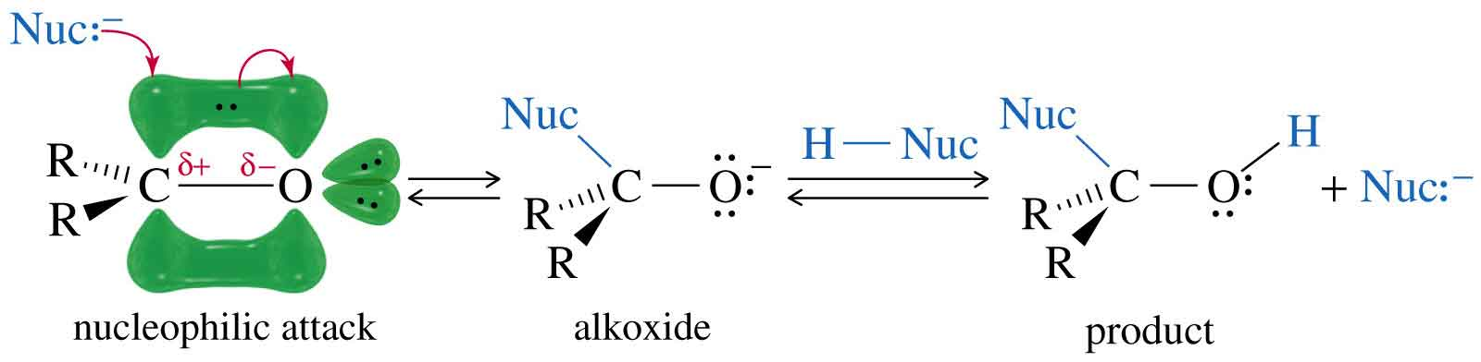
Nucleophilic Addition
A strong nucleophile attacks the carbonyl carbon, forming an alkoxide ion that is then protonated.
A weak nucleophile will attack a carbonyl if it has been protonated, thus increasing its reactivity.
Aldehydes are more reactive than ketones.

Slide 22
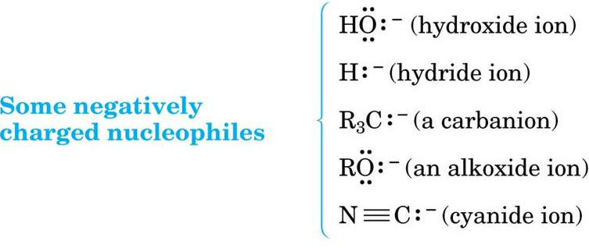
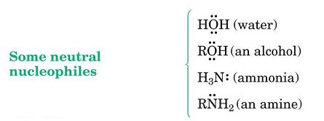
Nucleophiles
Nucleophiles can be negatively charged
( : Nu⁻) or neutral ( : Nu) at the reaction site
The overall charge on the nucleophilic species
is not considered

Slide 23
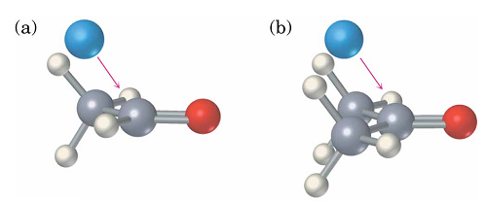
Relative Reactivity of Aldehydes and Ketones
Aldehydes are generally more reactive than ketones in nucleophilic addition reactions.
The transition state for addition is less crowded and lower in energy for an aldehyde (a) than for a ketone (b).
Aldehydes have one large substituent bonded to the C=O: ketones have two.

Slide 24
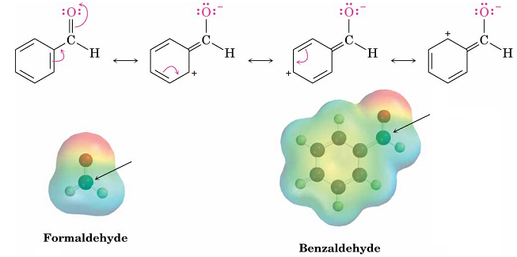
Reactivity of Aromatic Aldehydes
Less reactive in nucleophilic addition reactions than aliphatic aldehydes
Electron-donating resonance effect of aromatic ring makes C=O less reactive electrophilic than the carbonyl group of an aliphatic aldehyde

Slide 25
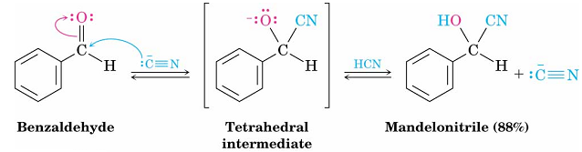
Addition of HCN
Addition of HCN is reversible and base-catalyzed, generating nucleophilic cyanide ion, CN
Addition of CN⁻ to C=O yields a tetrahedral intermediate, which is then protonated
Equilibrium favors adduct
Reactivity formaldehyde > aldehydes > ketones >> bulky ketones.

Slide 26
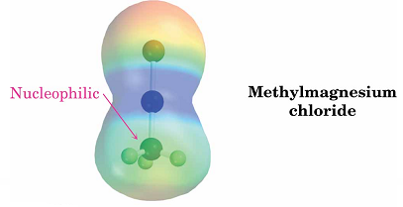
Nucleophilic Addition of Grignard Reagents
Treatment of aldehydes or ketones with Grignard reagents yields an alcohol.
Nucleophilic addition of the equivalent of a carbon anion, or carbanion. A carbon–magnesium bond is strongly polarized, so a Grignard reagent reacts for all practical purposes as R : ⁻ MgX ⁺.

Slide 27
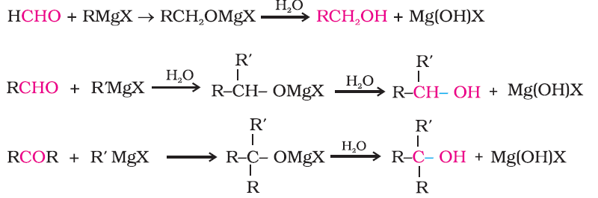
The reaction of Grignard reagents with methanal produces a primary alcohol, with other aldehydes, secondary alcohols and with ketone tertiary alcohols

Slide 28
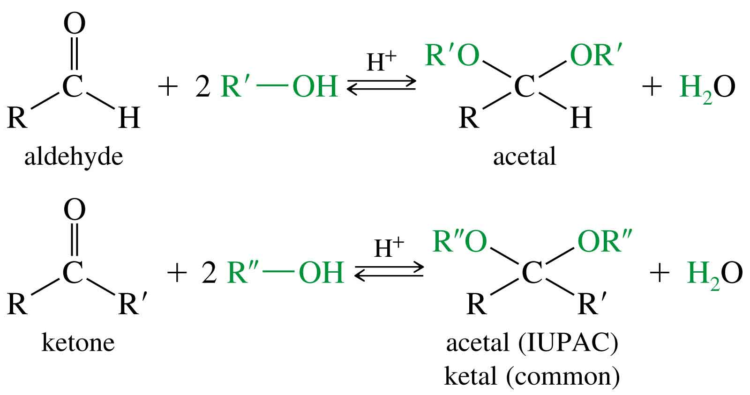
Addition of Alcohol
In presence of dry HCl aldehydes and ketones react with two equivalent of alcohols to form acetals and ketals

Slide 29
Addition of ammonia and its derivatives
Nucleophilic addition of ammonia or primary amine, followed by elimination of water molecule.
C=O becomes C=N-R

Slide 30
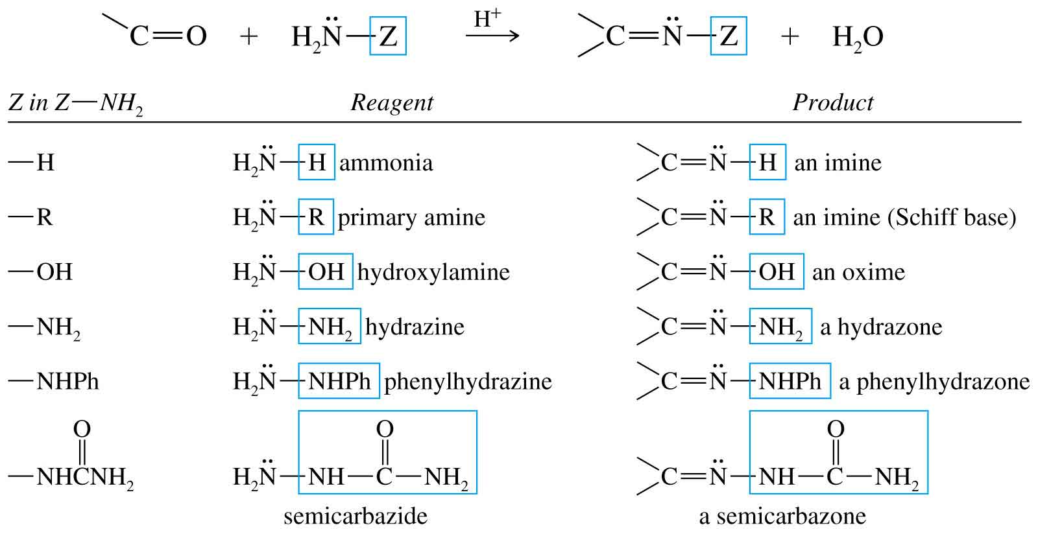
=>

Slide 31

Oxidation
Aldehydes are easily oxidised to carboxylic acids on treatment with common oxidising agents like nitric acid, potassium permanganate, potassium
dichromate, etc. Even mild oxidising agents, mainly Tollens’ reagent and Fehlings’ reagent also oxidise aldehydes.

Slide 32

Ketones Oxidize with Difficulty
Undergo slow cleavage with hot, alkaline KMnO₄
C–C bond next to C=O is broken to give carboxylic acids.
Cleavage at C-C bond gives mixture of acids.

Slide 33
Tollens Test
Add ammonia solution to AgNO₃ solution until precipitate dissolves. Ammonical silver nitrate solution [Ag(NH3)2]OH is called Tollens reagent.
Aldehyde react with Tollens reagent forms a silver mirror.

Slide 34
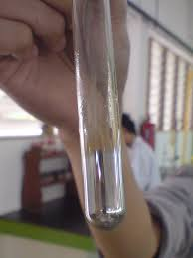
Silver Mirror

Slide 35
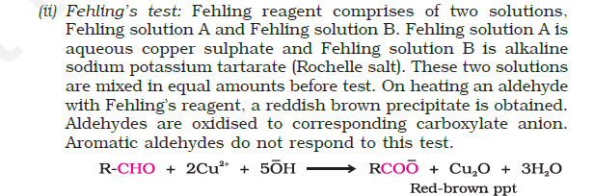
Fehling’s test

Slide 36
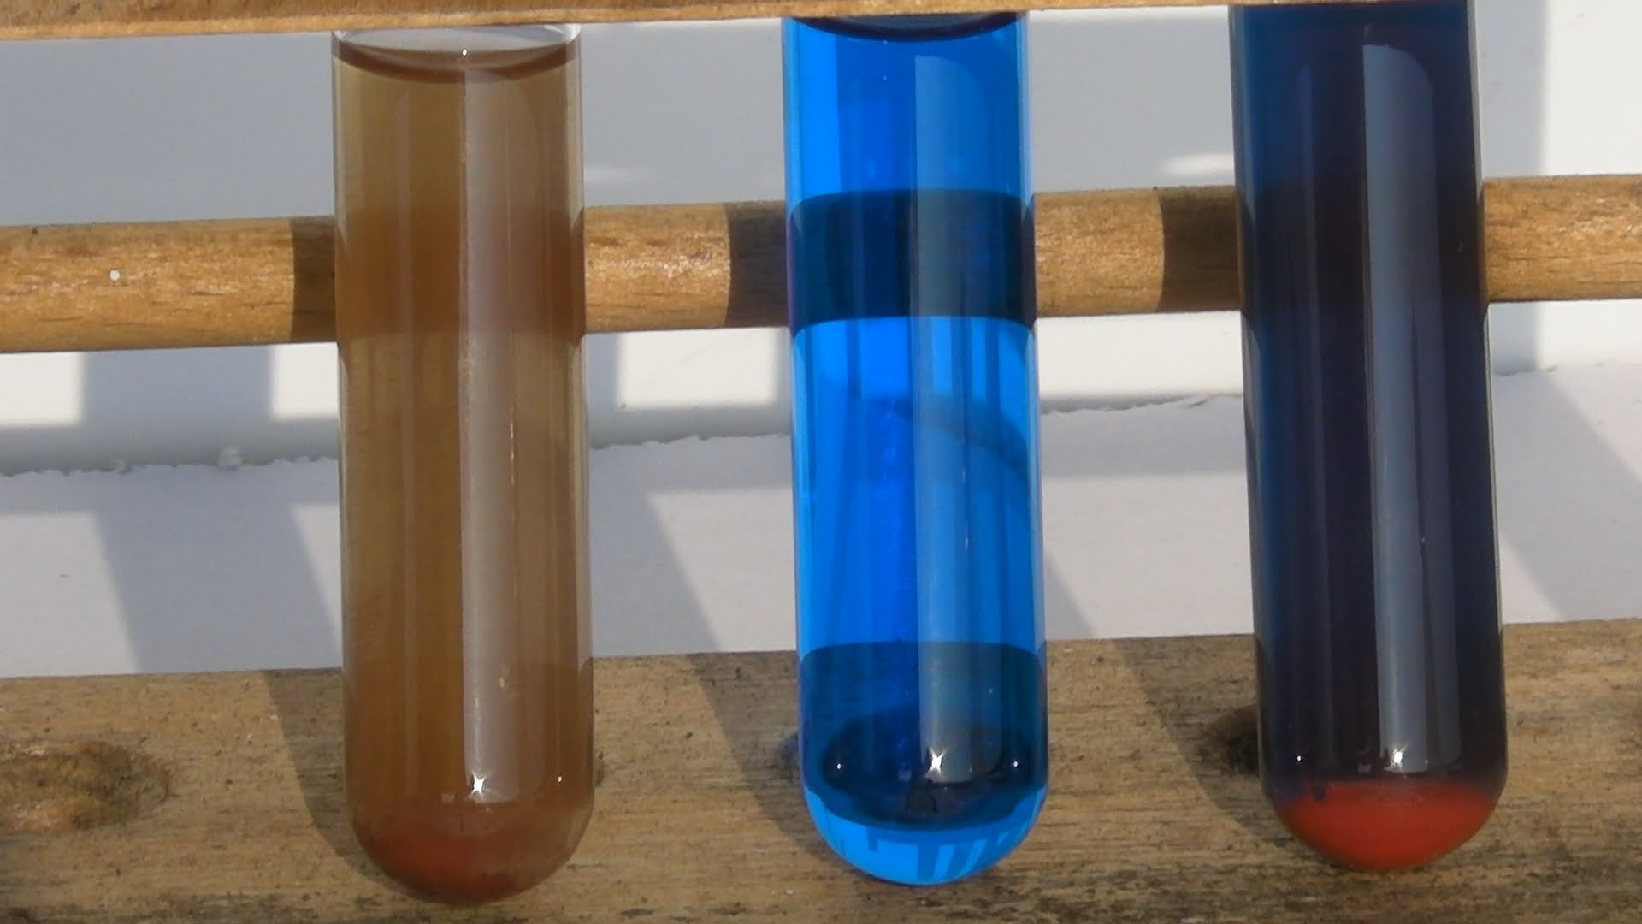

Slide 37
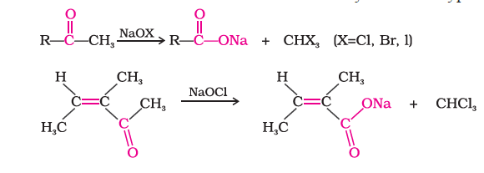
iii.haloform(iodoform)

Slide 38
Reduction Reagents
Sodium borohydride, NaBH₄, reduces C=O, but not C=C.
Lithium aluminum hydride, LiAlH₄, much stronger, difficult to handle.
Hydrogen gas with catalyst also reduces the C=C bond.

Slide 39
Clemmensen Reduction

Slide 40
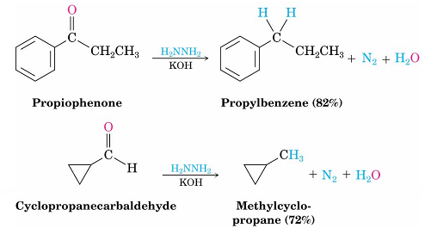
The Wolff–Kishner Reaction
Treatment of an aldehyde or ketone with hydrazine, H₂NNH₂ and KOH converts the compound to an alkane
Originally carried out at high temperatures but with dimethyl sulfoxide as solvent takes place near room temperature

Slide 41
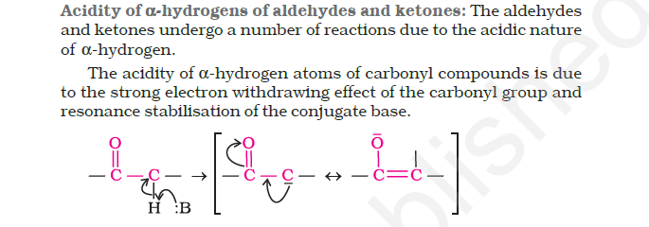
Alpha hydrogen-acidity

Slide 42
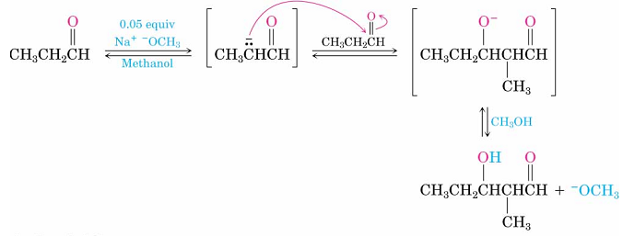
Aldol condensation
A small amount of base is used to generate a small amount of enolate in the presence of unreacted carbonyl compound. After the condensation, the basic catalyst is regenerated.

Slide 43
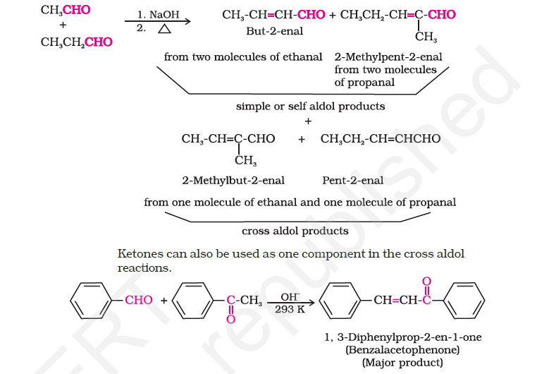
Cross –aldol condensation

Slide 44
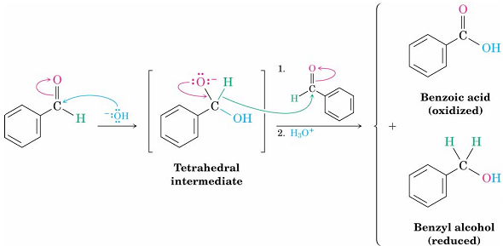
The Cannizzaro Reaction
The adduct of an aldehyde and OH⁻ can transfer hydride ion to another aldehyde C=O resulting in a simultaneous oxidation and reduction (disproportionation)

Slide 45
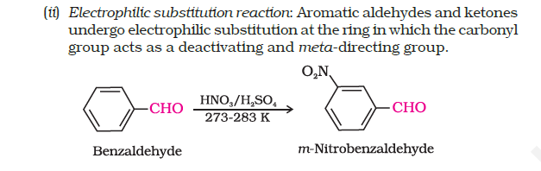
3.Electrophilic substitution

Slide 46
Thank you

