Slide 1
HALOARENES
BANDANA
PGT CHEMISTRY
K V NO. 2 NHPC BANBASA

Slide 2
HALOARENES

Slide 3
Classification
On the Basis of Number of Halogen Atoms haloarenes may be classified as follows:

Slide 4
Nomenclature
Haloarenes are the common as well as IUPAC names of aryl halides. For dihalogen derivatives, the prefixes o-, m-, p- are used in common system but in IUPAC system, the numerals 1,2; 1,3 and 1,4 are used.

Slide 5
Methods of Preparation
By Electrophilic Substitution
Aryl chlorides and bromides can be easily prepared by electrophilic substitution of arenes with chlorine and bromine respectively in the presence of Lewis acid catalysts like iron or iron(III) chloride
Reactions with iodine are reversible in nature and require the presence of an oxidising agent (HNO3, HIO4) to oxidise the HI formed during iodination. Fluoro compounds are not prepared by this method due to high reactivity of fluorine

Slide 6
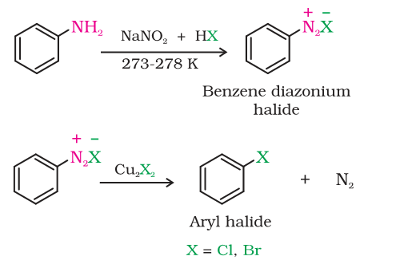
Sandmeyer’s Reaction

Slide 7
Balz Schiemann Reaction
Gatterman Reaction

Slide 8
Physical Properties
Aryl halides are colourless liquids or solids with characteristic odour.
Boiling point generally increase with increase in the size of aryl gp. Or halogen atom.
Due to resonance C-X bond is shorter and hence dipole moment is less. Boiling points of isomeric dihalobenzenes are very nearly the same.
However, the para-isomers are high melting as compared to their ortho-and meta-isomers. It is due to symmetry of para-isomers that fits in crystal lattice better as compared to ortho- and meta-isomers.

Slide 9
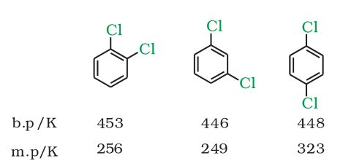
Physical Properties
They are heavier than water.
The density increases with increase in number of carbon atoms, halogen atoms and atomic mass of the halogen atoms

Slide 10
Nature of C-X Bond
Since halogen atoms are more electronegative than carbon, the carbon-halogen bond of alkyl halide is polarised; the carbon atom bears a partial positive charge whereas the halogen atom bears a partial negative charge.

Slide 11
1- Chemical Reactions
Nucleophilic Substitution
Aryl halides are extremely less reactive towards nucleophilic substitution reactions due to the following reasons:
(i)RESONANCE EFFECT :
C—Cl bond acquires a partial double bond character due to resonance. As a result, the bond cleavage in haloarene is difficult.

Slide 12
(ii)Difference in hybridisation of carbon atom in C—X bond:
The sp2 hybridised carbon with a greater s-character is more electronegative and can hold the electron pair of C—X bond more tightly than sp3-hybridised carbon in haloalkane with less s-chararcter. Thus, C—Cl bond length in haloalkane is 177pm while in haloarene is 169 pm

Slide 13
(iii) Instability of phenyl cation: In case of haloarenes, the phenyl cation formed as a result of self-ionisation will not be stabilised by resonance and therefore, SN1 mechanism is ruled out.
(iv) Because of the possible repulsion, it is less likely for the electron rich nucleophile to approach electron rich arenes.

Slide 14
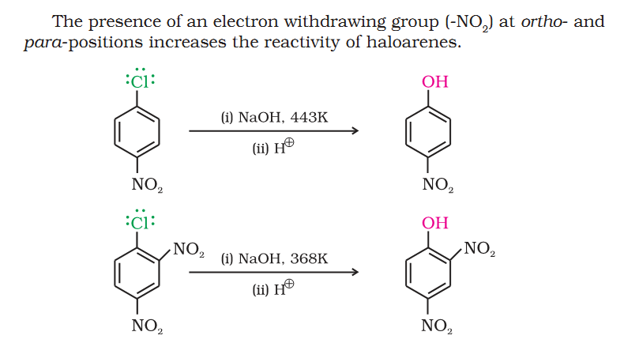
Replacement by hydroxyl group (Dow’s process)

Slide 16
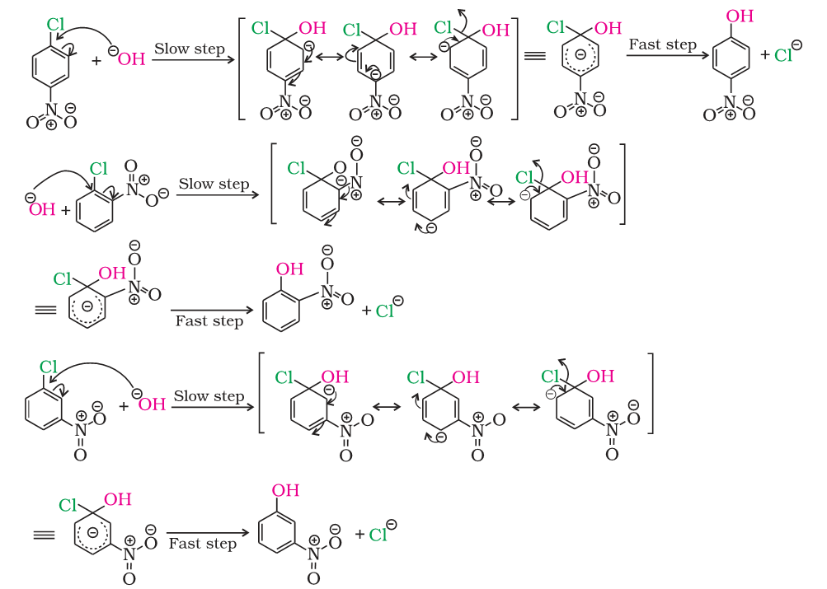

Slide 17
2. Electrophilic Substitution Reactions
Halogen atom besides being slightly deactivating is o, p-directing; therefore, further substitution occurs at ortho- and para-positions with respect to the halogen atom.
Due to resonance, the electron density increases more at ortho- and para-positions than at meta-positions. Further, the halogen atom because of its –I effect has some tendency to withdraw electrons from the benzene ring. As a result, the ring gets somewhat deactivated as compared to benzene and hence the electrophilic substitution reactions in haloarenes occur slowly and require more drastic conditions as compared to those in benzene.

Slide 18
(i) Halogenation

Slide 19
(ii) Nitration

Slide 20
(iii) Sulphonation

Slide 21
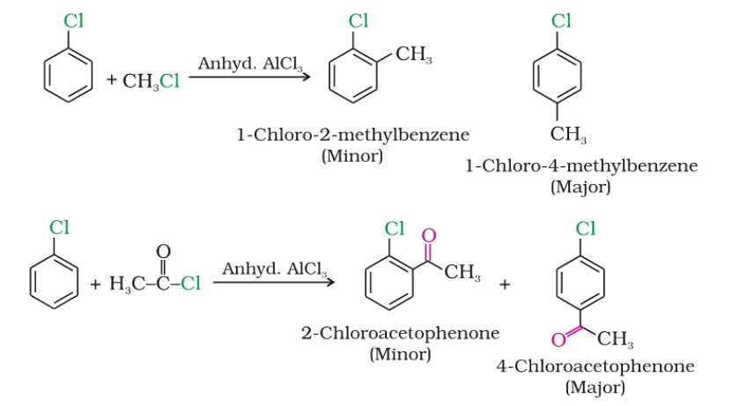
(iv) Friedel-Crafts Reaction

Slide 22
3- Reaction with Metals: Wurtz-Fittig reaction
Fittig reaction

Slide 23
Thanks.

