Slide 1
ALKYL HALIDES OR HALOALKANES
DHEERAJ GUPTA

Slide 2
ALKYL HALIDES OR HALOALKANES
An organic compound containing at least one carbon-halogen bond (C-X)
X (F, Cl, Br, I) replaces H
Alkyl halides are organic molecules containing a halogen atom bonded to an sp³ hybridized carbon atom.
Can contain many C-X bonds
Properties and some uses
Fire-resistant solvents
Refrigerants
Pharmaceuticals and precursors

Slide 3
Nomenclature Alkyl Halides
Select the longest chain of carbon that contains the halogen atom.
Give least possible number to the halogen atom.
The carbon containing double or triple bond is given the least number.
Place the suitable suffix like di, tri, tetra for 2, 3, 4 halogen atoms respectively.
Name the compounds as halo alkanes, halo alkenes or halo alkynes.
For example,

Slide 4
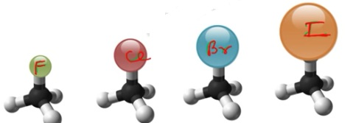
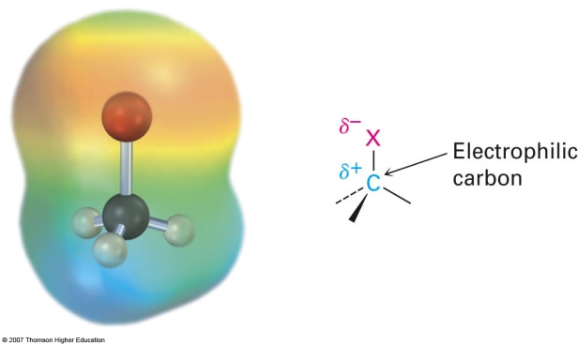
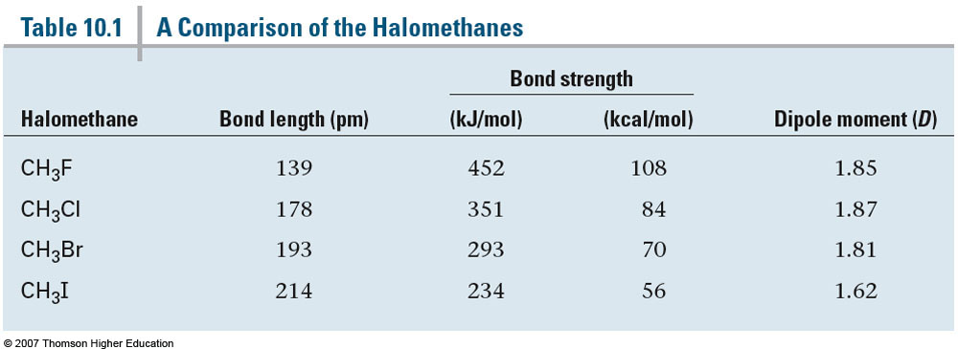
Structure of Alkyl Halides
C-X bond is longer as you go down periodic table
C-X bond is weaker as you go down periodic table
C-X bond is polarized with partial positive charge on carbon and partial negative charge on halogen

Slide 5
CLASSIFICATION OF ALKYL HALIDES
Alkyl halides are classified as primary (1°), secondary (2°), or tertiary (3°), depending on the number of carbons bonded to the carbon with the halogen atom.
The halogen atom in halides is often denoted by the symbol “X”.

Slide 6
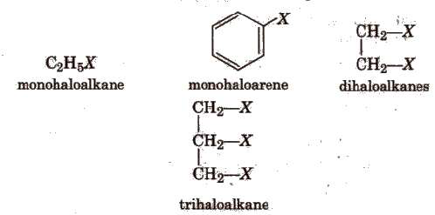
On the basis of number of halogen atoms present, halogen derivatives are classified as mono,
di, tri, tetra, etc., halogen derivatives, e.g.,

Slide 7
Vinyl halides have a halogen atom (X) bonded to a C—C double bond.
Aryl halides have a halogen atom bonded to a benzene ring.
Allylic halides have X bonded to the carbon atom adjacent to a C—C double bond.
Benzylic halides have X bonded to the carbon atom adjacent to a benzene ring.

Slide 8
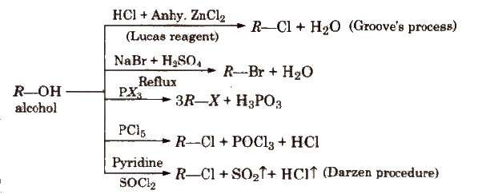
General Methods of Preparation of Haloalkanes
1. From Alcohols
In Groove’s method, ZnC1₂ is used to weaken the C-OH bond. In case of 3° alcohols, ZnC1₂ is not required.
The reactivity order of halogen acids is HI > HBr > HCl.
Darzen procedure is the best method for preparing alkyl halides from alcohols since both the byproducts (SO₂ and HCl) are gaseous and escape easily.

Slide 9
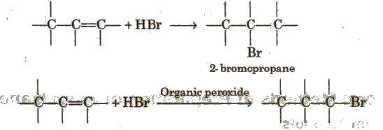
2. Free Radical Halogenation of Alkanes
3. Addition of Hydrogen Halides on Alkenes

Slide 10
4. Finkelstein Reaction
5.Swarts Reaction
H₃C – Br + AgF → H₃C – F + AgBr
Hg₂F₂, COF₂ and SbF₃ can also be used as a reagent for Swarts reaction.
6. Hunsdiecker Reaction

Slide 11
Physical Properties of Haloalkanes
1. Boiling point orders
i) R – I > R – Br > R – CI > R – F
ii) CH₃ – (CH₂)₂ – CH₂Br > (CH₃)₂ CHCH₂Br > (CH3)₃CBr
iii) CH₃CH₂CH₂X > CH₃CH₂X > CH₃X
2. Bond strength of haloalkanes decreases as the size of the halogen atom increases. Thus, the order of bond strength is
CH₃F > CH₃Cl > CH₃Br > CH₃I
3. Dipole moment decreases as the electronegativity of the halogen decreases.
4. Haloalkanes, though polar, but are insoluble in water as they do not form hydrogen bonding with water.
5. Density order is
RI > RBr > RCl > RF (For the same alkyl group)
CH₃I > C₂H₅I > C₃H₇I

Slide 12
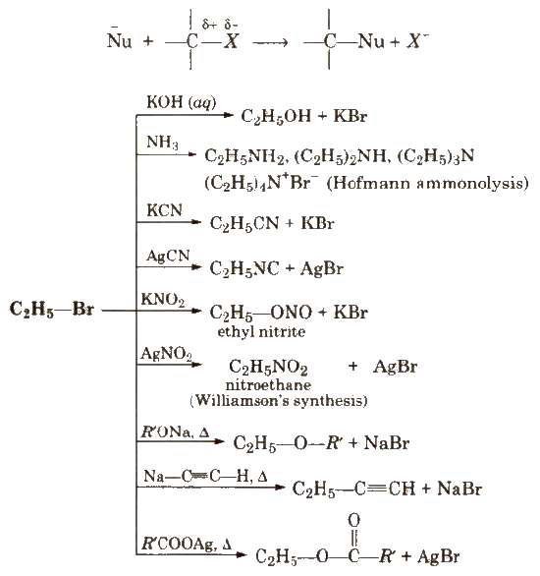
Chemical Reactions of Haloalkanes
Relative reactivity of alkyl halides for same alkyl group is
RI > RBr > RCI > RF
1. Nucleophilic Substitution Reactions (S_{N} reactions)

Slide 13
KCN is predominantly ionic and provides cyanide ions in solution, which is ambident nucleophile and bind with carbon side to form as the major product, while AgCN is covalent and form isocyanide as the major product.
Like KCN, KNO₂ form R-ONO while AgNO₂ produces R-NO₂ as product.
Vinyl chloride is less reactive towards nucleophilic substitution reactions due to resonance.

Slide 14
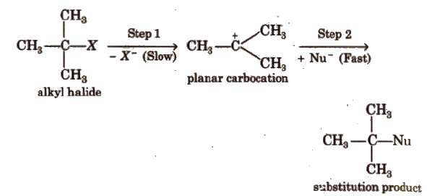
Nucleophilic substitution reactions are of two types
S_{N}1 type :-
Unimolecular nucleophilic substitution reactions proceed in two steps
Rate, r = k [RX]. It is a first order reaction.
Reactivity order of alkyl halide towards S_{N}1 mechanism 3° > 2° > 1°
Polar solvents, low concentration of nucleophiles and weak nucleophiles favour S_{N}1 mechanism

Slide 15
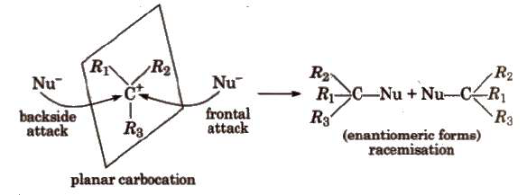
In S_{N}1 reactions, partial racemisation occurs due to the possibility of frontal as well as backside attack on planar carbocation.

Slide 17
(b) S_{N}2 type:-(Bimolecular nucleophilic substitution) These reactions proceed in one step and is a second order reaction with r = k[RX] [Nu].
During S_{N}2 reaction, inversion of configuration occurs (Walden inversion) i.e., starting with dextrorotatory halide a laevo product is obtained and vice-versa,
Reactivity of halides towards S_{N}2 mechanism is 1° > 2° > 3°
Rate of reaction in S_{N}2 mechanism depends on the strength of the attacking nucleophile.
Strength of some common nucleophiles is
:CN⁻ > : I⁻ > : OR⁻ > : OH⁻ > CH₃COO: ⁻ > H₂O > F⁻
Non-polar solvents, strong nucleophiles and high concentration of nucleophiles favour S_{N}2 mechanism

Slide 19
Relative rates of some alkyl halides in S_{N}1 and S_{N}2 reactions are in the order

Slide 20
2. Elimination Reactions
Dehydrohalogenation is a β – elimination reaction in which halogen is from α-carbon atom and the hydrogen from the α-carbon according to Saytzeff rule, e.g.,
Ease of dehydrohalogenation among halides
3° > 2° > 1°

Slide 21
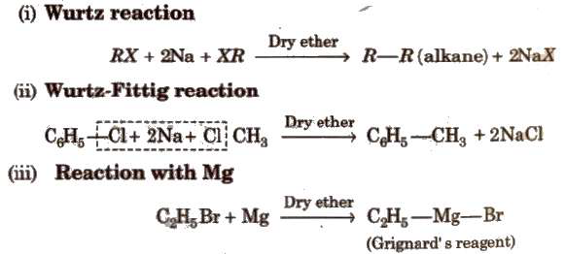
3. Reduction
4. Reaction with Metals
Grignard reagent is never isolated in the solid state as it explodes in dry state. So it is used as ethereal solution.

Slide 22
5. lsomerisation

Slide 23
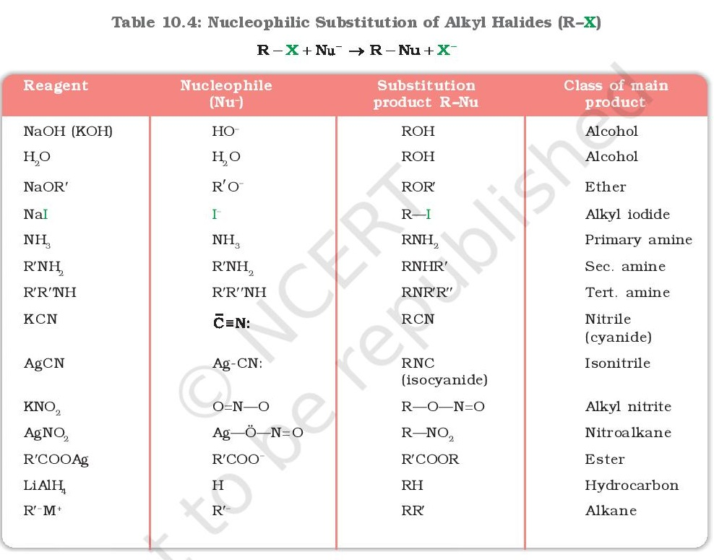

Slide 24
Distinction between haloalkanes and haloarene
Haloalkane and haloarenes can be distinguished by silver nitrate (AgNO₃). Haloalkanes react with AgNO₃ to give white precipitate of AgCl while haloarene do not react.
RCl + NaOH → NaCl + ROH
NaCl + AgNO₃ →AgCl + NaNO₃

