Slide 1

WELCOME TO
The Elements: The d-Block AND f-Block

Slide 2
Objectives
After studying this Unit, the students will be able to
• learn the positions of the d– and f-block elements in the periodic table;
• know the electronic configurations of the transition (d-block) and the inner transition (f-block) elements;
• appreciate the relative stability of various oxidation states in terms of electrode potential values;
• describe the preparation, properties, structures and uses of some important compounds such as K₂Cr₂O₇ and KMnO₄;
• understand the general characteristics of the d– and f–block elements and the general horizontal and group trends in them;
• describe the properties of the f-block elements and give a comparative account of the lanthanoids and actinoids with respect to their electronic configurations, oxidation states and chemical behaviour.

Slide 3
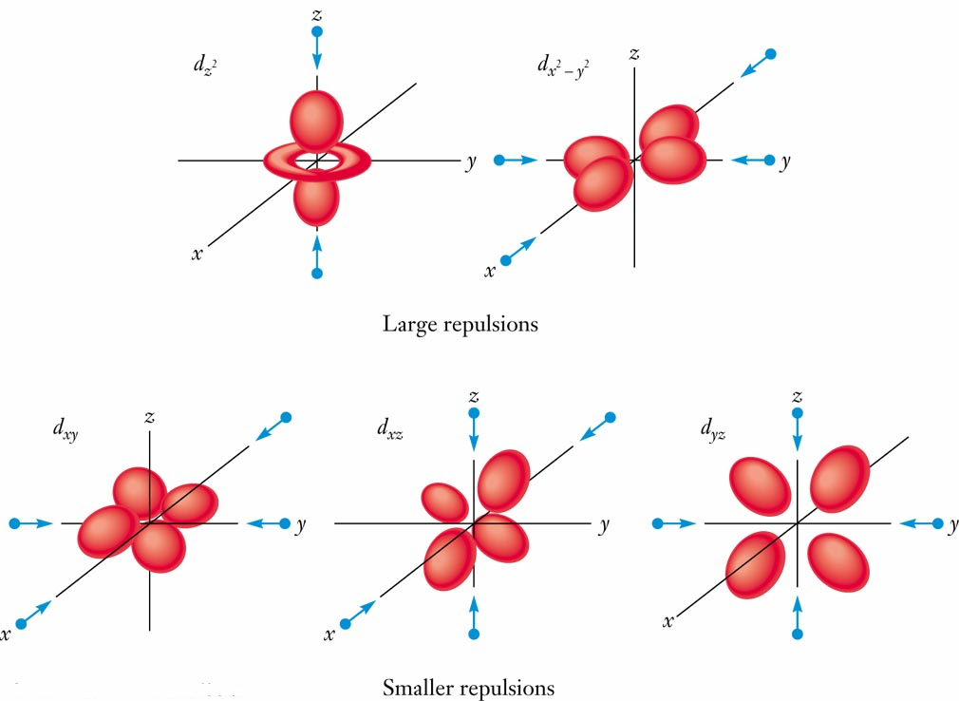
The d-Block Elements and Their Compounds
Shape of d Orbital
The shape of the d orbitals affect the properties of transition metals.
The dorbital lobes are far apart and so only weakly repel each other.
The d orbitals have low electron density near the nucleus therefore are not very effective at shielding.

Slide 4
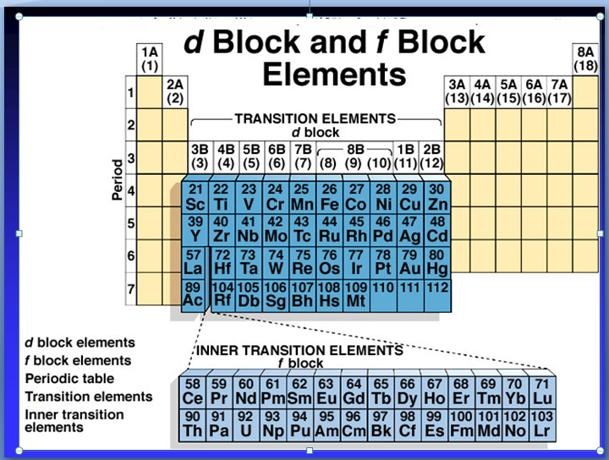
Similarities within a given period and within a given group.
Last electrons added are inner electrons (d’s, f’s).

Slide 7
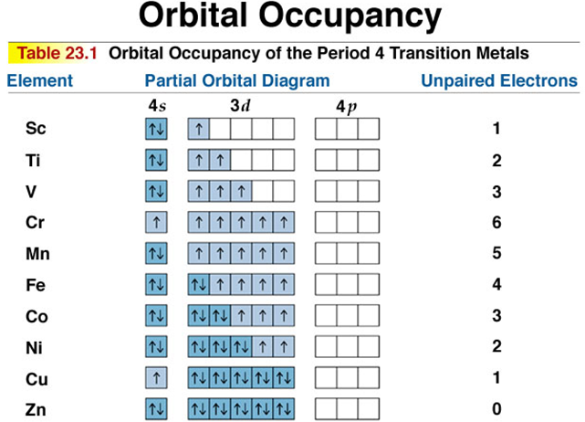

Slide 8
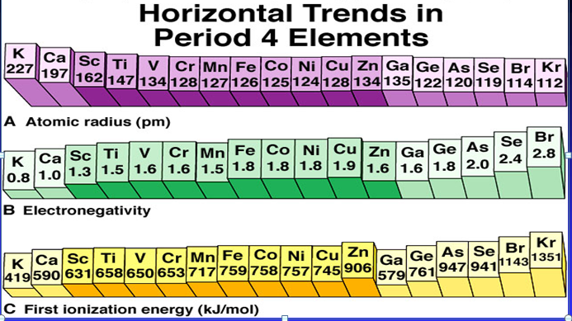

Slide 9
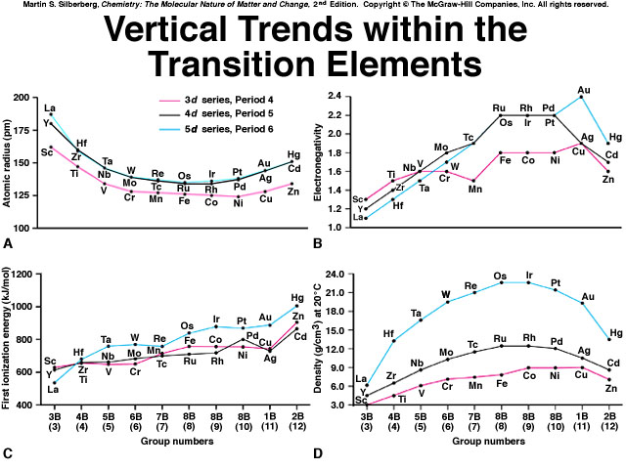

Slide 11
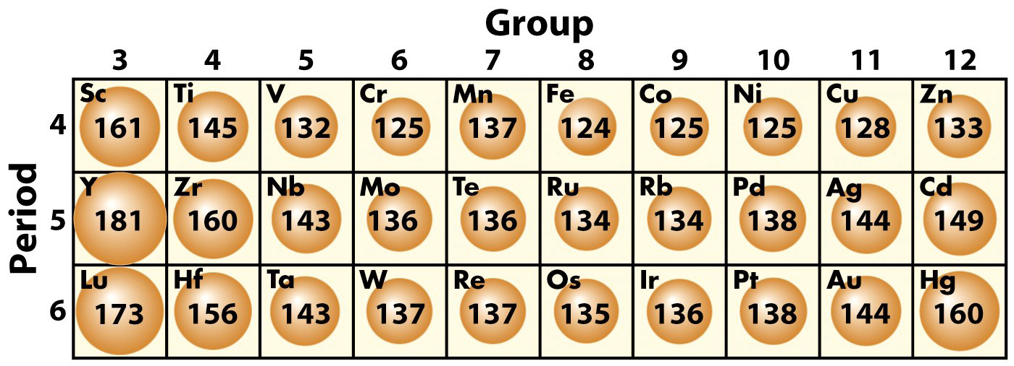
The d-Block Elements and Their Compounds
Trends in Atomic Radii
The shape of the d orbitals affect the properties of transition metals. The d orbital lobes
are far apart and thus only weakly repel each other. The d orbitals have low electron
density near the nucleus therefore are not very effective at shielding.

Slide 12
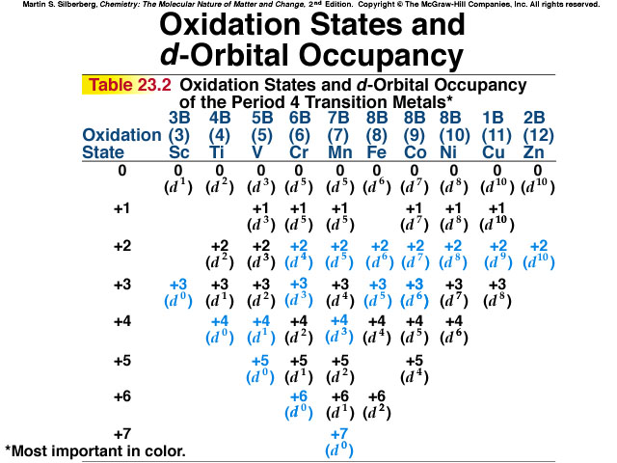
Multiple Oxidation States

Slide 13
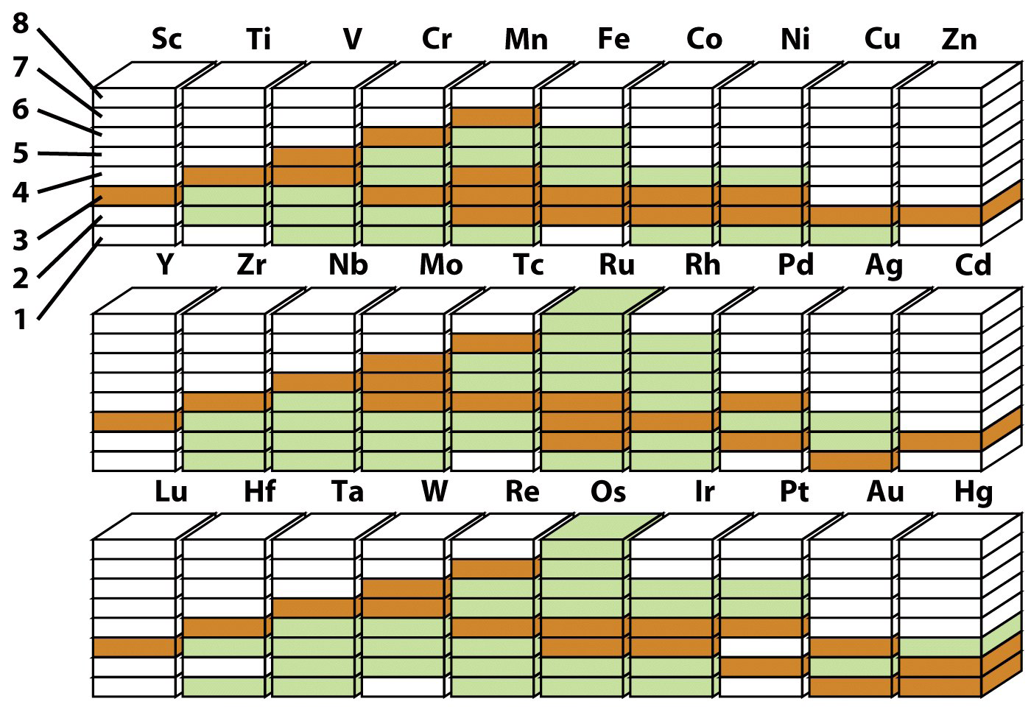
The d-Block Elements and Their Compounds Oxidation States
Orange boxes
are common
oxidation
numbers.
Green boxes
are other
know states.
Most d-block metals have more that one oxidation state other than 0. Elements close to
the center of the row have the widest rage of oxidation numbers.

Slide 14
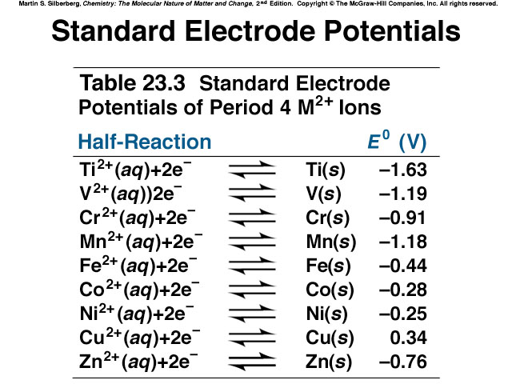
Metallic Behavior/Reducing Strength
Lower oxidation state = more metallic

Slide 15
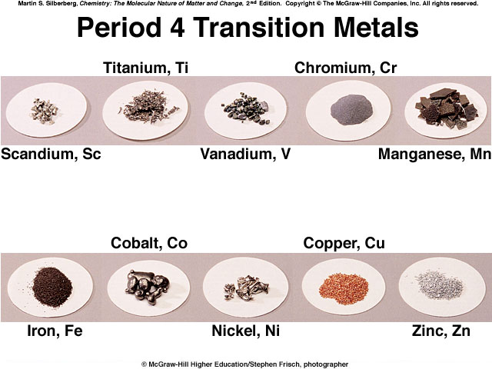
Color and Magnetism

Slide 16
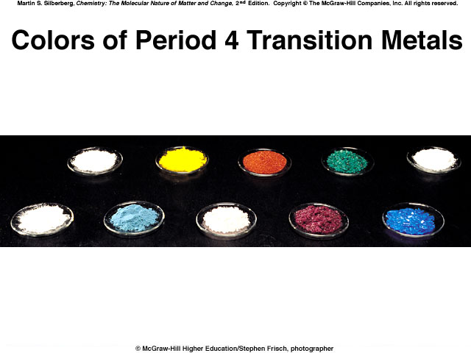
e⁻ in partially filled d sublevel absorbs visible light moves to slightly higher energy d orbital

Slide 17
Magnetic properties due to unpaired electrons

Slide 18
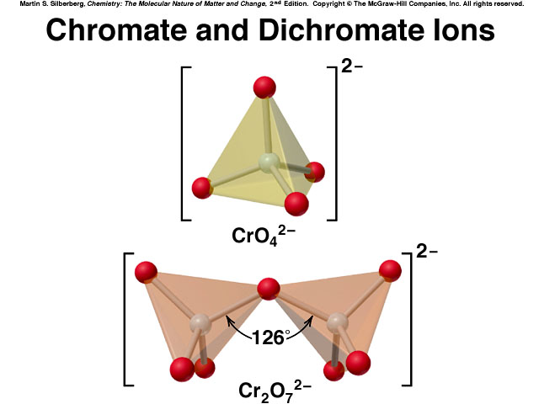
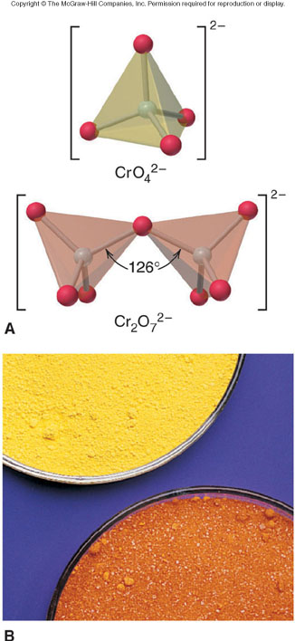
Chromium
Chemical properties reflect oxidation state

Slide 19
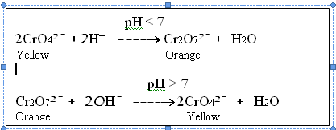
Potassium dichromate(K₂Cr₂O₇
The oxidation number of chromium in chromate (CrO₄²ˉ) and dichromate (Cr₂O₇²ˉ) in the
same +6.they are interconnverteble in aqueous solution depending upon pH of the solution.
Acid
2CrO₄²⁻ + 2H⁺ ⇔ Cr₂O₇²⁻ + H₂O
Yellow Alkali Orange

Slide 20
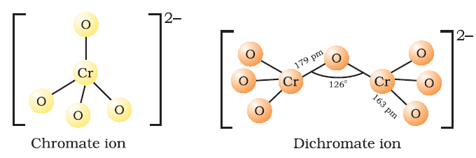
Preparation of K₂Cr₂O₇: (From chromites ore,Fe₂Cr₂O₄ )
(i) 4Fe₂Cr₂O₄ + 8Na₂CO₃ + 7O₂ → 8Na₂CrO₄ + 2Fe₂O₃ + 8CO₂
(ii) 2Na₂Cr₂O₄ + H₂SO₄ → Na₂Cr₂O₇ + Na₂SO₄ + H₂O
(iii) Na₂Cr₂O₇ + 2KCl → K₂Cr₂O₇ + 2NaCl
Structure of CrO₄²⁻ and Cr₂O₇²⁻ions:-
(Tetrahedral yellow ) (Two tetrahedral sharing one corner
With Cr-O-Cr bond angle 126º, Orange)

Slide 21
Oxidizing action: i.Ferrous salts into ferric salts
Cr₂O₇²ˉ + 14H⁺ + 6Fe²⁺ → 2Cr³⁺ + 6Fe³⁺ + 7H₂O ii.Iˉ (iodide) to I₂(iodine)
Cr₂O₇²ˉ + 6Iˉ + 14H⁺ → 2Cr³⁺ + 3I₂ + 7H₂O
(iii)H₂S to S
Cr₂O₇²⁻ +8H ⁺+H₂S → 2Cr³⁺+3S+7H₂O
Potassium permanganate (KMnO₄) Preparation of KMnO₄.
(i) MnO₂+4KOH+O₂ →2K₂MnO₄+2H₂O
(ii) 3MnO₄²⁻ +4H⁺ →2MnO₄⁻+2H₂O

Slide 22
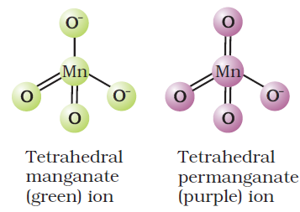
Structure of manganate ion (MnO₄²⁻) & permanganate ion (MnO₄⁻)

Slide 23
^{Oxidising action}
In acid solutions:
(a) Iodine is liberated from potassium iodide :
10I– + 2MnO₄ ⁻+ 16H⁺ →2Mn²⁺ + 8H₂O + 5I₂
(b) Fe²⁺ ion (green) is converted to Fe3+ (yellow):
5Fe²⁺ + MnO₄– + 8H⁺ →Mn²⁺ + 4H₂O + 5Fe³⁺
(c) Oxalate ion or oxalic acid is oxidised at 333 K:
5C₂O₄^{2–} + 2MnO₄– + 16H⁺ → 2Mn²⁺ + 8H₂O + 10CO₂
(d) Hydrogen sulphide is oxidised, sulphur being precipitated:
5S^{2–} + 2MnO₄ ⁻⁻ + 16H⁺ 2Mn² →⁺ + 8H₂O + 5S
(e) Sulphurous acid or sulphite is oxidised to a sulphate or sulphuric acid:
5SO₃^{2–} + 2MnO₄– + 6H⁺ →2Mn²⁺ + 3H₂O + 5SO₄ ²⁻
(f) Nitrite is oxidised to nitrate:
5NO^{2–} + 2MnO^{4–} + 6H⁺ →2Mn²⁺ + 5NO^{3–} + 3H₂O
2. In neutral or faintly alkaline solutions:
(a) A notable reaction is the oxidation of iodide to iodate:
2MnO₄– + H₂O + I– → 2MnO₂ + 2OH– + IO₃⁻
(b) Thiosulphate is oxidized almost quantitatively to sulphate:
8MnO₄– + 3S₂O₃^{2–} + H₂O →8MnO₂ + 6SO₄^{2–} + 2OH–
(c) Manganous salt is oxidized to MnO₂; the presence of zinc sulphate or zinc oxide catalyses the oxidation:
2MnO₄– + 3Mn²⁺ + 2H₂O → 5MnO₂ + 4H⁺

Slide 24
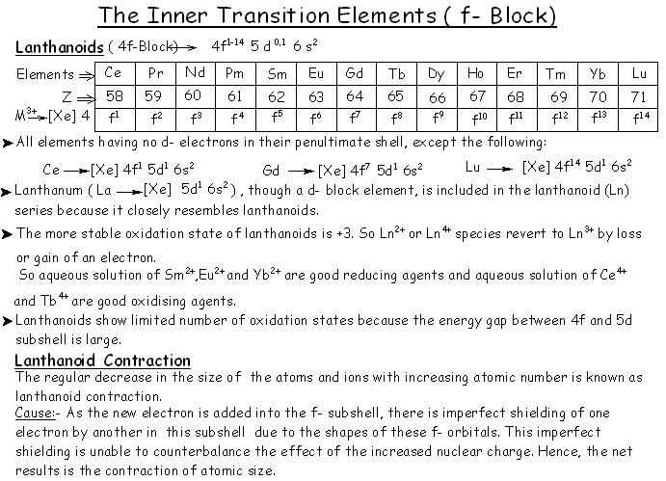

Slide 25
Lanthanides Contraction: The steady decrease in atomic radii of
lanthanides with increase in atomic number is called lanthanide
contraction.
Consequences:-
Similar in the atomic sizes of the elements of second and
lanthanoid contraction 2nd &3rd transition series possesses almost
similar atomic radii that is reason Zr (160Pm)& Hf (159Pm) almost
identical radii
2.Variation in basic strength of hydroxides:-Basic strength follow
a decreasing trend due to lanthanide contraction i.e La(OH)₃ is more basicthan Lu(OH)­­₃ lanthanides contraction i.e La(OH) ₃ is more basic than Lu(OH) ₃
3.Separation of lanthanoids
Separation of lanthanoids is possible only due to lanthanoids
contraction.All the lanthanoids have quite similar properties and due
to this reason they are difficult to separate but due to lanthanoids
contraction slightly variation in their
properties which helped to separate them by ion exchange method.

Slide 26
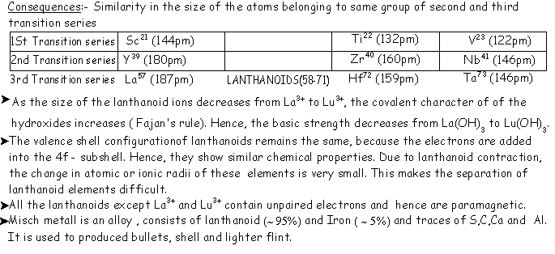

Slide 27
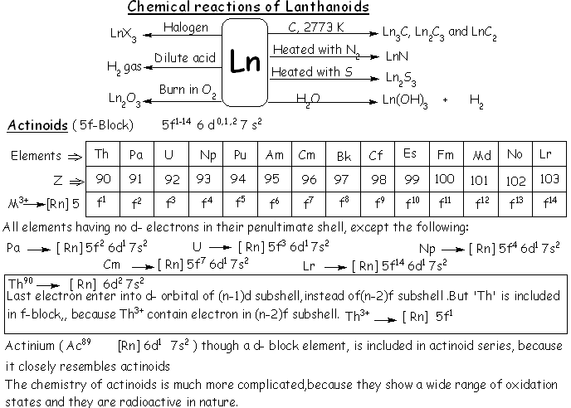

Slide 28
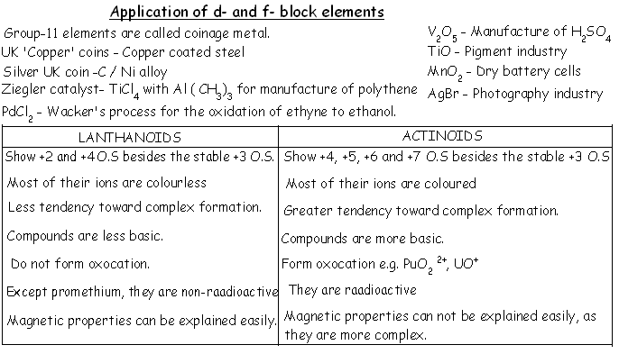

Slide 29
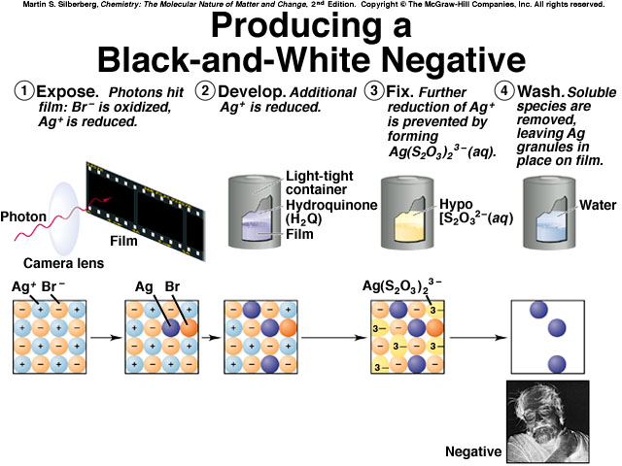
Silver

Slide 30
IMPORTANT QUESTION
Q 1. Why is the third ionization energy of manganese (atomic no. 25) unexpectedly high?
Ans. ₂₅Mn(Ar)3d⁵ 4s² and Mn²⁺ is (Ar)3d⁵.After loosing 2 electrons it has half filled d-orbitals, which is more stable that is why Mn²⁺ has exceptionally high third ionization energy.
Q 2. Which is more basic, La (OH) ₃ or Lu (OH) ₃? Why?
Ans. La (OH) ₃ is more basic because La is larger size than Lu, therefore more electropositive.
Q3. Why is Ce⁴⁺ in aqueous solution a good oxidizing agent?
Ans. Ce⁴⁺ gains electron to form Ce³⁺ ion, it is good oxidizing agent.

Slide 31
Q4. What is basic difference between the electronic configuration of lanthanides and those actinides?
Ans. In lanthanides df orbital is progressively filled where in actinides, 5f orbital progressively filled.
Q5. What is effect of pH on K₂Cr₂O₇?
Ans. It changes to K₂CrO₄ which is yellow in colour.
Cr­₂O₇²⁻ + 2OH⁻ → 2CrO₄²⁻ + H₂O
Orange yellow
Q6. Why Zn²⁺ salts are white while Cu²⁺ salts are blue?
Ans. Zn²⁺ 3d₁₀ has completely filled d-orbital while Cu²⁺(3d⁹) has incompletely filled d-orbital.
Q8. K₂PtCl₆ is a well known compound whereas corresponding Ni compound is not known. State a reason for it.
Ans.This is because Pt⁴⁺ is more stable than Ni⁴⁺; as the sum of four ionization enthalpies of Pt is less than that of Ni.

Slide 32
Q9. A substance is found to have a magnetic moment of 3.9 BM. How many unpaired electrons does it contain?
Ans. Magnetic moment, µ=√n (n+2) BM, n=3.
Q10. Why do transition elements show variable oxidation state?
Ans. In transition elements, the energies of (n-1)d orbitals & ns orbitals are very closed. Hence,
Electrons from both can participate in bonding.
Q11. Why Zn,Cd & Hg are soft and have low melting point?
Ans. In Zn, Cd & Hg all the electrons in d –subshell are paired,hence the metallic bonds present in them are weak .That is why they have low melting and boiling point .
12. Co (II) is stable in aqueous solution but in presence of strong ligands & in air gets oxidized to Co³⁺, why?
Ans.Stronger ligands & air oxidize Co²⁺ to Co³⁺ by providing energy released due to force of attraction between them & metal ions.
13. Why Ce³⁺ can be easily oxidized to Ce⁴⁺?
Ans.It is Ce⁴⁺ because has stable electronic configuration.
14. Represent by ionic equations, the oxidizing action of MnO₄⁻ in acidic medium.
Ans.5e⁻ + 8H⁺ + MnO₄⁻ → Mn²⁺ + 4H₂O in acidic medium.
15. The second & third transition series (4d & 5d) have similar ionic size, why?
Ans.It is due to lanthanoids contraction.

Slide 33
16. What happens when acidified KMnO₄ is added to ferrous sulphate solution?
Ans.MnO₄⁻ + 5Fe²⁺ + 8H⁺ → Mn²⁺ + 5Fe³⁺ + 4H₂O.
The colour of KMnO₄ becomes colourless & Fe²⁺ is oxidized to Fe³⁺ ion.
17. Ce forms Ce⁴⁺ in aqueous solution?
Ans.It is due to stable electronic configuration of Ce⁴⁺.
18. Why does Eu²⁺ & Yb²⁺ are formed & are stable?
Ans.Eu²⁺ has half filled f-orbital which is more stable whereas Yb²⁺ has fully filled f-orbital which is more stable.
19. Why Mn²⁺ is more stable than Mn³⁺ but Fe³⁺ is more stable than Fe²⁺?
Ans.Mn²⁺ has half filled d-orbital; therefore, it is more stable than Mn³⁺.
Fe³⁺ has half filled d-orbital; therefore, it is more stable than Fe²⁺.
20. Why are lanthanoids coloured & paramagnetic?
It is due to presence of unpaired electrons, they are paramagnetic & they absorb light from visible region & undergo f-f transitions & radiate complementary colour.
21. What are interstitial compounds? Why are such compounds well known for transition metals?
Ans.Small atoms like C, H, N, and B get fit into void resulting in formation of interstitial compounds. Transition metals have voids; therefore, they form interstitial compounds.

Slide 34
21. Explain giving reasons: a) Transition metals & many of their compounds show paramagnetic behavior. b) The enthalpies of atomization of the transition metals are high. c) The transition metals generally form coloured compounds. d) Transition metals & their many compounds act as good catalyst.
(a) It is due to presence of unpaired electrons.
(b) It is due to strong metallic bond & additional covalent bonds due to presence of unpaired electrons in d-orbitals.
(c) It is due to presence of unpaired electrons, they undergo d-d transitions by absorbing light from visible region & radiate complementary colour.
(d) It is due to variable oxidation state.

Slide 35
ASSIGNMENT
E X P L A I N W H Y ? / D E S C R I B E
1. Transition metals have high boiling points and have high enthalpies of atomization. (AI-05)
2. Transition metals and many of their compounds show paramagnetic behavior. (AI-05)
3. Transition metals generally from colour compound
4. Transition metals and many of their compound act as a good catalyst. (AI-05)
5. Transtion metals form complex compounds.
6. Transition elements show variable oxidation states.
7. Transition metal generally form alloys with other transition metals.
8. Transition metals form a number of interstitial compounds.
9. Why do transition metals have high enthalpy of hydration?
10. Zn, Cd, and Hg are normally not considered as Transition metals

Slide 36
11. Mn⁺² compounds are more stable than Fe⁺² toward oxidation to their + 3 state. (AI-06)
12.E⁰ for Mn⁺³ / Mn⁺² couple is more positive than for Fe⁺³ / Fe⁺² or Cr⁺³ / Cr⁺² .
13. The first I.E of 5d-transition metals are higher than those of 3d and 4d- transition metals series.
14. The second and third series transition elements have very similar atomic radii.
15. Ni⁺² compounds are thermodynamically more stable than Pt⁺² compounds whilst Pt (IV) are relatively more stable than Ni (IV) compounds.
OR K₂PtCl₆ is well known cpds. but corresponding Ni-compound is not known
16. For the first row transition metals the Eº values are: Eº V Cr Mn Fe Co Ni Cu
M²⁺/M –1.18 – 0.91 –1.18 – 0.44 – 0.28 – 0.25 +0.34 Explain the irregularity in the above values.

Slide 37
O X O M E T A L I O N S ( KMnO₄ and K₂Cr₂O₇)
17. Describe the steps involved in the preparation of
(a) K₂Cr₂O₇ from chromite ore
(b) KMnO₄ from pyrolusite ore
c) K₂Cr₂O₇ from sodium chromate
18. Describe the oxidising action of potassium dichromate
and write the ionic equations for its reaction with: (i) iodide
(ii) iron (II) solution and (iii) H₂S
19. Describe the preparation of potassium permanganate.
How does theacidified permanganate solution react with
(i) Iron (II) ions (ii) SO₂ (iii) oxalic acid?
Write the ionic equations for the reactions.
20. Why is that orange solution of K₂Cr₂O₇ turns yellow on
adding NaOH to it. OR, what is the effect of increasing pH
on a solution of K₂Cr₂O₇
21. Why is HCl not used to acidify permanganate solutions in
volumetric estimation of Fe⁺² or C₂O₄²⁻?

Slide 38
L A N T H A N O I D S A N D A C T I N O I D S
23. What i s lanthanide contraction? State the cause and two consequences of of lanthanide contraction. (F, AI-06)
24. What are the different oxidation states exhibited by the lanthanoids?
25. Why is the separation of lanthanide elements difficult?
26. (a) What is misch metal? Mention its two important uses. (F-06)

