Slide 1
f block ELEMENTS)
(INNER-TRANSITION ELEMENTS)
GURMEET SINGH
PGT CHEMISTRY
KV NO.1,AMBALA CANTT.

Slide 2
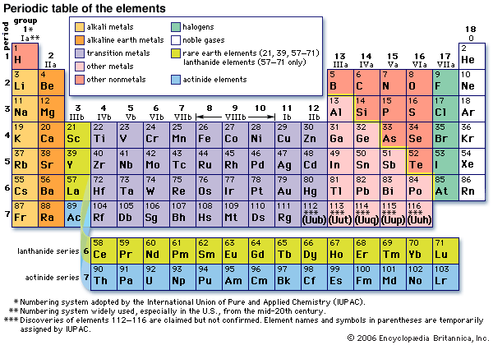

Slide 3
THE INNER TRANSITION ELEMENTS (f-BLOCK)
The f-block consists of two series, LANTHANOIDS(rare earth metals) and ACTINOIDS. The Lanthanoids resembles one another more closely than do the members of ordinary transition elements in any series *Lanthanoids have only one stable oxidation state (+3). *The chemistry of Actinoids is much more complicated.The complication arises partly owing to the occurrence of a wide range of oxidation states in these elements and partly because their radioactivity creates special problems in their study.

Slide 4
Electronic Configurations of lanthanoids
It may be noted that atoms of these elements have electronic configuration with 6s² common but with variable occupancy of 4f level. However, the electronic configurations of all the tri positive ions (the most stable oxidation state of all the lanthanoids) are of the form 4f ^{n} (n = 1 to 14 with increasing atomic number).

Slide 5
THE LANTHANOIDS:-
*Cerium- (58) *praseodymium- (59) *neodymium - (60) *promethium-(61) * samarium- (62) *europium- (63) *gadolinium- (64) *terbium- (65) *dysprosium- (66) *holmium- (67) *erbium- (68) *thulium- (69) *ytterbium- (70) *lutetium-(71)

Slide 6
ATOMIC and IONIC SIZES OF LANTHANOIDS:-
The overall decrease in atomic and ionic sizes is a unique feature of Lanthanoids. Due to imperfection shielding of one electron by the another in the same sub-shell. Thus, there is fairly regular decrease in the sizes with increasing atomic number.The cumulative effect of the contraction of the lanthanoids series known as ‘lanthanoids contraction’ , causes the radii of the members of the third transition series to be very similar to those of the corresponding members of the second series.

Slide 7
OXIDATION STATE OF LANTHANOIDS:-
Occasionally,+2 and +4 ions in the solution or in solid compounds are also obtained. The irregularities arises mainly from the extra stability of empty , half –filled or filled f -sub-shell.
*Q. Why Ce(IV) is a good analytical reagent? Ans. Eº value for Ce⁺⁴ /Ce⁺³ is + 1.74 v which suggest that it can oxidise water. However, the reaction rate is very slow and hence, Ce(IV) is a good analytical reagent. *Praseodymium, Neodymium, Terbium and Dysprosium also exhibit +4 state but only in oxides.

Slide 8
GENERAL CHARACTERISTICS:-
1. All lanthanoids are silvery white soft metals and tarnish rapidly in air. 2. The hardness increases with increasing atomic number, Samarium being steel hard. 3.Their melting point ranges between 1000-1200K but Samarium melts at 1632K. 4.They have a typical metallic structure and are good conductors of heat and electricity. 5.Lanthanoids ions are coloured both in solid and aqueous state. Colour of these ions may be attributed to the presence of f-electrons. But La+³ ions doesn’t shows any colour but rest do so. 6. Lanthanoids are paramagnetic in nature. 7. In their chemical behaviour, in general, earlier members of the series are quite reactive similar to calcium but with increasing atomic number, they behave more like aluminium.

Slide 9
CHEMICAL REACTIONS WITH LANTHANOIDS:-
Ln-> with halogens-LnX₃ *with acids->H₂ *with H₂ 0 ->Ln(OH)₃ +H₂ *with C -> LnC₂ *heated with N->LnN *heated with S->Ln₂S₃ *burns with o₂ ->Ln₂O₃
*USES:- 1.Used for the production of alloy steel for plates and pipes.
2. Mischmetall-consists of Lanthanoids metal, iron, traces S, C, Ca . A good deal of mischmetall is used in Mg-based alloy to produce bullets, shell and lighter flint.

Slide 10
ACTINOIDS:-
**thorium- 90 *protactincium-91 * uranium-92 *neptunium- 93 *plutonium- 94 *americium- 95 *curium- 96 *berkelium- 97 * californium- 98 * einsteinium- 99 *fermium- 100 *mendelevium- 101 *nobelium- 102 *lawrencium-103

Slide 11
ELECTRONIC CONFIGURATION OF ACTINOIDS:-
They have common 7s² and variable occupancy of the 5f and 6d subshells.
Irregularities in electronic configuration of the actinoids, like those in the lanthanoids are related to the stabilities of the f⁰ ,f⁷ , f ¹⁴ occupancies of 5f orbitals.

Slide 12
Ionic sizes and oxidation state of actinoid:-
There is a gradual decrease in the size of atoms or M³⁺ ions across the series. *This is may be referred to ‘actinoid contraction’. The contraction is, however, greater from element in this series resulting from poor shielding by 5f electron.
OXIDATION STATES:- The actinoids show in general +3 oxidation states. * For e.g. Maximum oxidation state increases from +4 in Thorium to +5, +6 and +7, respectively, in Protactinicium , Urenium, Neptunium but decreases in succeeding elements.

Slide 13
GENERAL CHARACTERISTICS:-
They are silvery in appearance but display a variety of structures which is due to irregularities in metallic radii which are far greater than in lanthanoids.
They are highly reactive metals, especially when finely divided.
The action of boiling water on them for e.g. Gives a mixture of oxide and hydride and combination with most non-metals takes place at moderate temperature. HCl attacks all metals but most are slightly affected by nitric acid owing to the formation of protective oxide layers.

Slide 14
Uses of Actinoids
Even though hazards are associated with radioactivity of actinides, many beneficial applications exist as well. Radioactive nuclides are used in cancer therapy, analytical chemistry, and in basic research in the study of chemical structures and mechanisms.
The explosive power of uranium and plutonium are well exploited in making atom bombs. In fact, the uranium enriched atom bomb that exploded over Japan was the first uranium bomb released.
Nuclear reactions of uranium-235 and plutonium-239 are currently utilized in atomic energy powerplants to generate electric power. Thorium is economically useful for the reason that fissionable uranium-233 can be produced from thorium-232.
Plutonium-238 is used in implants in the human body to power the heart pacemaker, which is does not need to be replaced for at least 10 years.
Curium-244 and plutonium-238 emit heat at 2.9 watts and 0.57 watts per gram, respectively. Therefore, curium and plutonium are used as power sources on the Moon to provide electrical energy for transmitting messages to Earth.

Slide 15
THANK YOU

