Slide 1
BY: P S THAKUR
17th group elements
INTRODUCTION
PHYSICAL PROPERTIES
CHEMICAL REACTIONS
USES

Slide 2
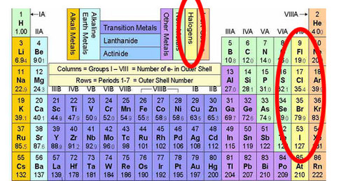
Group 17 – The Halogens

Slide 3
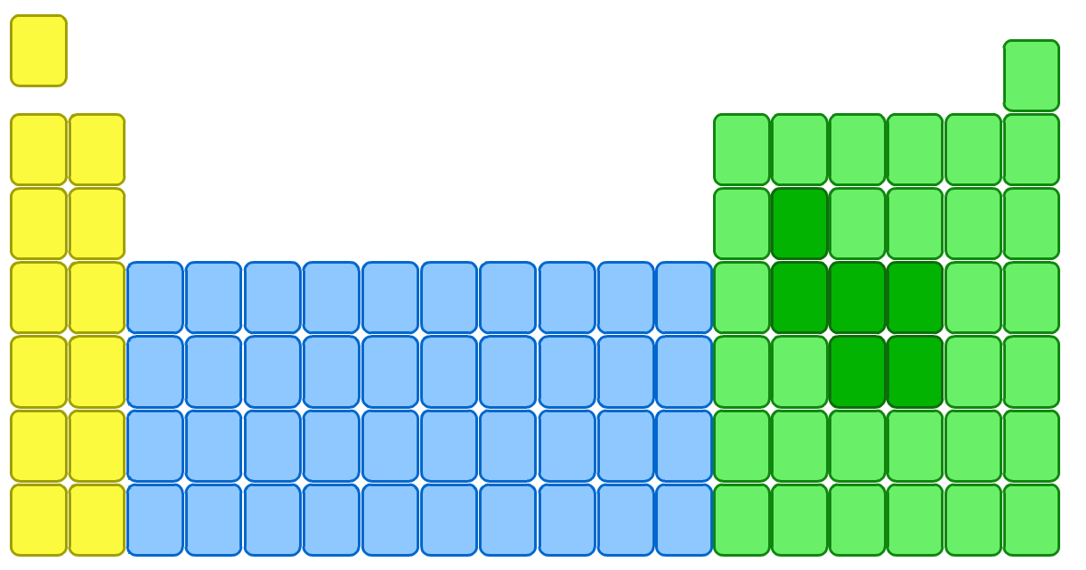
Group 17 – the halogens
The elements in group 7 of the periodic table, on the right, are called the halogens.
F
fluorine
Cl
chlorine
Br
bromine
I
iodine
At
astatine

Slide 4
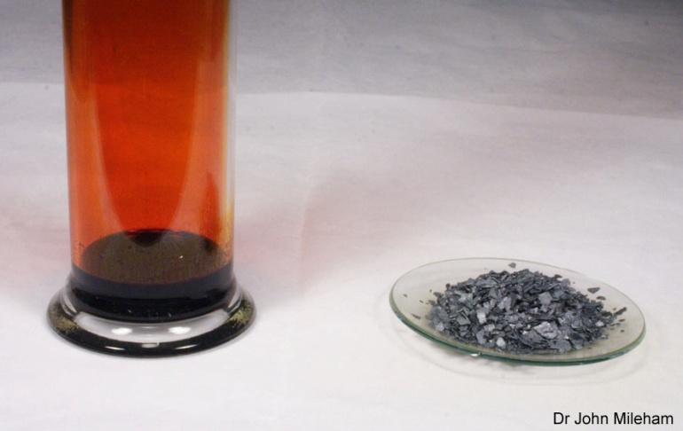
Why are they called the ‘halogens’?
Halogens are very reactive non metals.
They are all toxic or harmful because they are so reactive. Before antiseptics, iodine was used to clean wounds as it is harmful to all things, including bacteria.
They are also never found free in nature because of their reactivity – they are found as compounds with metals.
These halogen-metal compounds are salts, which give halogens their name – ‘halo-gen’ means ‘salt-former’.
Notes:
Photo credit: Dr John Mileham
Liquid bromine in a jar on the left, iodine on the right.

Slide 5
What is the electron structure of the halogens?
All halogens have seven electrons in their outer shell.
This means that:
fluorine
2,7
They can easily obtain a full outer shell by gaining one electron.
chlorine
2,8,7
They all gain an electron in reactions to form negative ions with a -1 charge.
They have similar chemical properties.
bromine
2,8,8,7

Slide 6
What are the general properties of the halogens?
All the halogens are:
non-metals and so do not conduct electricity
brittle and crumbly when solid
poisonous and smelly.
They become darker in colour down the group:
is pale yellow
is green-yellow
is red-brown
is blue-black.

Slide 7
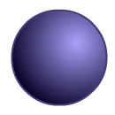
What is the physical state of the halogens?
The melting and boiling points of the halogens increase down the group, as the molecules become bigger.
Halogen
Relative size
Melting point (°C)
Boiling point (°C)
State
-220
-118
gas
-101
-34
gas
-7
59
liquid
114
184
solid
What is the state of each halogen at room temperature?

Slide 8
Properties of the Halogens
Colour
State
F
Cl
Br
I
At
Yellow
Gas
Green
Orange
Grey/black
Gas
Liquid
Solid
DECREASING REACTIVITY
INCREASING DENSITY
INCREASING MOLECULAR SIZE
Black
Solid

Slide 9
17th group
Hydrides- Hydrogen forms hydrogen halides . The acid strength of these acids are as follows :-
HI>HBr>HCl>HF
HI is most acidic because it can release H⁺ ions easily due to larger size of iodine .
Thermal stability :- most thermally stable is HF and least stable is HI .This is because HI has covalent bond and a longer bond with a low bond dissociation energy .In this way HI becomes most covalent and H become least thermally stable.
Ionic character :- HI is most ionic in nature and ionic character decreases down the group . HI is least ionic . HF has got high ionic character because F is most electronegative.
Metal halides:- ionic character of metal halides are in the following order:-
MF>MCl>MBr>MI
As we go down the group the covalent tendency increases .
Melting points of metal halides :-
Higher the ionic character higher is the melting point.

Slide 10
Reactions of the Halogens
All of the halogens will react with water to produce 2 acids
WATER + HALOGEN ACID 1 + ACID 2
Water + Chlorine Hydrochloric + Hydrochlorus
Acid Acid
H₂O + Cl₂ HCl + HOCl
This also happens with Bromine and Iodine and the acids formed are much stronger!

Slide 11
Oxo acids Of Chlorine

Slide 12
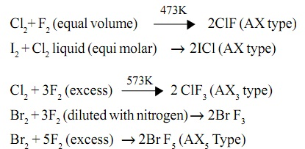
Interhalogen compounds
Interhalogen compounds are compounds formed between the halogens themselves. Examples being ICl5, ClF3 etc. The element with the bigger size and lesser electronegativity forms the electron pair acceptor. Fluorine doesn’t form interhalogen compounds since it lacks vacant orbitals for electron pair acceptance

Slide 13
Commercial preparation
1 oxygwn is passed through HCl in presence of CuCl₂, chlorine gas is liberated. Decaeon’s process.
4HCl +O₂ ^{CuCl}₂→ 2H₂O+4Cl₂
2 electrolysis of brine
Brine solution contains NaCl which on electrolysis liberates chlorine gas
NaCl ^{electro}→Na⁺+Cl⁻
(+) at anode :- 2Cl⁻ →Cl₂+2e⁻
(-) at cathode :- Na⁺+ 1e⁻→Na(s)

Slide 14
Physical properties :-
1 greenish yellow gas
2 soluble in water
3 heavier than air
Chemical properties :-
1 chlorine reacts with metals forming metal halides
2Na+Cl₂→2NaCl
Mg+Cl₂→MgCl₂
2Al +3Cl₂→2AlCl₃
2 chlorine rteacts with non metals
P₄+3Cl₂→4PCl₃
2S+Cl₂→S₂Cl₂
H₂+Cl₂→2HCl

Slide 15
3 chlorine reacts with compounds like ammonia and hydrocarbon like C₁₀H₁₆
8NH₃+Cl₂→6NH₄Cl+N₂
NH₃+3Cl₂^{excess}→NCl₃+ 3HCl
C₁₀H₁₆+8Cl₂→10C+16HCl
Chlorinating agent:-
Chlorine reacts with hydrocarbon in presence of sunlight to form haloalkanes .
CH₄ +Cl₂^{sunlight}→CH₃Cl+HCl
Oxidising agent:-
Chlorine is a very good oxidising agent.
1 ferrous sulphate to ferric sulphate
2FeSO₄+H₂SO₄+Cl₂→Fe₂(SO₄)₃+2HCl
2 it oxidises Na sulphite to sodium sulphate
Na₂SO₃+H₂O+Cl₂→Na₂SO₄ +2HCl
3 it oxidises ulphur dioxide to sulphuric oxide
SO₂+2H₂O+Cl₂→H₂SO₄+2HCl

Slide 16
4 it oxidises iodine to hydrochloric acid
I₂+6H₂O+5Cl₂→2HIO₃+10HCl
Bleaching agent :-
5 chlorine is a good bleaching agent .it undergoes reaction to give nascent oxygen .this bleaching action is due to oxidation and it is a permanent bleaching agent .
H₂O+Cl₂→2HCl+[O]
Colouring matter +[o]→decolourise
[bleaching]

Slide 17
Chlorine reacts with cold and dilute NaOH to form sodium hypochlorite
2NaOH+Cl₂→Nacl + NaClO+H₂O
Sod.hypochlorite
Chlorine reacts with hot and conc. NaOH to give sodium Chlorate
6NaOH+3Cl₂→5NaCl+NaClO₃+3H₂O
Sod.chlorate
Cl reacts with slaked lime to form bleaching powder
2Ca(OH)₂+6Cl₂→Ca(OCl)₂+CaCl₂ +2H₂O
Bleaching powder
Bleaching powder is good source of chlorine .this is used for the preparation of chloroform .
CaOCl₂+H₂O→Ca(OH)₂+Cl₂

Slide 18
Uses of chlorine :-
Clis used as ableaching agent in wood pulp
It is used for manufacturing of dyes and drugs like DDT.
It is used for preparing poisonous gases like phosgene COCl₂,tear gas CCl₃NO₂
Mustard gas →
ClCH₂CH₂-S- CH₂CH₂Cl
Lab preraration of HCl:-
HCl is prepared in lab by treating sodium chloride with sulphuric acid
NaCl+H₂SO₄→NaHSO₄+HCl
Hcl is prepared by treating bisulphates with NaCl
NaHSO₄+ NaCl→Na₂SO₄+ HCl

Slide 19
Physical properties :-
HCl is a pungent smelling gas which is very irritating.
It is highly soluble in water
HCl+H₂O→H₃O⁺+Cl⁻
Chemical properties :-
Zinc reacts with HCl
Zn+2HCl→ZnCl₂+H₂
HCl reacts with non metals in presence of CuCl₂
4HCl+O₂^{CuCl}₂ →2 H₂O+2Cl₂
HCl reacts with carbonates ,bicarbonates and sulphide to liberate SO₂ and CO₂ gas
Na₂CO₃+2HCl→NaCl+H₂O+CO₂
NaHCO₃+HCl→NaCl+H₂O+CO₂
Na₂SO₃+ HCl→NaCl+H₂O+SO₂
HCl reacts with ammonia to form dense fumes of ammonium chloride
NH₃+HCl→NH₄Cl
Aqua regia:-
Conc. →HCl:HNO₃
3:1
HCl→H⁺+Cl⁻
HNO₃→ H⁺+NO₃⁻
Aqua regia dissolves gold, silver and platinum

Slide 20
Uses of the Halogens
Fluorine
Chlorine
Bromine
Iodine
Toothpaste
Water treatment
Extraction of Aluminium
Non stick coatings
Enrichment of Uranium
Water disinfection
Hydrochloric acid
Plastics
Bleaches
Photographic film
Tear gas
Flame retardants
Pharmaceuticals
Disinfectant
Halogen lamps
X ray diagnosis
Salt additive
Thyroid treatment
Cancer treatment

Slide 21
Textbook
Q7.17) write the balanced chemical equation for the reaction with conc. Hot NaOH it is a disproportion:
Ans:-6NaOH+3Cl₂→NaClO₃+5NaCl+3H₂O
the reaction is as follows .this is a disproportion reaction because the product obtained has two
Different product with two different oxidation state.
Q7.29) Give reason for bleaching action of Cl₂
Ans:- H₂O+Cl₂→2HCl+[O]
Colouring matter +[o]→decolourise
[bleaching]
chlorine is a good bleaching agent .it undergoes reaction to give nascent oxygen .this bleaching action is due to oxidation and it is a permanent bleaching agent .

Slide 22
Q7.30) name two poisonous gas which can be prepared by
Tear gas →CCl₃NO₂
Phosgen →CoCl₂
Mustard gas →
ClCH₂CH₂-S- CH₂CH₂Cl
Q)when HCl reacts with powder iron it forms ferrous chloride and not ferric chloride
Fe+2HCl→FeCl₂+H₂
Hydrogen which is liberated ,prevent ferrous to get converted to ferric.
Q) why is ICl more reactive than I₂
Ans:- ICl is an interhalogen compound .it has a weaker bond with low bond dissociation energy so ICl is more reactive than I₂

