Slide 1
General Principles and
Processes of Isolation
of Elements
SANJEEV KUMAR BHANDARI

Slide 2
A few elements like carbon, sulphur, gold and noble gases, occur in free state while others in combined forms in the earth’s crust.
The extraction and isolation of an element from its combined form involves various principles of chemistry.
A particular element may occur in a variety of compounds.
The process of metallurgy and isolation should be such that it is chemically feasible and commercially viable.
SANJEEV KUMAR BHANDARI

Slide 3
Minerals are naturally occurring chemical substances in the earth’s crust obtainable by mining.
Out of many minerals in which a metal may be found, only a few are viable to be used as sources of that metal. Such minerals are known as ores.
SANJEEV KUMAR BHANDARI

Slide 4
Rarely, an ore contains only a desired substance. It is usually contaminated with earthly or undesired materials known as gangue. The extraction and isolation of metals from ores involve the following major steps:
• Concentration of the ore,
• Isolation of the metal from its concentrated ore, and
• Purification of the metal.
The entire scientific and technological process used for isolation of the metal from its ores is known as metallurgy.
SANJEEV KUMAR BHANDARI

Slide 5
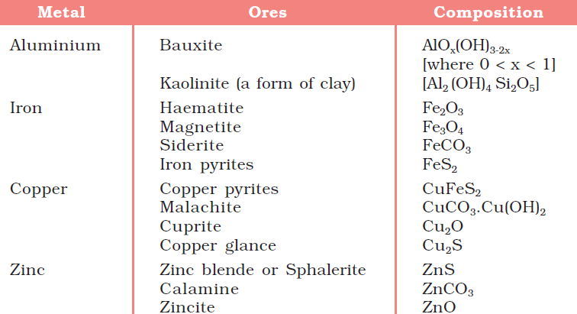
Principal Ores of Some Important Metals
SANJEEV KUMAR BHANDARI

Slide 6
Concentration of Ores
Removal of the unwanted materials (e.g., sand, clays, etc.) from the ore is known as concentration, dressing or benefaction. It involves several steps and selection of these steps depends upon the differences in physical properties of the compound of the metal present and that of the gangue.
SANJEEV KUMAR BHANDARI

Slide 7
Hydraulic Washing
This is based on the differences in gravities of the ore and the gangue particles. It is therefore a type of gravity separation.
In one such process, an upward stream of running water is used to wash the powdered ore. The lighter gangue particles are washed away and the heavier ores are left behind.
SANJEEV KUMAR BHANDARI

Slide 8
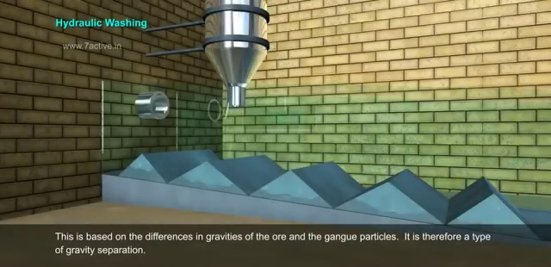
SANJEEV KUMAR BHANDARI

Slide 9
Magnetic Separation
This is based on differences in magnetic properties of the ore components. If either the ore or the gangue (one of these two) is capable of being attracted by a magnetic field, then such separations are carried out (e.g., in case of iron ores). The ground ore is carried on a conveyer belt which passes over a magnetic roller
SANJEEV KUMAR BHANDARI

Slide 10
SANJEEV KUMAR BHANDARI

Slide 11
Froth Floatation Method
This method has been in use for removing gangue from sulphide ores. In this process, a suspension of the powdered ore is made with water. To it, collectors and froth stabilisers are added. Collectors (e. g., pine oils, fatty acids, xanthates, etc.) enhance non-wettability of the mineral particles and froth stabilisers (e. g., cresols, aniline) stabilise the froth. The mineral particles become wet by oils while the gangue particles by water. A rotating paddle agitates the mixture and draws air in it. As a result, froth is formed which carries the mineral particles. The froth is light and is skimmed off. It is then dried for recovery of the ore particles.
SANJEEV KUMAR BHANDARI

Slide 12
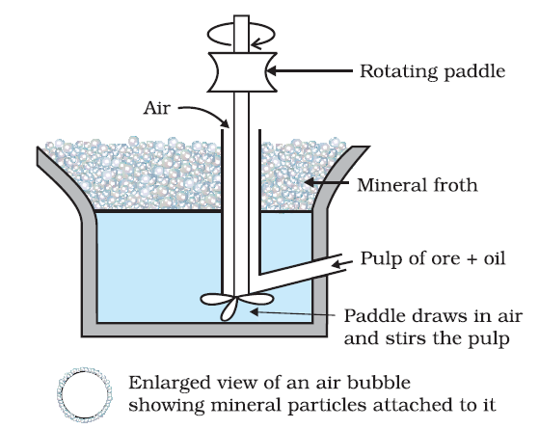
SANJEEV KUMAR BHANDARI

Slide 13
Depressants
Sometimes, it is possible to separate two sulphide ores by adjusting proportion of oil
to water or by using ‘depressants’. For example, in case of an ore containing ZnS
and PbS, the depressant used is NaCN. It selectively prevents ZnS from coming to the
froth but allows PbS to come with the froth.
SANJEEV KUMAR BHANDARI

Slide 14
Leaching of alumina from bauxite
The principal ore of aluminium, bauxite, usually contains SiO2, iron oxides and titanium oxide (TiO2) as impurities. Concentration is carried out by digesting the powdered ore with a concentrated solution of NaOH at 473 – 523 K and 35 – 36 bar pressure. This
way, Al2O3 is leached out as sodium aluminate (and SiO2 too as sodium silicate) leaving the impurities behind:
Al2O3(s) + 2NaOH(aq) + 3H2O(l) → 2Na[Al(OH) 4](aq)
The aluminate in solution is neutralized by passing CO2 gas and hydrated Al2O3 is precipitated. At this stage, the solution is seeded with freshly prepared samples of hydrated Al2O3 which induces the precipitation:
2Na[Al(OH)4](aq) + CO2(g) → Al2O3.xH2O(s) + 2NaHCO3 (aq)
The sodium silicate remains in the solution and hydrated alumina is filtered, dried and heated to give back pure Al2O3:
Al2O3.xH2O(s) 1470 K Al2O3(s) + xH2O(g)
SANJEEV KUMAR BHANDARI

Slide 15
Leaching
Other examples
In the metallurgy of silver and that of gold, the respective metal is leached with a dilute solution of NaCN or KCN in the presence of air (for O2) from which the metal is obtained later by replacement:
4M(s) + 8CN–(aq)+ 2H2O(aq) + O2(g) → 4[M(CN)2]– (aq) + 4OH–(aq) (M= Ag or Au)
SANJEEV KUMAR BHANDARI

Slide 16
Extraction of Crude Metal from Concentrated Ore
The concentrated ore must be converted into a form which is suitable for reduction. Usually the sulphide ore is converted to oxide before reduction. Oxides are easier to reduce (for the reason see box). Thus isolation of metals from concentrated ore involves two major steps viz.,
conversion to oxide
(b) reduction of the oxide to metal.
SANJEEV KUMAR BHANDARI

Slide 17
Conversion to oxide
Calcination
Calcinaton involves heating when the volatile matter escapes leaving behind the metal oxide: Fe2O3.xH2O(s) → Fe2O3 (s) + xH2O(g)
ZnCO3 (s) → ZnO(s) + CO2(g)
CaCO3.MgCO3(s) → CaO(s) + MgO(s ) + 2CO2(g)
Roasting
In roasting, the ore is heated in a regular supply of air in a furnace at a temperature below the melting point of the metal. Some of the reactions involving sulphide ores are:
2ZnS + 3O2 → 2ZnO + 2SO2
2PbS + 3O2 → 2PbO + 2SO2
2Cu2S + 3O2 → 2Cu2O + 2SO2
SANJEEV KUMAR BHANDARI

Slide 18
(b) Reduction of oxide to the metal
Reduction of the metal oxide usually involves heating it with some other substance acting as a reducing agent (C or CO or even another metal). The reducing agent (e.g., carbon) combines with the oxygen of the metal oxide.
MxOy + yC → xM + y CO
Some metal oxides get reduced easily while others are very difficult to be reduced (reduction means electron gain or electronation). In any case, heating is required. To understand the variation in the temperature requirement for thermal reductions
(pyrometallurgy) and to predict which element will suit as the reducing agent for a given metal oxide (MxOy), Gibbs energy interpretations are made.
SANJEEV KUMAR BHANDARI

Slide 19
Thermodynamic Principles of Metallurgy
Some basic concepts of thermodynamics help us in understanding the theory of metallurgical transformations. Gibbs energy is the most significant term here. The change in Gibbs energy, ΔG for any process at any specified temperature, is described by the equation: ΔG = ΔH – TΔS
where, ΔH is the enthalpy change and ΔS is the entropy change for the process. For any reaction, this change could also be explained through the equation:
ΔGo = – RTlnK
where, K is the equilibrium constant of the ‘reactant – product’ system at the temperature,T. A negative ΔG implies a +ve K in equation . And this can happen only when reaction proceeds towards products. From these facts we can make the following conclusions:
SANJEEV KUMAR BHANDARI

Slide 20
When the value of ΔG is negative in equation ΔG = ΔH – TΔS, only then the reaction will proceed. If ΔS is positive, on increasing the temperature (T), the value of TΔS would increase (ΔH < TΔS) and then ΔG will become –ve.
If reactants and products of two reactions are put together in a system and the net ΔG of the two possible reactions is –ve, the overall reaction will occur. So the process of interpretation involves coupling of the two reactions, getting the sum of their ΔG and looking for its magnitude and sign. Such coupling is easily understood through Gibbs energy (ΔGV) vs T plots for formation of the oxides
SANJEEV KUMAR BHANDARI

Slide 21
Ellingham Diagram
The graphical representation of Gibbs energy was first used by H.J.T.Ellingham. This provides a sound basis for considering the choice of reducing agent in the reduction of oxides. This is known as Ellingham Diagram. Such diagrams help us in predicting the feasibility of thermal reduction of an ore. The criterion of feasibility is that at a given temperature, Gibbs energy of the reaction must be negative.
SANJEEV KUMAR BHANDARI

Slide 22
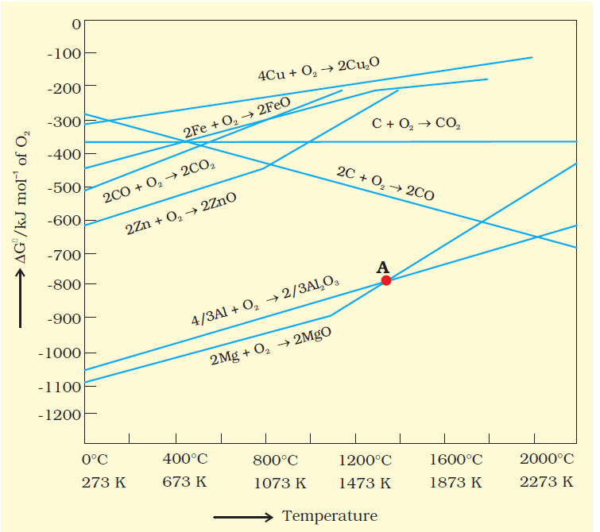
SANJEEV KUMAR BHANDARI

Slide 23
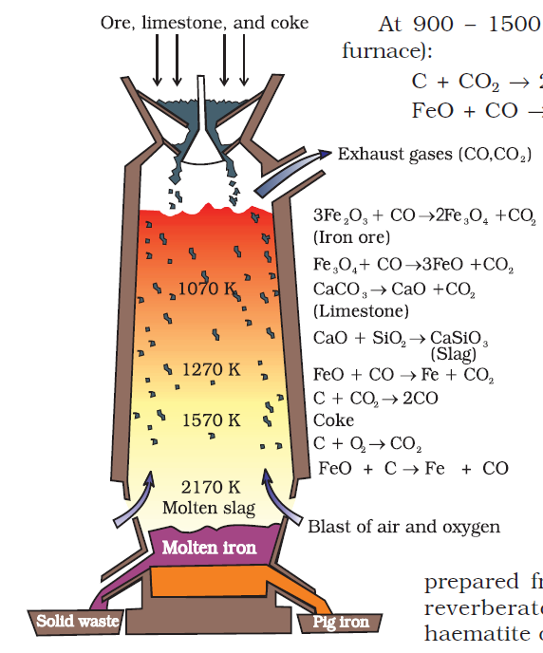
Extraction of iron from its oxides
SANJEEV KUMAR BHANDARI

Slide 24
The iron obtained from Blast furnace contains about 4% carbon and many impurities in smaller amount (e.g., S, P, Si, Mn). This is known as pig iron and cast into variety of shapes. Cast iron is different from pig iron and is made by melting pig iron with scrap iron and coke using hot air blast. It has slightly lower carbon content (about 3%) and is extremely hard and brittle.
SANJEEV KUMAR BHANDARI

Slide 25
Wrought iron or malleable iron is the purest form of commercial iron and is prepared from cast iron by oxidising impurities in a reverberatory furnace lined with haematite. This haematite oxidises carbon to carbon monoxide:
Fe2O3 + 3 C → 2 Fe + 3 CO
Limestone is added as a flux and sulphur, silicon and phosphorus are oxidised and passed into the slag. The metal is removed and freed from the slag by passing through rollers.
SANJEEV KUMAR BHANDARI

Slide 26
Extraction of copper from cuprous oxide [copper(I) oxide]
The sulphide ores are roasted/smelted to give oxides:
2Cu2S + 3O2 → 2Cu2O + 2SO2
The oxide can then be easily reduced to metallic copper using coke:
Cu2O + C → 2 Cu + CO
In actual process, the ore is heated in a reverberatory furnace after mixing with silica. In the furnace, iron oxide ‘slags of’ as iron silicate and copper is produced in the form of copper matte. This contains Cu2S and FeS.
FeO + SiO2 → FeSiO3
(Slag)
SANJEEV KUMAR BHANDARI

Slide 27
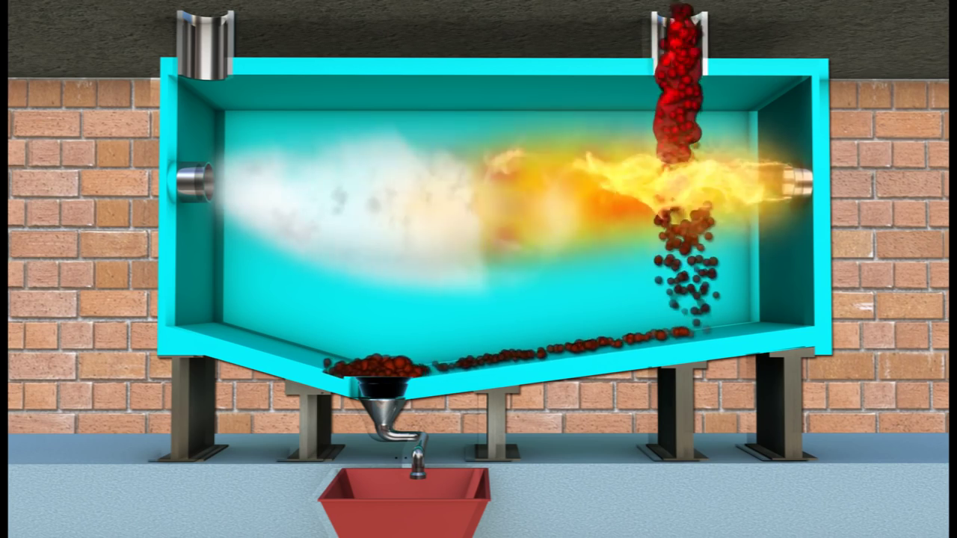
SANJEEV KUMAR BHANDARI

Slide 28
Copper matte is then charged into silica lined convertor. Some silica is also added and hot air blast is blown to convert the remaining FeS2, FeO and Cu2S/Cu2O to the metallic copper. Following reactions take place:
2FeS + 3O2 → 2FeO + 2SO2
FeO + SiO2 → FeSiO3
2Cu2S + 3O2 → 2Cu2O + 2SO2
2Cu2O + Cu2S → 6Cu + SO2
The solidified copper obtained has blistered appearance due to the evolution of SO2 and so it is called blister copper.
SANJEEV KUMAR BHANDARI

Slide 29
Copper from Low Grade Ores and Scraps Copper is extracted by hydrometallurgy from low grade ores. It is leached out using acid or bacteria. The solution containing Cu2+ is treated with scrap iron or H2 .
Cu2+(aq) + H2(g) → Cu(s) + 2H+ (aq)
SANJEEV KUMAR BHANDARI

Slide 30
Extraction of zinc from zinc oxide
The reduction of zinc oxide is done using coke. The temperature in this case is higher than that in case of copper. For the purpose of heating, the oxide is made into brickettes with coke and clay.
ZnO + C (coke) 673 K → Zn + CO
The metal is distilled off and collected by rapid chilling.
SANJEEV KUMAR BHANDARI

Slide 31
SANJEEV KUMAR BHANDARI

Slide 32
Electrochemical Principles of Metallurgy
In the reduction of a molten metal salt, electrolysis is done. Such methods are based on electrochemical principles which could be understood through the equation,
ΔG0 = – nE0F
In simple electrolysis, the Mn+ ions are discharged at negative electrodes (cathodes) and deposited there. Precautions are taken considering the reactivity of the metal produced and suitable materials are used as electrodes. Sometimes a flux is added for making the
molten mass more conducting.
SANJEEV KUMAR BHANDARI

Slide 33
Aluminium
In the metallurgy of aluminium, purified Al2O3 is mixed with Na3AlF6 or CaF2 which lowers the melting point of the mix and brings conductivity. The fused matrix is electrolysed. Steel cathode and graphite anode are used. The graphite anode is useful here for reduction to the metal. The overall reaction may be taken as:
2Al2O3 + 3C → 4Al + 3CO2
This process of electrolysis is widely known as Hall-Heroult process. The electrolysis of the molten mass is carried out in an electrolytic cell using carbon electrodes. The oxygen liberated at anode reacts with the carbon of anode producing CO and CO2. This way for each kg of aluminium produced, about 0.5 kg of carbon anode is burnt away. The electrolytic reactions are:
Cathode: Al3+ (melt) + 3e– → Al(l)
Anode: C(s) + O2– (melt) → CO(g) + 2e–
C(s) + 2O2– (melt) → CO2 (g) + 4e–
SANJEEV KUMAR BHANDARI

Slide 34
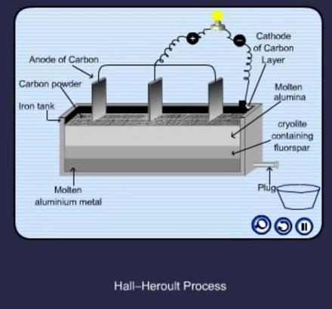
SANJEEV KUMAR BHANDARI

Slide 35
Refining
Distillation
This is very useful for low boiling metals like zinc and mercury. The impure metal is evaporated to obtain the pure metal as distillate.
SANJEEV KUMAR BHANDARI

Slide 36
Liquation
In this method a low melting metal like tin can be made to flow on a sloping surface. In this way it is separated from higher melting
impurities.
SANJEEV KUMAR BHANDARI

Slide 37
Electrolytic refining
In this method, the impure metal is made to act as anode. A strip of the same metal in pure form is used as cathode. They are put in a suitable electrolytic bath containing soluble salt of the same metal. The more basic metal remains in the solution and the less basic ones go to the anode mud. This process is also explained using the concept of electrode potential, over potential, and Gibbs energy
which you have seen in previous sections. The reactions are:
Anode: M → Mn+ + ne–
Cathode: Mn+ + ne– → M
SANJEEV KUMAR BHANDARI

Slide 38
Copper is refined using an electrolytic method. Anodes are of impure copper and pure copper strips are taken as cathode. The electrolyte is acidified solution of copper sulphate and the net result of electrolysis is the transfer of copper in pure form from the anode
to the cathode:
Anode: Cu → Cu2+ + 2 e–
Cathode: Cu2+ + 2e– → Cu
Impurities from the blister copper deposit as anode mud which contains antimony, selenium, tellurium, silver, gold and platinum; recovery of these elements may meet the cost of refining.
SANJEEV KUMAR BHANDARI

Slide 39
Zone refining
This method is based on the principle that the impurities are more soluble in the melt than in the solid state of the metal. A circular mobile heater is fixed at one end of a rod of the impure metal . The molten zone moves along with the heater which is moved forward. As the heater moves forward, the pure metal crystallises out of the melt and the impurities pass on into the adjacent molten zone. The process is repeated several times and the heater is moved in the same direction. At one end, impurities get concentrated. This end is cut off. This method is very useful for producing
semiconductor and other metals of very high purity, e.g., germanium, silicon, boron,
gallium and indium.
SANJEEV KUMAR BHANDARI

Slide 40
Vapour phase refining
In this method, the metal is converted into its volatile compound and collected elsewhere. It is then decomposed to give pure metal. So, the two requirements are:
(i) the metal should form a volatile compound with an available reagent,
(ii) the volatile compound should be easily decomposable, so that the recovery is easy.
SANJEEV KUMAR BHANDARI

Slide 41
Mond Process for Refining Nickel
In this process, nickel is heated in a stream of carbon monoxide forming a volatile complex, nickel tetracarbonyl: Ni + 4CO 330 – 350K →Ni(CO)4
The carbonyl is subjected to higher temperature so that it is decomposed giving the pure metal: Ni(CO)4 450 – 470K → Ni + 4CO
van Arkel Method for Refining Zirconium or Titanium
This method is very useful for removing all the oxygen and nitrogen present in the form of impurity in certain metals like Zr and Ti. The crude metal is heated in an evacuated vessel with iodine. The metal iodide being more covalent, volatilises:
Zr + 2I2 → ZrI4
The metal iodide is decomposed on a tungsten filament, electrically heated to about 1800K. The pure metal is thus deposited on the filament.
ZrI4 → Zr + 2I2
SANJEEV KUMAR BHANDARI

Slide 42
Chromatographic methods
This method is based on the principle that different components of a mixture are differently adsorbed on an adsorbent. The mixture is put in a liquid or gaseous medium which is moved through the adsorbent.
Different components are adsorbed at different levels on the column. Later the adsorbed components are removed (eluted) by using suitable solvents (eluant). Depending upon the physical state of the moving medium and the adsorbent material and also on the process of passage of the moving medium, the chromatographic method is given the name.
SANJEEV KUMAR BHANDARI

Slide 43
In one such method the column of Al2O3 is prepared in a glass tube and the moving medium containing a solution of the components is in liquid form. This is an example of column chromatography. This is very useful for purification of the elements which are available in minute quantities and the impurities are not very different in chemical properties from the element to be purified. There are several chromatographic
techniques such as paper chromatography, column chromatography, gas chromatography.
SANJEEV KUMAR BHANDARI

Slide 44
Uses of Aluminium, Copper, Zinc and Iron
Aluminium foils are used as wrappers for chocolates. The fine dust of the metal is used in paints and lacquers. Aluminium, being highly reactive, is also used in the extraction of chromium and manganese from their oxides. Wires of aluminium are used as electricity conductors. Alloys containing aluminium, being light, are very useful.
SANJEEV KUMAR BHANDARI

Slide 45
Copper is used for making wires used in electrical industry and for water and steam pipes. It is also used in several alloys that are rather tougher than the metal itself, e.g., brass (with zinc), bronze (with tin) and coinage alloy (with nickel).
Zinc is used for galvanising iron. It is also used in large quantities in batteries, as a constituent of many alloys, e.g., brass, (Cu 60%, Zn 40%) and german silver (Cu 25-30%, Zn 25-30%, Ni 40–50%). Zinc dust is used as a reducing agent in the manufacture of dye-stuffs,
paints, etc.
SANJEEV KUMAR BHANDARI

Slide 46
Cast iron, which is the most important form of iron, is used for casting stoves, railway sleepers, gutter pipes , toys, etc. It is used in the manufacture of wrought iron and steel. Wrought iron is used in making anchors, wires, bolts, chains and agricultural implements. Steel finds a number of uses. Alloy steel is obtained when other metals are added to it. Nickel steel is used for making cables, automobiles and aeroplane parts, pendulum, measuring tapes, chrome steel for cutting tools and crushing machines, and stainless steel for cycles, automobiles, utensils, pens, etc.
SANJEEV KUMAR BHANDARI

Slide 47
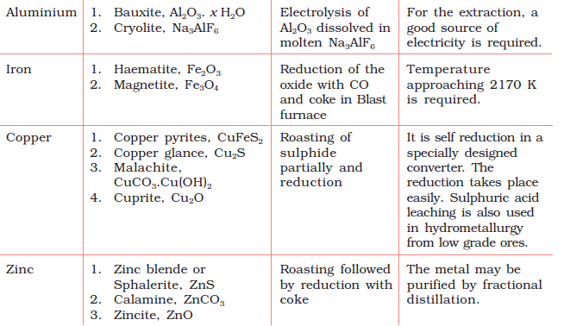
SANJEEV KUMAR BHANDARI

