Slide 1
Introduction to surface chemistry:
It is that branch of chemistry which deals with the study of phenomena occurring at the surface.

Slide 2
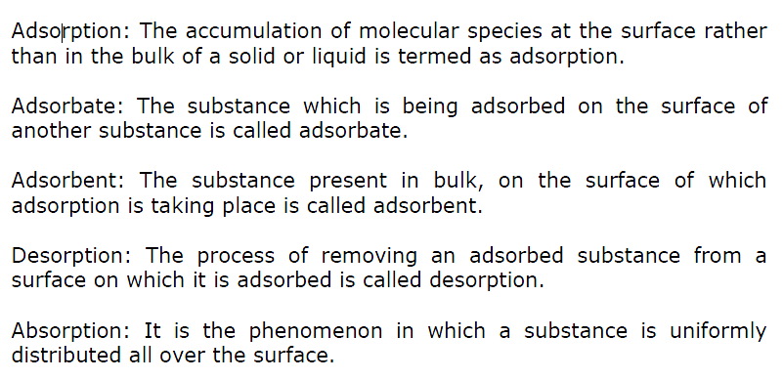
Introduction to surface chemistry

Slide 3
Classification of adsorption
Physical Adsorption | Chemical adsorption
1. The forces operating is Vander waal's forces | 1. Chemical bond between adsorbate & adsorbent
2.Heat of adsorption is low (20-40 kJ/mol) | Heat of adsorption is high(40-200 kJ/mol)
3. Reversible | Irreversible
4. Non specific | specific
5. It takes at low temperature & decrease with increase with temp. | It first increase with increase in temp.
6. Multimolecular in nature | Unimolecular in nature
7. The amount of gas adsorb depends on its critical temp | There is no such correlation

Slide 4
Factors affecting adsorption of gases on solids
Nature of adsorbate
Nature of adsorbent
Surface area of adsorbent
Pressure
Temperature
Activation of solid adsorbent.

Slide 5
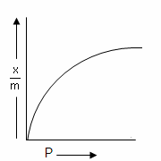
Freundlich Adsorption isotherm
The relationship between x/m and pressure of the gas at constant temperature is called adsorption isotherm and is given by

Slide 6
Application of Adsorption
1. In clarification of sugar 2. In gas masks 3. In heterogeneous catalysis 4. In chromatographic analysis 5. In softening of hard water 6. In preserving vacuum 7. In paint industry 8.In removing moisture from air in the storage of delicate instruments

Slide 7
Distinction between true solution, colloids and Suspension

Slide 8
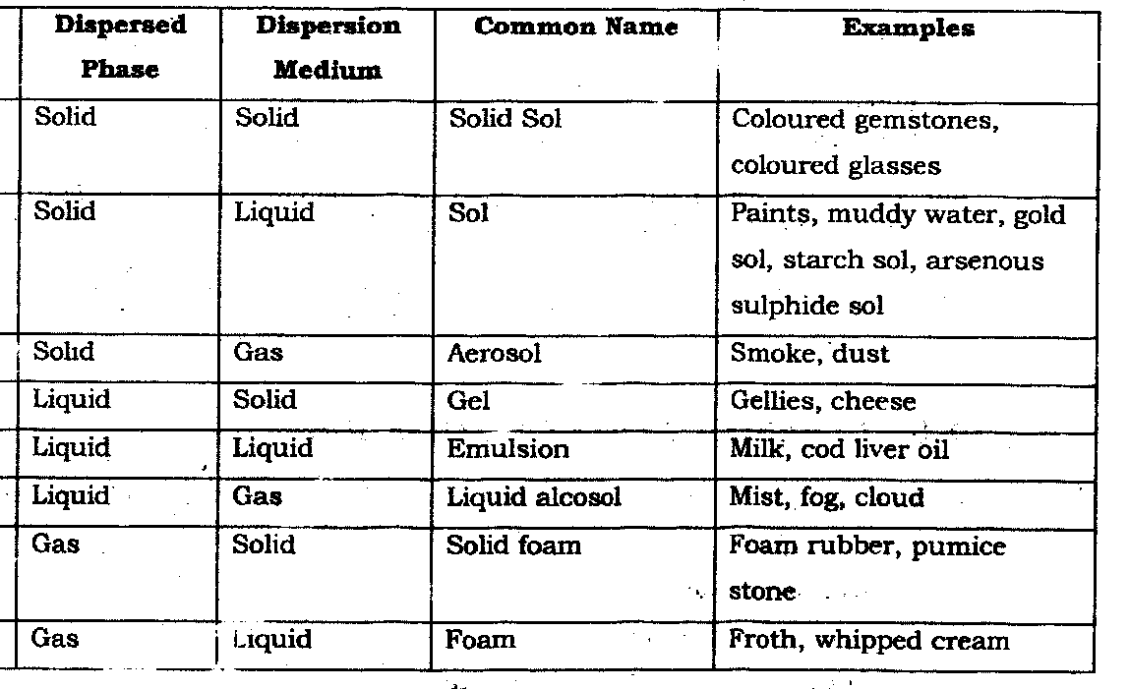
Types of colloids
Colloids are usually classified according to:
1- The original states of their constituent parts

Slide 9
Classification based on nature of interaction
Lyophobic colloids (solvent hating colloids )
When metals and their sulphides .simply mixed with dispersion medium, they don’t form colloids.
need stabilizing to preserve them.
irreversible.
For example, colloidal solutions of gold, silver, Fe(OH)₃, As₂S₃,
Lyophilic colloids ( solvent loving)
Directly formed by substances like gum, gelatin rubber etc. on mixing with a suitable liquid(the dispersion medium).
self-stabilizing
reversible sols
For example, gums, gelatin, starch, albumin in water.

Slide 10
Classification based on type of particles of the dispersed phase
Multimolecular colloids : Consists of aggregates of a large number of atoms or smaller molecules whose diameter is less than 1 nm
Macromolecular colloids: In these colloids, the molecules have sizes and dimensions comparable to colloidal particles. For example proteins, starch, cellulose.

Slide 11
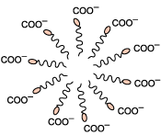
Associated colloids
At low concentrations, behave as normal, strong electrolytes At higher concentrations exhibit colloidal state properties due to the formation of aggregated particles (micelles)
The formation of micelles takes place only above a particular temperature called
Kraft temperature (T_{k}) and above a particular micelle concentration called
Critical Micelle Concentration
E.G Soaps and detergents
Notes:
The maximum concentration above which miccells are formed is called critical micellization conc.

Slide 12
Cleaning Action of Soap
Soap contains a non polar carbon end that dissolves in non polar fats and oils, and a polar end that dissolves in water.
Dust and soap molecules form micelles that dissolve in water and are
washed away.
Soap forms a precipitate with ions in hard water (Ca²⁺, Mg²⁺, Fe³⁺)

Slide 13
Preparation of Lyophobic sols
Condensation methods
Particles of atomic or molecular size are induced to form aggregates
Oxidation method
Sulphur colloids are prepared by oxidation of H₂S by O₂.
Reduction
Silver colloids are prepared by passing H₂ through a saturated aqueous solution of silver oxide at 65° C.
Hydrolysis
Dark brown Fe(OH)₃ colloidal solution is prepared by adding FeCl₃
into boiling water.
Double decomposition
Arsenious sulphide colloidal solution is prepared by passing of
H₂S gas into a solution of As₂O₃.
Exchange of solvent
Colloidal solution of phosphorus is prepared by addition of alcohol
into a solution of phosphorous in excess water.

Slide 14
Properties of colloids
Optical properties: Tyndall effect When a beam of light falls at right angles to the line of view through a solution, the solution appears to be luminescent and due to scattering of light the path becomes visible.
Quite strong in lyophobic colloids while in lyophilic colloids it is quite weak.

Slide 15
Purification of colloids
Dialysis
In this process, the colloidal particles are separated from the
impurities (mainly electrolytes) by the diffusion through a porous
membrane such as parchment, collodion, etc.
Electro dialysis
This is a special type of dialysis process, which is accelerated by the
application of a potential difference across the membrane. So ions
migrate faster than the colloids .
Ultra filtration
In this process the colloidal particles are separated by the process of
filtration, through a filter paper, which is impregnated with gelatin or
collodion followed by hardening in formaldehyde.

Slide 16
Properties of colloids
Brownian movement: Zig- zag movement of colloidal particles in a colloidal sol

Slide 17
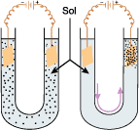
Properties of colloids
Electrophoresis
Movement of colloidal particles under influence of electric field

Slide 18
Properties of colloids
Electro-osmosis: molecules of dispersion medium are allowed to move under influence of electric field
Coagulation or flocculation: Process which involves coming together of colloidal particles so as to change into large sized particles which ultimately settle as a precipitate or float on surface. It is generally brought about by addition of electrolytes.
The minimum amount of an electrolyte that must be added to one litre of a colloidal solution so as to bring about complete coagulation or flocculation is called coagulation or flocculation value. Smaller is the flocculation value of an electrolyte, greater is the coagulating or precipitating power.

Slide 19
Properties of colloids
Hardy Shulze law : Coagulating power of an electrolyte increases rapidly with the increase in the valency of cation or anion.
Hardy Shulze law : Coagulating power of an electrolyte increases rapidly with the increase in the valency of cation or anion.
For negatively charged sol, the coagulating power of electrolytes are
For negatively charged sol, the coagulating power of electrolytes are
AlCl₃ > BaCl₂ > NaCl or Al³⁺ > Ba²⁺ > Na⁺
For positively charged, then the coagulating power of electrolytes follow the following order:

Slide 20
Emulsion
A colloidal dispersion of one liquid in another immiscible liquid is known as an emulsion, e.g. milk, Na-soaps, vanishing cream, etc.
Types of emulsions
Oil in water, where oil is the dispersed phase and water is the dispersion medium, e.g. milk.
Water in oil where water is the dispersed phase and oil is the dispersed medium, e.g. butter, cream.

Slide 21
Applications of colloids
Rubber plating
Sewage disposal
Smoke screen
Purification of water
Cleaning action of soap
In medicine
Formation of delta
Photography
Artificial rain

Slide 22
The end

