Slide 1
BY JHERUDDEN PGT (CHEMISTRY) KV SECL,NOWROZABAD
Chemical Kinetics

Slide 2
The branch of chemistry, which deals with the study of reaction rates and their mechanisms, called chemical kinetics. Thermodynamics tells only about the feasibility of a reaction whereas chemical kinetics tells about the rate of a reaction.

Slide 3
Kinetic studies not only help us to determine the speed or rate of a chemical reaction but also describe the conditions by which the reaction rates can be altered. The factors such as concentration, temperature, pressure and catalyst affect the rate of a reaction.

Slide 4
Rate of a Chemical Reaction The speed of a reaction or the rate of a reaction can be defined as the change in concentration of either reactant or product per unit time. Consider a hypothetical reaction , R P

Slide 5
Rate of the reaction = $\frac{−∆[R]}{∆t}$ Here, minus (-) sign indicates that the concentration of reactant decreasing with time. OR Rate of the reaction = $\frac{+∆[P]}{∆t}$ Here, plus (+) sign indicates that the concentration of product increasing with time. Unit of rate of a reaction is =$mol L^{−1}{ s}^{−1}$

Slide 6
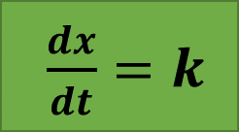
Specific reaction rate or rate constant R P a mol/L 0 Initially (t=0) (a-x) x mol/L (at time t) $\frac{dx}{dt} ∝(a−x)$ $\frac{dx}{dt}=k\left(a−x\right)$ where, k is constant or rate constant. If (a-x) = 1, then The rate constant is equal to rate of a reaction, when the molar concentration of reactants is unity. This is also called specific reaction rate.
$\frac{dx}{dt}=k$

Slide 7
Factors affecting the Rate of a Chemical Reaction 1. Temperature :- Temperature $∝$ Rate of a Reaction. 2. Pressure :- Pressure $∝$ Rate of a Reaction. 3. Concentration :- Concentration $∝$ Rate of a Reaction. 4. Presence of Catalyst :- A catalyst alters the Rate of a reaction. 5. Nature of reactant :- Ionic substance react much faster than covalent substances. 6. Surface Area of the Reactants :- Rate of reaction ∝ surface area.

Slide 8
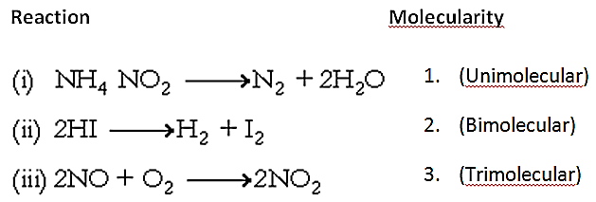
Molecularity of a Reaction Total number of reactant molecules or reacting species taking part in the rate determining step of a chemical reaction is called molecularity of the reaction. On the basis of their molecularity the reactions may be classified as follows :-

Slide 9
Molecularity of most of the reactions is one and two. Since the chances of collision and reaction of more than three molecules at a time are very less, therefore the molecularity greater than three is rare.

Slide 10
Order of a Reaction The sum of powers of the concentration of the reactants in the rate law expression is called the order of that chemical reaction. For a general reaction, aA + bB → cC + dD Let, Rate of reaction = k [A]^{x}[B]^{y} Here , x = order of reaction w.r.t. A y = order of reaction w.r.t. B Overall order of reaction(n) = x + y

Slide 11
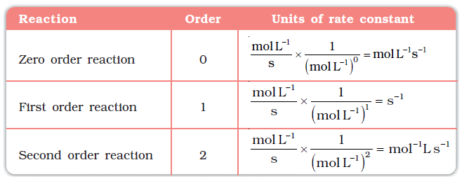
On the basis of their order the reaction may be defined as follows :-

Slide 12
Difference between order and molecularity of a reaction
Molecularity of Reaction | Order of Reaction
It is the number of atoms, ions or molecules that must collide with one another simultaneously so as to result into a chemical reaction. | It is the sum of the power of concentration terms on which the rate of reaction actually depends or it is the sum of powers of the concentration terms in the rate law equation.
Molecularity of reaction cannot be zero. | Order of reaction can be zero.
It is a theoretical concept. | It is determined experimentally.
It is always a whole number. | It can even have fractional values.
The overall molecularity of complex reaction has no significance. Individual step has its own molecularity. | Order of reaction is for overall reaction.

Slide 13
Integrated Rate Equations Zero Order Reactions Zero order reaction means that the rate of the reaction is proportional to zero power of the concentration of reactants. Consider the reaction, R → P

Slide 14
Integrating both sides between proper limit $$\int_{R0}^{R}{d\left[R\right]=−k \int_{0}^{t}{dt}}$$ [R] ̶ [R_{o}] = ̶ kt Or [R_{o} ] ̶ [R] = kt Or k = $\frac{\text{[}\text{Ro}\text{ ]}\text{ ̶ [}\text{R}\text{]}}{t}$

Slide 15
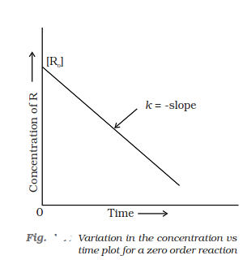
a

Slide 16
First Order Reactions First order reaction means that the rate of the reaction is proportional to first power of the concentration of reactants. Consider the reaction, R → P

Slide 17
Integrating both sides between proper limits $$\int_{R0}^{R}{\frac{d[R]}{R} =−k \int_{0}^{t}{dt}}$$ ln[R] ̶ ln [R_{o}] = ̶ kt Or ln [R_{o} ] ̶ ln [R] = kt Or kt = ln $\frac{\text{[}\text{Ro}\text{] }}{\text{[}\text{R}\text{]}}$ Or k = $\frac{1}{t}$ ln $\frac{\text{[}\text{Ro}\text{]} }{\text{[}\text{R}\text{]}}$ Or k = $\frac{2.303}{t}$ log₁₀ $\frac{\text{[}\text{Ro}\text{] }}{\text{[}\text{R}\text{]}}$

Slide 18
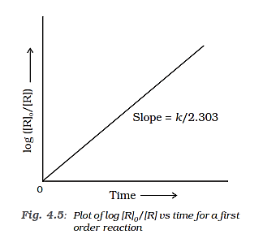
a

Slide 19
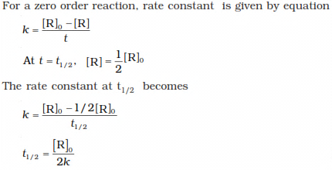
Half-Life of a Reaction The half-life of a reaction is the time in which the concentration of a reactant is reduced to one half of its initial concentration. It is represented as t_{1/2} . t_{1/2} for a Zero Order Reactions

Slide 20
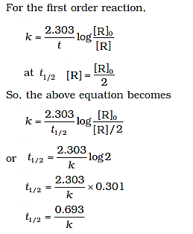
t_{1/2} for a First Order Reactions Thus for a first order reaction, half-life period is constant, i.e., it is independent of initial concentration of the reacting species.

Slide 21
Pseudo - first order reaction A chemical reaction whose molecularity is 2 but order is 1 is called pseudo – first order reaction. For example: Hydrolysis of ester in presence of acid CH₃COOC₂H₅ + H₂O → CH₃COOH + C₂H₅OH From this reaction, the rate expression should be r = k [ester] [H₂O] Since, hydrolysis takes place in the excess of H₂O and concentration change of H₂O is negligible practically. therefore, r = k’ [ester] Where k’ = k[H₂O].

Slide 22
Arrhenius equation The temperature dependence of the rate of a chemical reaction can be accurately explained by Arrhenius equation. A is frequency factor or Arrhenius constant, E_{a} is activation energy The energy difference between threshold energy & average energy of reacting molecules is called activation energy. Or

Slide 23
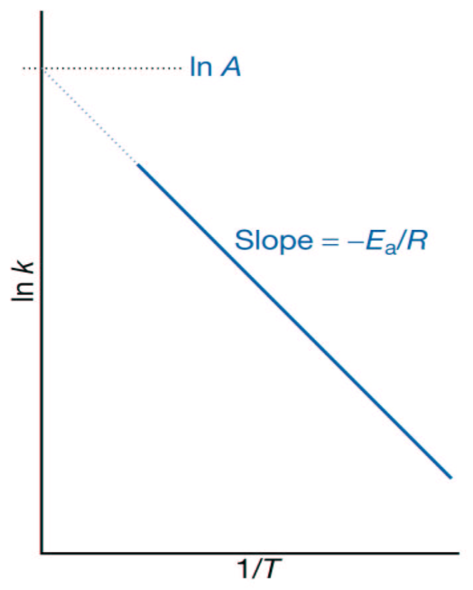
Plot of ln k vs 1/T is a straight line & slope =-E_{a}/R

Slide 24
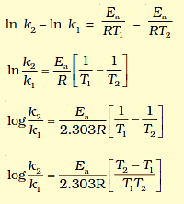
At temperature T₁ , _{………………………eqn. (1)} At temperature T₂ , _{……………………..eqn. (2)} k₁ and k₂ are the values of rate constants at temperatures T₁ and T₂ respectively. Subtracting equation (2) from (1), we obtain

Slide 25
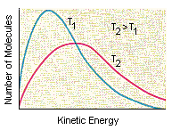
a

Slide 26
Collision Theory
According to this theory, the reactant molecules are assumed to be hard spheres and the reaction is postulated to occur, when molecules collide with each other.
The number of collisions between the reacting molecules taking place per second per unit volume is known as collision frequency (ZAB)·
But only those collisions in which the colliding species are associated with certain minimum amount of energy and collide in proper orientation result in the product formation, such collisions are called fruitful collisions or effective collision.
The molecules which take part in chemical reaction are known as active molecules.

Slide 27
Those molecule which do not take part in chemical reaction are known as passive molecules. Energy barrier: The minimum energy which the colliding particles possess in order to bring about the chemical reaction is called threshold energy. Activation energy: The minimum amount of energy required to make passive molecules into active molecules is known as activation energy. To account for effective collisions, another factor, P called the probability or steric factor is introduced. So, rate = PZABe ^{-Ea /RT}
Notes:
THANK YOU

