Slide 1
Solutions

Slide 2
Solutions
Solutions are homogeneous mixtures of two or more components.
Two components – Binary solution
Three components – Trinary solutions
Many components – Polynary solutions

Slide 3
Types of solutions
Solvent | Solute | Example
Gas | Gas | Mixture of gases, air.
Gas | Liquid | Water vapours in air, mist.
Gas | Solid | Sublimation of a solid into a gas, smoke.
Liquid | Gas | CO₂ gas dissolved in water (aerated drinks).
Liquid | Liquid | Mixture of miscible liquids, e.g., alcohol in water.
Liquid | Solid | Salt in water, sugar in water.
Solid | Gas | Adsorption of gases over metals; hydrogen over palladium.
Solid | Liquid | Mercury in zinc, mercury in gold,CuSO₄.5H₂O.
Solid | Solid | Homogeneous mixture of two or more metals (alloys), e.g., copper in gold, zinc in copper.

Slide 4
Concentration of Solutions
The amount of solute dissolved in fixed amount of solvent is called Concentration of solution
Expressions
1. Strength 2. Molarity
3. Molality 4. Mole Fraction
5. Mass % 6. Parts per mollion
7. Normality 8. Formality

Slide 5
Concentration of Solutions
Strength in g/L
Mass of solute dissolved in 1 L of solution is called strength of a solution.
Strength ( g/L) = Molarity of x Molar mass of
solution Solute
Strength ( g/L) = Mass of Solute(g) x 1000
Volume of solution(mL)

Slide 6
Concentration of Solutions
Molarity (moles/L)
Number of moles of solute dissolved in one litre volume of solution is called Molarity.
M = No. of moles of solute
Volume of solution (L)
M = Mass of solute (g)
Molar mass of solute x Volume of solution (L)
M = Mass of solute (g) x 1000
Molar mass of solute x Volume of solution (mL)
M = Mass of solute (g) x 1000 x Density of solution
Molar mass of solute x Mass of solution (mL)

Slide 7
Concentration of Solutions
Molality (moles/Kg)
Number of moles of solute dissolved in one kilogram mass of solvent is called Molality.
m = No. of moles of solute
Mass of Solvent(Kg)
m = Mass of solute (g)
Molar mass of solute x Mass of Solvent(Kg)
m = Mass of solute (g) x 1000
Molar mass of solute x Mass of Solvent(g)

Slide 8
Concentration of Solutions
Mole Fraction
The ratio of number of moles of a component to total number of moles of solution is called mole fraction of that component.
For binary solutions
χ₁ = χ₂ =
χ₁ = χ₂ =
χ₁ + χ₂ = 1

Slide 9
Concentration of Solutions
Mass Percentage
(a) Mass by Mass %
It is the mass of solute dissolved per 100 g mass of solution.
Mass percentage = Mass of solute (g) X 100
(w/w) Mass of solution (g)
(b) Mass by Volume %
It is the mass of solute dissolved per 100 mL volume of solution.
Mass percentage = Mass of solute (g) X 100
(w/V) Volume of solution (mL)

Slide 10
Concentration of Solutions
Parts Per Million (ppm)
It is the particles of solute present per million particles of solution.
ppm = Mass of solute (g) X 10⁶
Mass of solution (g)
ppm = Mass percentage (w/w) X 10⁴

Slide 11
Concentration of Solutions
Normality (g eq/L)
Number of g eq of solute dissolved in one litre volume of solution is called Normality.
N = No. of g eq of solute
Volume of solution (L)
N = Mass of solute (g)
Eq. mass of solute x Volume of solution (L)
N = Mass of solute (g) x 1000
Eq. mass of solute x Volume of solution (mL)
N = Mass of solute (g) x 1000 x Density of solution
Eq. mass of solute x Mass of solution (mL)

Slide 12
Concentration of Solutions
Formality
Number of Formula masses of solute dissolved in one litre volume of solution is called Formality.
F = Mass of solute (g)
Formula mass of solute x Volume of solution (L)
F = Mass of solute (g) x 1000
Formula of solute x Volume of solution (mL)

Slide 13
Concentration of Solutions
Relation between w/w% and Molarity
Molarity = Mass % (w/w) x density of solution x 10
Molar mass of solute
Formula for Dilution of solutions
Number of moles of solute = Number of moles of solute
before dilution after dilution
M₁ X V₁ = M₂ X V₂

Slide 14
Solubility
The ability of one compound to dissolve in another compound is called solubility
In other words, amount of solute dissolved in 100 g of solvent to make a saturated solution is called solubility

Slide 15
Dissolution
It involves two processes-
(a) Dissociation (b) Hydration

Slide 16
Factors affecting solubility
Nature of solute and solvent
Generally ionic solids are more soluble in water than other covalent or non polar molecules
Polar liquids are more soluble in water
Easily liquefiable gases are more soluble in water

Slide 17
Factors affecting solubility
Temperature
It can be explained on the basis of Gibb’s Helmholtz equation-
∆solG = ∆solH - T ∆solS
∆S is positive
To make ∆G negative (spontaneous process),
∆H should have –ve or small +ve value.
∆solH = ∆latH +∆hydH
∆solH is +ve, On increasing temperature, solubility increases
∆solH is -ve, On increasing temperature, solubility decreases

Slide 18
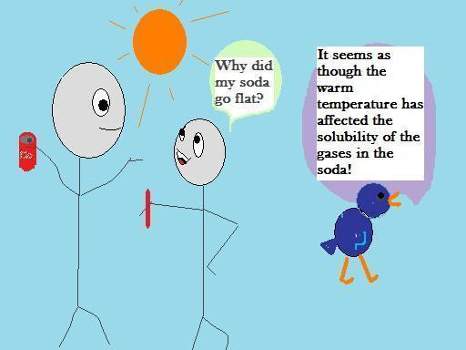

Slide 19
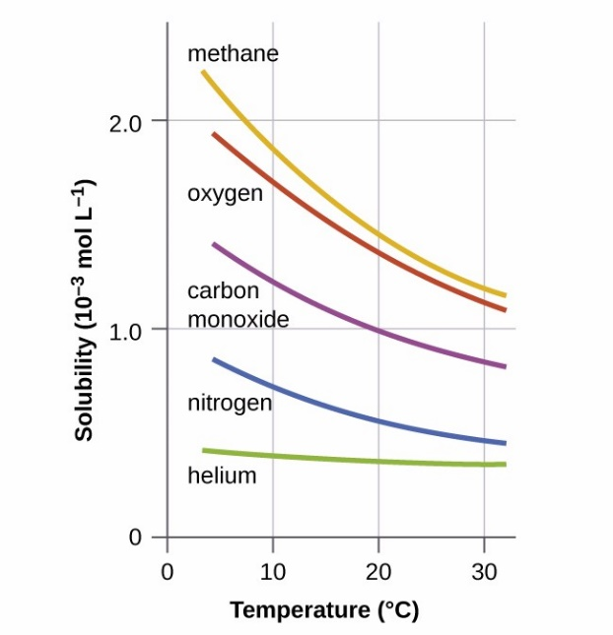
Factors affecting solubility
Temperature
For gases, solubility is inversely proportional to temperature, because-
Kinetic energy so as velocity of gas molecule increases, attraction between gas and solvent decreases and gas escapes from solution.

Slide 21
Factors affecting solubility
Pressure
No or very little effect of pressure on solubility of solids and liquids.
On gases the effect can be explained by Henry’s law

Slide 22
Henry’s Law
The mole fraction of gas in the solution is proportional to the partial pressure of the gas over the solution. The most commonly used form of Henry’s law states that “the partial pressure of the gas in vapour phase (p) is proportional to the mole fraction of the gas (x) in the solution” and is expressed as:
P = K_{H} x

Slide 23
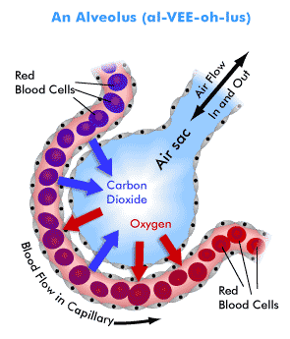
Applications
Painful effects of Bends in deep sea divers are reduced by diluting oxygen cylinders with He.
Exchange of gases through blood in lungs and cells depend on variation of partial pressures of O₂ and CO₂ gases.

Slide 24
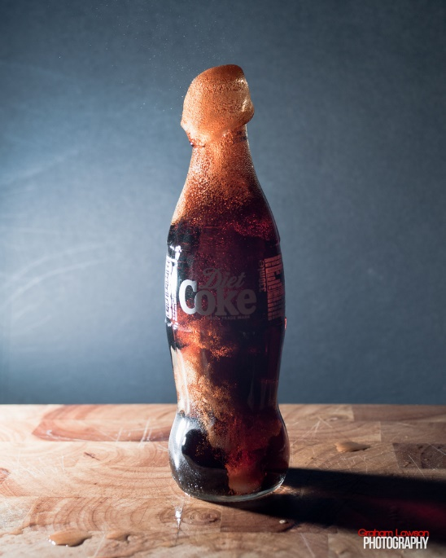
Applications
Cold drink bottles are sealed at high pressure
Anoxia disease at high altitudes, is due to decrease in oxygen level in blood due to decrease in its partial pressure.

Slide 25
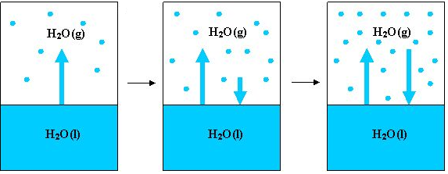
Vapour Pressure
The pressure exerted by vapours of a liquid at it’s surface when liquid is in equilibrium with it’s vapours at fixed temperature and volume, is called vapour pressure.
(vaporization) (vaporization Equilibrium between & Condensation) both

Slide 26
Vapour Pressure
Effect of surface area

Slide 27
Vapour Pressure
Effect of Temperature
Vapour pressure increases with increase in temperature

Slide 28
Vapour Pressure and Boiling Point
Effect of Vapour Pressure on boiling point of liquids
Boiling Point will be less if vapour pressure of a liquid is higher than that of other

Slide 29
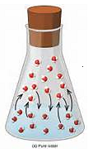
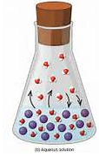
Vapour Pressure
Effect of addition of non volatile solute in a solvent
Vapour pressure of solvent decreases, because-
Presence of non volatile solute decreases the mole fraction of solvent in solution
Non volatile solute itself has almost zero vapour pressure

Slide 30
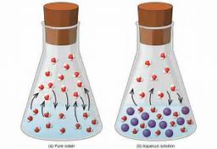
Raoult’s Law
Vapour pressure of a liquid is directly proportional to it’s mole fraction.
Vapour pressure of a pure liquid is always a constant at fixed temperature
A
B

Slide 31
Raoult’s Law
Solution containing non volatile solute
Vapour pressure of solution is equal to the vapour pressure of solvent component.
OR
Vapour pressure of solution is directly proportional to mole fraction of solvent present in the solution.

Slide 32
Raoult’s Law
Solution containing non volatile solute
According to Raoult’s Law
P₁ = P₁◦ χ ₁ P₂ = P₂◦ χ ₂
And, P_{s} = P₁ + P₂
But, solute is non volatile, hence
P₂ = 0 P_{s} = V P of solution
Thus, P_{s} = P₁ + 0 P₁◦ = V P of pure solvent
P_{s} = P₁ = P₁◦ χ ₁ P₁ = V P of solvent in
solution
or, P χ ₁ P₂ = V P of solute
χ ₁ = Mole fraction of solvent
in solution

Slide 33
Raoult’s Law
Solution containing two volatile components
Vapour pressure of solution is equal to the sum of vapour pressures of both the components.
P_{s} = P₁ + P₂

Slide 34
Raoult’s Law
Solution containing two volatile components
According to Raoult’s Law
P₁ = P₁◦ χ ₁ P₂ = P₂◦ χ ₂
And, P_{s} = P₁ + P₂
Hence, P_{s} = P₁◦ χ ₁ + P₂◦ χ ₂
But, χ ₁ = 1 - χ ₂ P_{s} = V P of solution
Thus, P_{s} = P₁◦ (1 - χ ₂) + P₂◦ χ ₂ P₁◦ = V P of pure solvent
or, P_{s} = P₁◦ - P₁◦ χ ₂ + P₂◦ χ ₂ P₁ = V P of solvent in solution
P₂ = V P of solute
P_{s} = P₁◦ + χ ₂ (P₂◦ - P₁◦) χ ₁ & χ ₂ = Mole fractions
of solvent &
solute in solution

Slide 35
Raoult’s Law
Vapour phase composition
Mole fraction of a component in vapour phase is the ratio of it’s partial pressure to the ratio of total vapour pressure of the mixture
y₁ ₌ Vapour pressure of component
Total Vapour pressure of solution
y₁ ₌ P₁ y₂ ₌ P₂
P₁ + P₂ P₁ + P₂

Slide 36
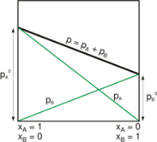
Ideal Solutions
These solutions follow Raoult’s law at all concentration and temperature.
No interaction between solute and solvent
Examples- Mixture of n- Hexane and n- Octane
Mixture of Benzene and Toluene
Characteristics
Δ_{mix}H = 0
Δ_{mix}V = 0
P_{s} = P₁ + P₂

Slide 37
Non ideal Solutions
These solutions do not follow Raoult’s law always
Due to interaction between solute and solvent
Examples- Mixture of Chloroform and Acetone
Characteristics
Δ_{mix}H = 0
Δ_{mix}V = 0
P_{s} = P₁ + P₂
Mixture of Alcohol and Water

Slide 38
Positive Deviation
When vapour pressure of a solution is greater than it’s expected value, the deviation is called positive deviation
Characteristics
Δ_{mix}H > 0
Δ_{mix}V > 0
P_{s} >P₁ + P₂

Slide 39
Negative deviation
When vapour pressure of a solution is lesser than it’s expected value, the deviation is called negative deviation
Characteristics
Δ_{mix}H < 0
Δ_{mix}V < 0
P_{s} < P₁ + P₂

Slide 40
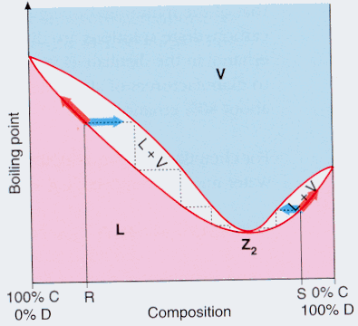
Azeotropes
Minimum Boiling Azeotropes
The constant boiling solutions in which both the components boil at same temperature but lower than normal boiling points of both.
These are solutions showing
positive deviation
Examples- Mixture of alcohol
and water.
Mixture of Ethanol
and cyclclohexane

Slide 41
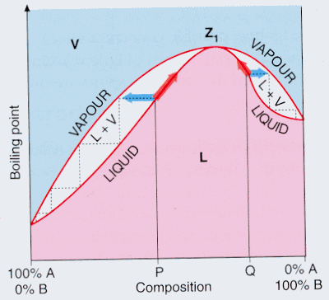
Azeotropes
Maximum Boiling Azeotropes
The constant boiling solutions in which both the components boil at same temperature but higher than normal boiling points of both.
These are solutions showing
negative deviation.
Examples- Mixture of acetone
and chloroform.
Mixture of nitric acid
and water

Slide 42
Thank You
Presented by
Jyotsna Mangal
K V O F Chanda

