Slide 1
Positive & Negative Deviation from Raoult’s Law
Mrs. Usha Paroha
PGT Chemistry
K.V. No 1 GCF ,Jabalpur (M.P.)

Slide 2
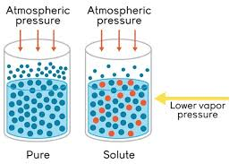
Vapour Pressure
At constant temperature, the pressure exerted by the liquid on its surface when they are in equilibrium, is known as vapour pressure.

Slide 3
Raoult’s Law
For Non volatile Solute
The vapour pressure of solution containing a non volatile solute at a given temperature is equal to the product of vapour pressure of the pure solvent and its mole fraction.
P = P_{A} = P°_{A}X_{A}
In general we can say that
that on adding a non volatile solute to a solvent the vapour pressure of a solution always gets lowered

Slide 4
For Volatile solute
For a solution of volatile liquid the partial vapour pressure of any component at constant temperature is equal to vapour pressure of pure component multiplied by mole fraction of the component in the solution .
P_{A} = P°_{A}X_{A} & P_{B} = P°_{B}X_{B}
P_{Total} = P_{A} + P_{B}

Slide 5
Ideal & Non Ideal Solution
Ideal Solution – A solution is said to be ideal if it strictly obeys Raoult’s Law at all concentration and temperature .
Example (i) Benzene and toluene
(ii) n- Hexane and n- Heptane
Non Ideal Solution – Solutions which fails to fulfill the characteristic of an ideal solution are known as non- ideal solution.
Example (i) Ethanol and Water
(ii) HNO3 and Water

Slide 6
Comparison Between Ideal and Non Ideal Solution
Ideal Solution The forces of interaction in the solution are the same as in the pure components i.e. A....B interaction are same as A….A and B……B interaction. ΔV mix = 0 and ΔH mix = o P_{A} = P°_{A}X_{A} and P_{B} = P°_{B}X_{B} | Non Ideal Solution The forces of interaction in the solution are different from those present in pure component i.e. A…..B interaction are different from A……A and B……B interaction ΔV mix = 0 and ΔH mix = 0 P_{A} = P°_{A}X_{A} and P_{B} = P°_{B}X_{B}

Slide 7
Non Ideal Solution
Non Ideal Solution showing positive deviation – In case on mixing the two volatile component of the solution, the magnitude of forces of interaction decreases i.e. A…..B interaction is less than A…..A and B……B interaction
P_{A} > P°_{A}X_{A} and P_{B} > P°_{B}X_{B}
ΔV mix is positive and ΔH mix is positive
Example (i) Ethyl Alcohol and Cyclohexane
(ii) Acetone and Carbon disulphide

Slide 8
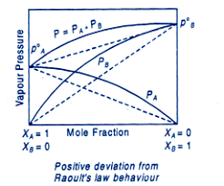

Slide 9
Non Ideal Solution showing negative deviation - In case on mixing the two volatile component of the solution, the magnitude of forces of interaction decreases i.e. A…..B interaction is more than A…..A and B……B interaction .
P_{A} < P°_{A}X_{A} and P_{B} < P°_{B}X_{B}
ΔV mix is negative and ΔH mix is negative
Example (i) Chloroform and Benzene
(ii) Chloroform and Diethyl ether

Slide 10
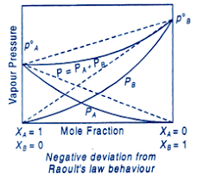

Slide 11
Comparison between +ve and –ve deviation
Solution with +ve deviation A…..B interaction is less than A…..A and B……B interaction P_{A} > P°_{A}X_{A} and P_{B} > P°_{B}X_{B} ΔV mix is positive and ΔH mix is positive Process of dilution is endothermic | Solution with –ve deviation A…..B interaction is more than A…..A and B……B interaction P_{A} < P°_{A}X_{A} and P_{B} < P°_{B}X_{B} ΔV mix is negative and ΔH mix is negative Process of dilution is exothermic

Slide 12
Some more example of positive deviation
Ethanol and Cyclohexane
Ethanol and water
Ethanol and Acetone
Methanol and Water
CCl₄ and Benzene
CCl₄ and Toluene
CCl₄ and CHCL₃
CCl₄ and Methanol
Benzene and Acetone
CS ₂ and Acetone
CS ₂ and Acetaldehyde

Slide 13
Some more example of negative deviation
CHCL₃ and CH₃COCH₃
CHCL₃ and C₆H₆
CHCL₃ and C₂H₅OC₂H₅
CHCL₃ and HNO₃
CH₃COOH and CH₃OH
CH₃COOH and C₅H₅N
CH₃COOH and C₆H₅NH₂ (aniline )

Slide 14
THANK YOU

